Slide 1
Enlisted Advancement Selection Boards
Navy Personnel Command
Enlisted Selection Boards (PERS-803)
April 2018
Notes:
Introductions.
PERS 803
Enlisted Selection Board Sponsor

Slide 2
Topics of Discussion
Eligibility
Available for review
Not available for review
Communicating with the board
Pre-Board
Membership
Convening order
Precept
Post board process
Items board members can’t discuss
Common Issues/ FAQs/Myths
Notes:
Here are the topics that we will discuss today.
Basically we will walk you through the entire process from being eligible to the board to post board procedures.

Slide 3
Eligibility
Eligibility questions? First read the advancement cycle NAVADMIN
and Chapter Two of the Advancement Manual
View your board eligibility profile sheet via NKO
CPO, SCPO, and MCPO candidates
No profile sheet? You will not be considered by the board.
Check monthly to ensure your profile sheet has not changed your eligibility status
If a "BUPERS Invalid", contact PERS-802 to verify reason
Except for STA-21, MECP, MSC ISPP, and JAGC ISPP, selects for commissioning programs are ineligible, i.e. LDO/CWO selects
Fleet Reserve/Retirement Requests
Voluntary (Prior to mandated) -vs- Involuntary (At HYT)
Must be in an eligible status on 1 July (E8/E9) or 1 Sep (E7)
Notes:
Chapter 2 of the advancement manual provides advancement eligibility criteria. Every enlisted advancement board is announced via a NAVADMIN which details the board’s convening date, provides amplifying advancement board eligibility criteria, and guidance on communicating with the board. These NAVADMINs are available on NPC’s enlisted board web pages.
The ONLY AUTHORITATIVE SOURCE in determining CPO, SCPO, and MCPO board eligibility for enlisted advancement boards is the NETPDTC Examination Profile Sheet available on the Navy Advancement Center’s (NAC) website via your NKO account. The link to the NAC section on NKO is under the Career Management tab. Do not rely on BOL or social media sites to verify your board eligibility. If you do not have a NETPDTC profile sheet indicating “SELBD ELIGIBLE”, you WILL NOT be considered by the selection board.
If your profile sheet indicates “BUPERS Invalid”, you may contact PERS-802 to determine the reason. PERS-802 POC info is contained in the cycle NAVADMIN.
Additional considerations for board eligibility include:
- Whether a member was selected for commissioning programs (MSC ISPP stands for Medical Service Corps In-Service Procurement Program). (JAGC ISPP stands for JAG Corps In-Service Procurement Program)
- Nuclear power personnel have their own rules regarding departure from a nuclear billet.
- Submarine ratings must maintain their submarine designator for eligibility.
- Whether a member submitted a voluntary or involuntary fleet reserve request. The effective date of an involuntary fleet reserve request aligns with a member’s HYT date whereas the effective date of a voluntary request is prior to a member’s HYT date.

Slide 4
Eligibility
HYT Waiver
Cannot exceed HYT for next paygrade
Must go to or beyond 1 July (E8/E9) and 1 Sep (E7)
Security Clearances
Must have valid security clearance in JPAS for rates designated in current NAVADMIN.
Early Promote TIR Waiver (CPO Candidates)
Latest Periodic eval must be EP and maintain EP’s (can be 1 of 1)
In-Theater CPO board waiver
Not automatic; command must send validation to NETPDTC
Must be Boots On Ground in specific locations. Refer to NAVADMIN 336/07 paragraphs 3 and 8.
Recent Change in Rating?
Must be approved 1 month prior to board convening
Notes:
- Candidates reaching HYT must be in an eligible status on or after the dates listed in the cycle NAVADMIN.
- A candidate who is in a rating which requires a security clearance but does not has a clearance is not eligible. A local interim clearance must be updated in JPAS prior to board convene date in order to establish eligibility.
- A candidate with an “Early Promote” waiver must comply with the requirements set forth in the cycle NAVADMIN.
- A candidate eligible for an “In-Theater Selection Board Eligible” waiver, must be validated by their command and coordinated with NETPEDTC to obtain a SELBD ELIGIBLE profile sheet. This is not an automatic waiver.
- A candidate who was recently approved for change in rating will only be considered in the new rating if the effective date of rating change was one month or more prior to the board convening.
- And most importantly, a member must maintain their CO’s recommendation for advancement
Refer to Chapter 2 of the advancement manual and the advancement cycle NAVADMIN for questions regarding advancement board eligibility.

Slide 5
Eligibility
Must maintain CO’s recommendation for advancement
PERS-802 performs continuous reviews of eligibility
Multiple adds and deletes up to convening day.
No immediate notification of adds or deletes.
Candidates should periodically review eligibility
Review Navy Advancement Center website for profile sheet changes
Sign up for profile sheet change notification via the Navy Advancement Center website.
CANDIDATES: CLOSELY MONITOR YOUR ELIGIBILITY
Notes:
Some of the reasons for adding a candidate to the board after the initial eligibility file is loaded are when the command validates a candidate as eligible because their fleet reserve request was cancelled, an exam discrepancy was corrected through the Navy Advancement Center now making the member eligible, or a candidate was validated by their command who is eligible for an in-theater waiver.
Some of the reasons for deleting a candidate to the board after the initial eligibility file is loaded are when
A member is not eligible for “Early Promote” TIR waiver or the eval that justified the EP TIR waiver is not available to the board.
A member does not meet the eligibility requirements based on HYT
A member submits a voluntary Fleet Reserve or Retirement request
A member is invalidated by the command because of loss of advancement recommendation
A member is an LDO/CWO selectee and did not decline their selection to LDO/CWO (a selectee in a “hold” status is still a selectee)
A member is in a rating which requires a security clearance and either does not hold a clearance or their security clearance is revoked

Slide 6
Available for review by board
Official Military Personnel File (OMPF) field codes
30-38 (MILPERSMAN 1070-080)
Available via BOL menu item “OMPF-My Record”
Performance Summary Record (PSR)
Available via BOL menu item “ODC, OSR, PSR”
Part I (Personnel Data Summary)
Part II (Pre-1996 evaluation summary)
Part III (1996 to present evaluation summary)
Candidate’s Letter to the Board
ACCURACY OF THESE THREE ITEMS MAY BE THE DIFFERENCE BETWEEN SELECT AND NON-SELECT
Notes:
There are only 3 things available for review to board members.
The board will only review the Official Military Personnel File (OMPF) (Field Codes 30-38) and Performance Summary Record Parts I, II, and III, as well as items submitted by candidates. Any missing items from the candidate's OMPF should be addressed in the candidate's Letter to Board (LTB). Candidates are encouraged to review BUPERSINST 1430.16F, chapter 12 and MILPERSMAN 1070-080 concerning selection board record review, selection board correspondence submission, and OMPF corrections. Candidates should review their OMPF via the "OMPF My Record" option on BUPERS Online (BOL) or by ordering a CD-ROM of their complete OMPF record either via BOL or per MILPERSMAN 1070-150.
In many cases, up-to-date information viewable in NSIPS electronic service record (ESR) may not be contained in a candidate's OMPF. Therefore, documents that candidates want the board to review that are not viewable or have been verified as missing via "OMPF My Record" must be submitted, under a signed cover letter, to the selection board president to be reviewed by the board.

Slide 7
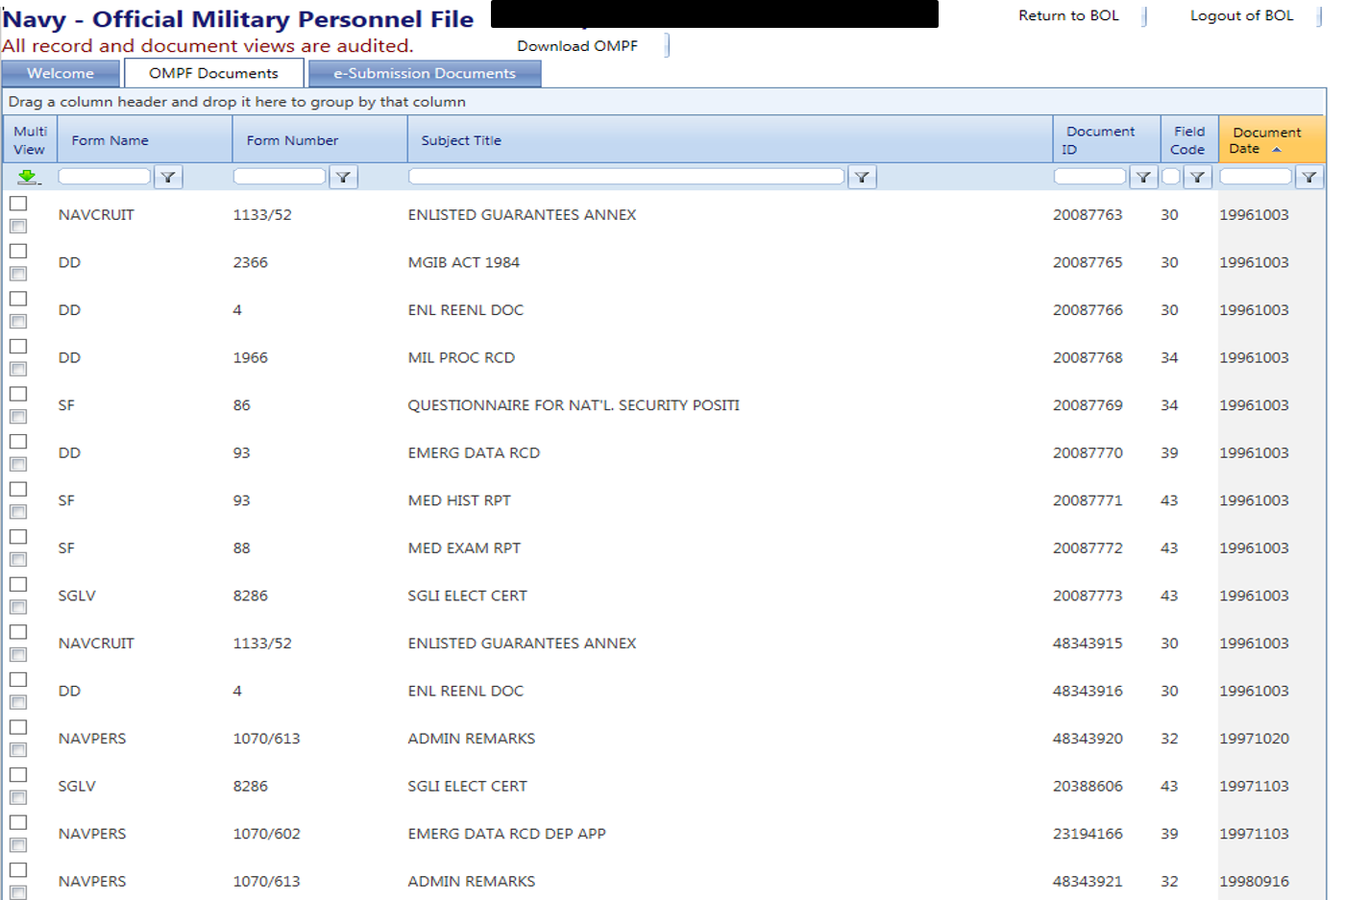
Available for review by board
Notes:
This is what you see when you log in to BOL and view your OMPF. This should not be new to anybody.
Notice the columns on the top, second from the right is “Field Code”. Click here and your documents will sort by those field codes. Anything in 30-38 will be seen by the board.

Slide 8
Not available for review
Items Not Presented to Board Members
NSIPS ESR data not in the OMPF
Should have been forwarded to the OMPF at time of reenlistment/record close-out
Items sent to the board by anyone other than the candidate
Letters to the board received after the “received by” date
ESR, NTMPS, FLTMPS, ETJ – unless submitted by the candidate
PRIMS information
IF YOU WANT THE BOARD TO CONSIDER ITEMS NOT IN YOUR OMPF, YOU MUST SUBMIT THEM IN YOUR LTB.
Notes:
These items are not available for review by board members. If a candidate feels there is information available in databases that board members will not have access to, they should include that information in their letter to the board.

Slide 9
Communicating With The Board
Your Letter to the Board (LTB)
Only method to communicate with the board!
Must be **RECEIVED** by the cut-off date in cycle NAVADMIN
Read the cycle NAVADMIN before you begin!
Consider having an experienced board member review your OMPF with you
Per the cycle NAVADMIN, submit items you want considered that are missing from your OMPF
Do not send originals, they will not be returned
Do not send duplicates of items already in your OMPF
Do not highlight items on your documents mailed
Include your FULL SSN on each page submitted
Notes:
Candidates submitting a letter to the board should carefully review the cycle NAVADMIN and the selection board website to ensure they are submitting their letter to the board correctly.
Remember to sign your cover letter, if the letter to the board is not signed by the candidate, it will not be presented to the board members for review.
Late letters to the board or letters to the board that are submitted via third party are also not presented to board members for review. No form of notification is sent back to the candidate to inform them that their letter to the board was submitted incorrectly and will not be presented to board members.

Slide 10
Communicating With The Board
Documents forwarded to selection boards do not update your OMPF.
Can be e-mailed or snail-mailed to the address in the cycle NAVADMIN
100% accountability and verification of LTBs. Reasons LTB not presented to board:
Candidate not board eligible
LTB received after “received by” date published in the cycle NAVADMIN
Notes:
Every LTB received by NPC’s Customer Service Center is accounted for. Those LTB’s complying with the policy of the cycle NAVADMIN are presented to the board for consideration. Each enlisted board season NAVPERSCOM receives approximately 200 letters to the board received after the “received by” date published in the board NAVADMIN and cannot be presented to the board. Candidates must play close attention to the received by date for their letter to the board and comply with that receive by date to ensure their letter to the board is presented to the board. Candidates should encrypt their email letters to the board.

Slide 11
Membership
Membership demographics:
Source Rating Race
Gender Geographic Location
Community Special Qualifications
Component Prior Board Experience
Number of eligibles
Divided into panels by rating for record review. For example:
Admin/Supply Surface Ops/Engineering
Nuke/SPECWAR Submarine
Aviation Combat Systems/Info Warfare
Notes:
Now that we have talked about Pre-Board information. Let’s get into board matters.
PERS-805 receives board member and board recorder applications then builds the board membership to closely reflect the demographics of the eligibles. Members and recorders are notified of their selection as board members and recorders approximately a month prior to the board convening. Membership MUST NOT be compromised. Only those in the board member’s or recorder’s immediate chain of command with a need to know should be aware of their pending board assignment. Membership is made public only after the board adjourns.
At this point we are going to start diverging from how these board were run in the past. There have been significant changes beginning with the FY19 board season.
We break down ratings into panels to keep like communities together and balance the workload. An example of how we may group panels as shown on the screen. Each panel reviews an entire rating and then takes that rating to the tank for briefing and voting. For example, all HTs are going to be reviewed by someone in the Surface Ops/Engineering panel.

Slide 12
Board Precept/Convening Orders
Precept = general guidance for the entire board season
Convening Order = specific guidance for that board
Guidance from the Chief of Naval Personnel to the Board
Guidance on quota use and restrictions
Guidance on secrecy of board discussions
Membership and quotas
Fully qualified and best qualified considerations
Read them each year, then ask yourself:
ARE YOU EXHIBITING THESE LEADERSHIP TRAITS AND ARE THEY DOCUMENTED IN YOUR EVALUATIONS?
Notes:
The board precepts provide general guidance used by all senior enlisted selection boards for that season. This year’s precept is posted on the NPC website.
The Convening Order provides the board’s membership and quotas. Only the convening order and quotas are made public after the board convenes. Membership will be published after the board adjourns.
Convening orders are time-late since we do not post them until we convene the board.
Junior Sailors – read these now and keep the guidance it in mind when you are working with your detailer for your next assignment.
How many of you have been to the NPC Boards page and know how to find the precepts and convening orders?

Slide 13
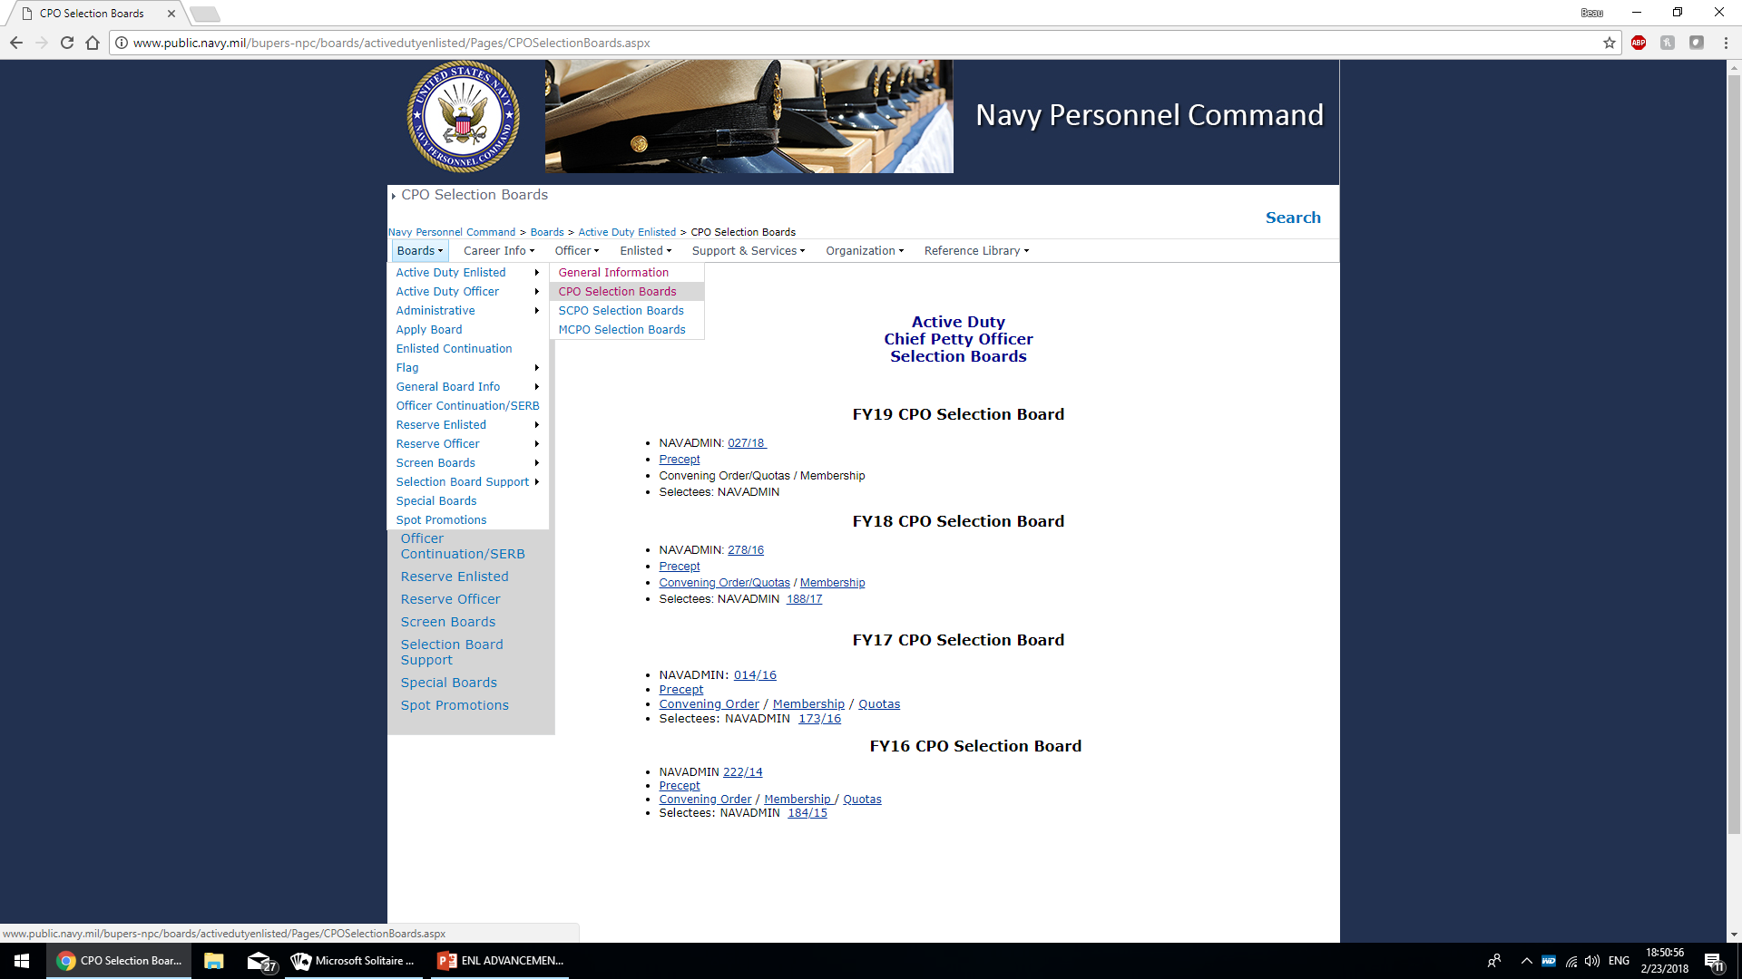
Notes:
This is where the precept and convening order are published for guidance to the fleet.
Read the precept for overall general guidance and the convening order for specific guidance for that board.

Slide 14
Precept
The board precept provides guidance consistent with all enlisted selection boards, such as:
Function and Membership
Guidance on secrecy of board discussions
Direction to gather feedback to improve future boards
Duties of the Board President and SEA
Board Proceedings
Marital/Dependency Status
Area Tours
History of Assignments
Record Review
Adverse Information
Equal Opportunity and Diversity Guidance
Board Reports and Oaths
Notes:
The same precept is utilized each year for all enlisted and reserve boards for advancement to Chief, Senior, and Master Chief. It contains general information on the various topics listed.
Board members are provided a copy of the precept and convening order and directed to read and discuss both documents before starting the actual process.
The precept discusses several key areas to provide guidance to board members on how to conduct the board.

Slide 15
Precept
Area Tours
History of Assignments
Not always in control of duty assignments
Closed-loop communities can restrict assignment diversity
Size of command and number with peer ranking are not controlled by the candidate
Record Review
Notes:
Since Sailors or not in control of their duty assignments, board members are directed to focus on if the candidate has progressed in billet complexity, professional development, and leadership responsibility.
The precept reminds the board members that candidates are not in control of these items and to focus on the candidate’s performance and the items listed in the precept / convening order.

Slide 16
Precept - Evals
Evaluation gaps / breaks in service
Decline in performance
Promotion Recommendation gap
Reporting Senior’s Cumulative Average (RSCA)
Notes:
In evaluating a gap in a candidate’s evaluation history, consideration should be given to the fact that any gap, regardless of its duration, results in a period of undocumented service. Candidates should review their OMPF carefully to ensure every evaluation is posted and to check their evaluation continuity report to ensure there is day to day continuity between each evaluation.
Some candidates may have breaks in service of extended length due to enrollment in Career Intermission Program or release from active/inactive duty. These breaks in service shall not be viewed negatively.
A decline in performance is either a drop of two or more evaluation trait grades or a drop in promotion recommendation, be sure to review the precept for a detailed explanation.
Who knows what a promotion recommendation gap (or “air gap”)is? A promotion recommendation gap is when a reporting senior had the opportunity to grant a higher promotion recommendation, but chose not to. An example is during a transfer evaluation and the reporting senior assigns a promotion recommendation lower than Early Promote. But sometimes, the candidate did not deserve the Early Promote recommendation and the reporting senior correctly assigned the mark.
Who knows what the RSCA is and why it is important? RSCA is the reporting senior’s cumulative trait average of all Sailors (active duty and reserve) within a paygrade. Candidates should look at their individual trait average and compare it against the reporting senior’s cumulative average to see how the reporting senior truly felt about the candidate.
Where do you find RSCA? RSCA can be found by asking the reporting senior while signing your evaluation or by reviewing your performance summary record.

Slide 17
Precept – Adverse info
For those candidates who are recommended for selection and who have received disciplinary action, or whose official military personnel file contains matters relating to conduct or performance of duty, regardless of the date the matter occurred, every board member in that respective tank shall be briefed on the adverse information contained therein prior to the final board decision.
NAVY DOES NOT EMBRACE BLIND ADHERENCE TO A ZERO-DEFECT MENTALITY
Notes:
Adverse information is contained in field code 38 (FC-38) of the enlisted record. Any FC-38 in a candidate’s record must be briefed during the tank process. It is important to know that a candidate’s entire career history is available to board members for review.

Slide 18
Quotas
Vacancy driven
Recommended by Enlisted Community Managers
Approved by Chief of Naval Personnel for AC/FTS and Chief of Navy Reserve for SELRES
Made public when board convenes
May go unfilled when insufficient number of candidates meet “fully qualified” standard
Notes:
Quotas are vacancy driven and are made public after the board convenes.
Candidates must first meet the precept standard for fully qualified to be selected for advancement.
Quotas may be returned when there is are an insufficient number of candidates in a competitive group that meet the fully qualified standard.

Slide 19
Enlisted Career Paths
Outline a normal career path and some “best qualified” items for each rating.
Prepared by ECMs with Fleet senior enlisted input
Approved by Deputy Chief of Naval Personnel
Posted on the NPC website.
Read them each year and use them as a tool when making career decisions.
Notes:
Enlisted career paths are what the board members use to brief the individual ratings before starting record reviews. They are revised every year and posted on the NPC website. Again - junior Sailors, start reading these now and use them to help you make career decisions.

Slide 20
Notes:
Finding the enlisted career paths
Enlisted – Community Managers – Your community – Your rating

Slide 21
Notes:
Are there any questions before we move on to how the board is executed?

Slide 22
Board Process
Board is sworn in and convened
Members receive board process in-briefs and training
Members read convening order and precept
Records randomly assigned within panels
Rating subject matter expert conducts rating brief per the enlisted career path (ECP) for that rating
Members conduct initial independent review of each record
All records are then brought to tank for individual briefing and voting. Records are then scattergrammed until selects and non-selects are determined
Conduct debrief on security of board deliberation & adjourn board
Board President’s call-out with DCNP
Notes:
What can be made public of the enlisted advancement board process is reflected on this slide. Board members arrive and are sworn in. They receive training on the process, Rating briefs are conducted and the first set of records for a rating are distributed for review. Once complete, all records are brought to the tank for individual briefing and voting. Based on those votes, a scattergram is done to select, drop, or crunch records. Once a rating is complete in the tank, members are out-briefed and the board president may have a call out with DCNP.

Slide 23
Post Board Process
Conduct post-board review of selects to identify adjudicated or pending substandard or adverse information. Items discovered:
Security clearance issues
Misconduct
These selects are placed on hold, notified of their selection and hold status, who then provide additional information to CNP to decide whether to release the hold or permanently remove their selection.
Results in missing sequence numbers on NAVADMIN
Notes:
The board’s results are generally made public 3-4 weeks after the board adjourns. The date of call-out is not public information.
Ensure command BOL access is current. This is the immediate way to identify those placed on hold.

Slide 24
Notes:
This is a typical boardroom. This is where recorders will do their prep week scrubs of the records and where members will review records and assign grades during the board.
There could be a number of statutory and/or administrative boards ongoing simultaneously in the selection board spaces among many separate boardrooms.

Slide 25
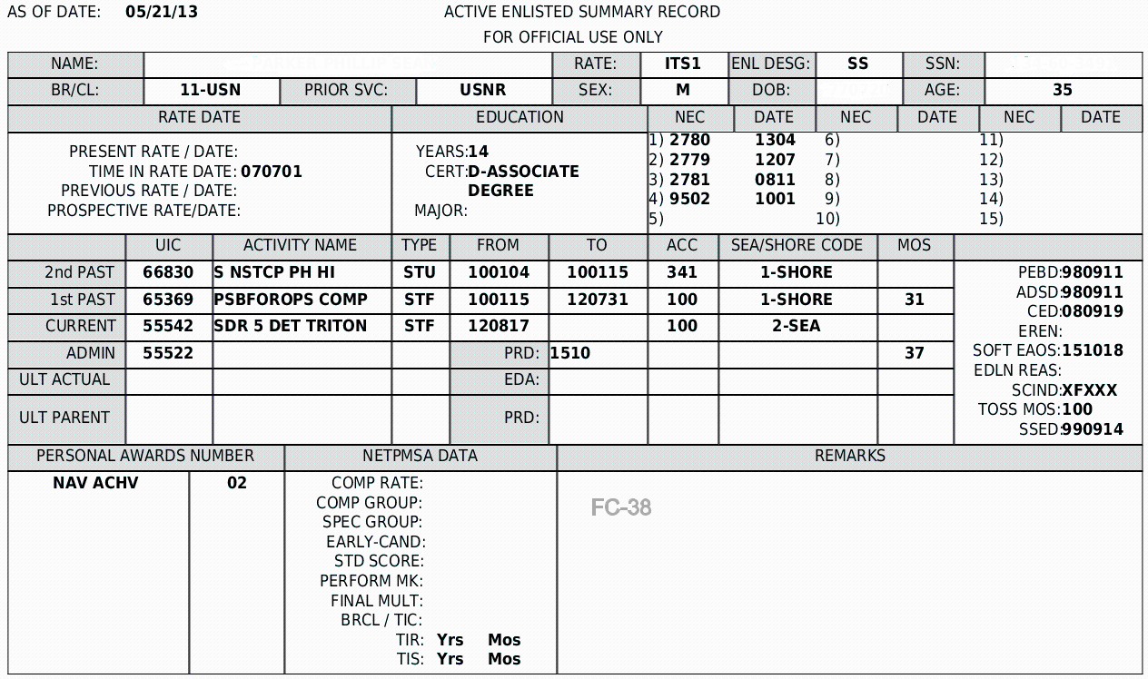
Reviewing a Record
Notes:
Here is how the Performance Summary Record (or PSR) part 1 looks. (For reserve boards...The Selective Reserve PSR looks slightly different.)
****** (Discuss various items)****** The top lines are personal identifiable information, NECs earned, documented education, rate data, current and past commands, enlistment and reenlistment dates, and personal awards received. Note the FC-38.
Again – this is all available to you via BOL and it is on you to make sure that it is accurate.

Slide 26
Reviewing a Record
Notes:
This is a sample PSR part 2 – your evaluation history. Things you should be checking:
Dates – no gaps and your most recent report is included.
Traits/Averages/Promotion Rec/Physical Readiness – match the paper copies of your evals
Talk about RSCA

Slide 27
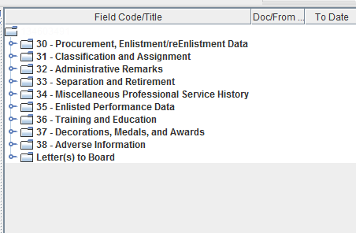
Reviewing a Record
Notes:
Here are the Official Military Personnel File field codes that will be available for the board review. The format is a little different from what we saw before, but it is the exact same information. Each of these opens up into another tree of documents within that field. If a candidate has submitted a letter to the board, you’ll see that listed at the bottom as indicated here.
Field Code 38 will be populated if there is any adverse matter in a member’s career. If there is any adverse matter, this must be opened and reviewed before moving on to the next record. Be aware that not all adverse information will be contained in field code 38. For example, an NJP that does not involve pay is only documented via administrative remarks (page 13) and should also be included on an evaluation. In this case, the NJP would not be listed in field code 38. Bottom line is that we direct members to review all documents available carefully and you should be doing the same.
Letters to the board. If an eligible submitted an LTB, it will be here. If that eligible submitted 3 LTBs, they will be here. Board members must review each one.

Slide 28
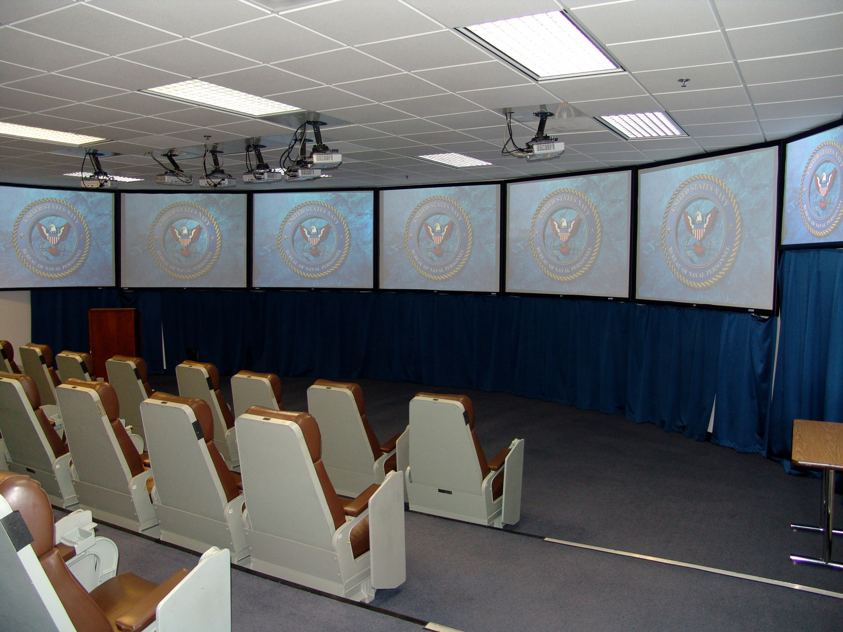
Notes:
This is a view of the infamous “tank”. There are three tanks in the selection board spaces. The members sit in ready room type chairs. You will notice five screens visible to the members. In most cases the first screen on the far left will have the PSR cover page which provides general background information on an eligible such as name, rate, education, last three duty stations, etc. On the other screens, PSR detail pages are shown which have a line entry summarizing every eval an applicant has had in his/her career.
The member who reviewed the applicant’s record in the board room starts to brief, members start to vote using their handset, when the last member has voted the votes are tabulated and the number of yes votes and the computed confidence factor is entered into the computer vote file and is simultaneously displayed on the two computer monitors at the front of the room.

Slide 29
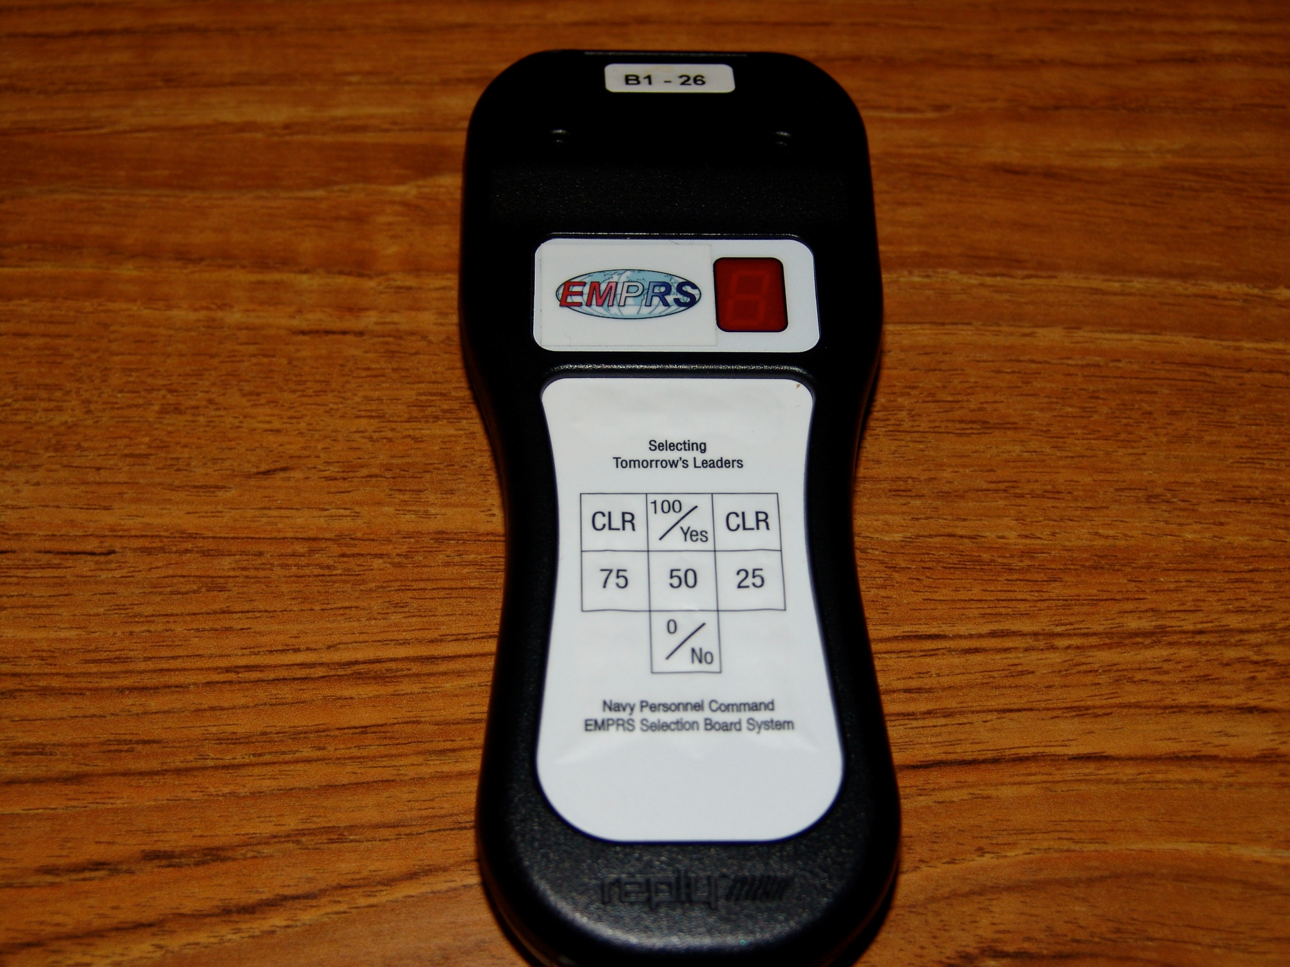
Notes:
This is the voting box that members use in the tank. Board members vote their confidence in the applicant’s ability to perform at the next higher paygrade using 100 (absolutely), 75 (probably), 50 (maybe), 25 (maybe not), or 0 (definitely not).

Slide 30
Board Process
Once all records have been briefed and voted, a scattergram is displayed that shows a cumulative number of votes at each confidence level
The floor is open for motions
Tentatively select those applicants that are clearly at the top
Drop from further consideration those applicants that are clearly not competitive for further consideration
Those applicants who remain after those tentatively selected or dropped from further consideration are considered “crunch” records and are briefed and voted again
NOTE: This is an overview of typical motions made by a board membership and is not meant to represent an actual tank voting session
Notes:
Once all the records in that rating have been briefed and voted, a scattergram is displayed which shows the cumulative number of votes at each confidence level.
At this point motions are made to select or drop eligibles. Any eligible remaining may go back to the board room for another review or they can be voted on again during that tank session.

Slide 31
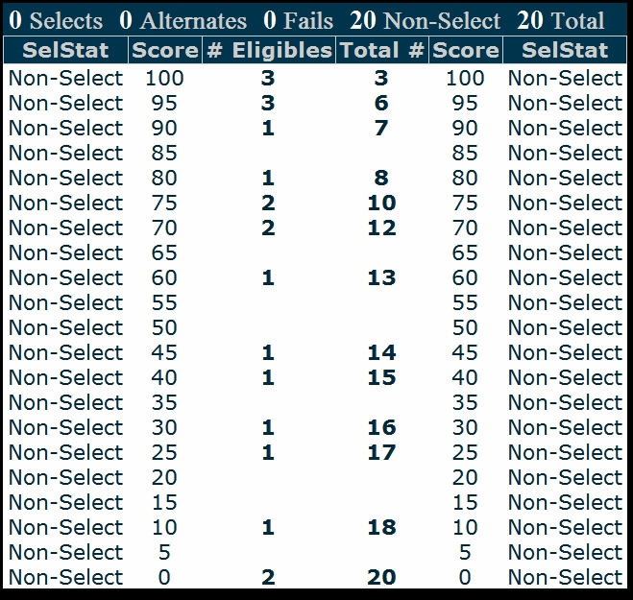
Scattergram
To select 10
Notes:
This is an example of a scattergram prior to any voting motions.
The scattergram allows members to see the results of a vote session, so that the relative scores of applicants may be considered. In this example of 20 records, and assuming 10 quotas, one might see discussion of simply selecting the top 10 records, or of selecting perhaps the top 7 records, while removing the bottom 7 records from further consideration. Once the members have discussed the topic, a member will make a voting motion.
For this example, a board member may say: Mr/Madam President, I move that we tentatively select those eligibles with a confidence factor of 90 and above, and drop from further consideration those eligibles with a confidence score of 45 and below.

Slide 32
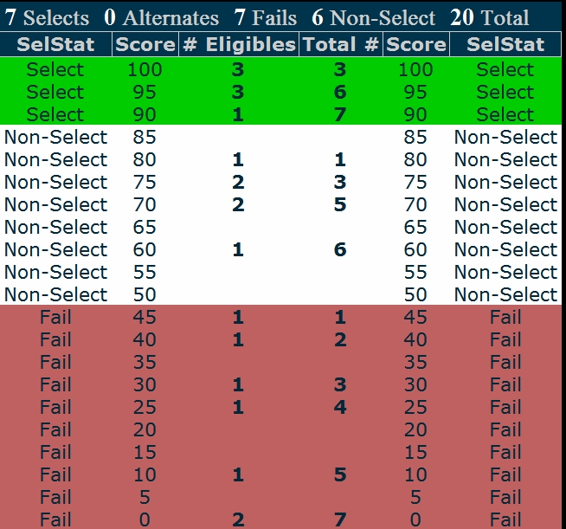
Scattergram
Tentatively
Select 90 and above
Crunch 6
to select 3
Drop From Further Consideration 45 and below
To select 10
Notes:
Once a voting motion has been seconded, a majority vote is taken. In this example, if the motion is approved, the board will “crunch” 6 records to tentatively select a maximum of 3 additional applicants, which would be 10 tentative selects. The records which are neither removed from consideration, nor tentatively selected, are commonly referred to as crunch records. They are briefed again and go through the same scattergram and voting process. This process continues until the board has selected the number of applicants authorized or until the board determines that no further applicants are fully qualified for advancement.

Slide 33
Post Board Process
Conduct post-board review of selects to identify adjudicated or pending substandard or adverse information. Items discovered:
Security clearance issues
Misconduct
These selects are placed on hold, notified of their selection and hold status, who then provide additional information to CNP to decide whether to release the hold or permanently remove their selection.
Results in missing sequence numbers on NAVADMIN
Notes:
Just because you’ve made it on the board doesn’t mean you’re selected yet. There is a post-board scrub that looks for any adverse information that the board may or may not have seen.
The board’s results are generally made public 3-4 weeks after the board adjourns and your name may not be on the list.
If you see missing sequence numbers, that is usually what that means. The sequence numbers are based off of seniority – not how an eligible faired in the board process.

Slide 34
Post Board Process
Holds can take six weeks to one year to resolve
Results approved and public release authorized via NAVADMIN / BOL
Profile sheets generated reflecting the results of the board
Notes:
Holds receive a CNPC letter via e-mail providing “hold” resolution guidance.
Profile sheets produced by NETPDTC reflect select/non-select status.
Rate Change Authorizations are published as pay dates are determined.

Slide 35
Items board members can’t discuss
Recommended selectees prior to results being made public
Why a candidate was or was not selected
Items they saw in a candidate’s record
Specific items briefed in the tank
MAY NEVER DISCLOSE THE PROCEEDINGS AND DISCUSSIONS
Notes:
Here are various items that board members are not authorized to discuss after they depart from a selection board. For ex-board members, the safest way to preserve the integrity of the board process in providing career guidance to candidates on selection board matters is via career development boards after the results are made public; not one-on-one discussions between board members and candidates.

Slide 36
Common Issues
Sailors not knowing how to verify their board eligibility.
Board profile sheet is the official source
No profile sheet = not being considered by the board
You may receive a BUPERS INVAL profile sheet without notification if you lose board eligibility.
Notes:
It is the command and candidate’s responsibility to know who is and is not eligible
It is important to know how to verify and correct eligibility (withdrawing recommendation for advancement) – refer to the recent advancement board NAVADMIN and advancement manual.
Board results are released via BOL.

Slide 37
Common Issues
Adverse event occurs, command documents locally, but fails to report that info to PERS/OMPF. Result: Candidate gets advanced
Ensure mandatory reporting of E6-E9 misconduct is reported to PERS-832 immediately per MPM 1616-040. If the recommendation is not withdrawn and if the Chief is selected for advancement, the NJP may be identified via the post-board scrub.

Slide 38
FAQs/Myths
A member of the board who knows you increases your chances for
advancement. FALSE
2. The selection board only considered items in my OMPF, PSR, and items in
my Letter to the Board (LTB). TRUE
3. Should a career summary be included with my LTB? By policy, only items
missing from the candidate’s OMPF field codes 30-38 and PSR should be included in their LTB. Any additional information that candidate’s deem important may be submitted.
4. The selection board accepts items from both me and my command up to the convening of the board. FALSE (only from candidate and only if received prior to the LTB deadline listed in the NAVADMIN)
5. Advancement board eligibility is posted on BOL. FALSE (Results are posted on BOL, but eligibility is reflected on profile sheet on My Navy Portal)
Advancement board eligibility profile sheets are available for CPO, SCPO, and MCPO candidates. TRUE

Slide 39
FAQs/Myths
7. CPO candidates are automatically board eligible if on an IA in theater. FALSE. Must be validated as board eligible by their command. NAVADMIN 336/07 paragraphs 3 and 8 refer. This is not automatic.
8. I am mobilized which makes me eligible regardless of my HYT. FALSE
9. Only adverse information contained in my OMPF can be considered by the board. TRUE, unless submitted in the candidate’s LTB.
10. CMCs/SELs maintaining their BOL for advancement results is important.
TRUE. Without BOL access, advance notification to the command triad is unavailable and “holds” cannot be readily identified.
11. How is PRIMS used in the selection board process? It is not used.
12. How is NSIPS ESR data used in the selection board process? Only if contained in the OMPF or in the candidate’s LTB.

Slide 40
FAQs/Myths
13. Is security clearance information made available to selection boards? No,
except where documented in narrative of an eval or on a revocation Page 13.
14. A change in rating must be effective how long before the advancement
board convenes to be considered in the new competitive group? One month
15. When must your letter to the board be received by NPC's customer service
center to be considered by the board? By the “received by” date published in the announcing NAVADMIN.
16. Which reference should you refer to for amplifying policy guidance for each selection board? The announcing NAVADMIN.
17. Once you verify that you have a board eligible profile sheet, is there any
reason either before or during the board to re-verify your profile sheet that
you are still board eligible? Yes. You may receive a BUPERS INVAL profile
sheet without notification if you lose board eligibility.

Slide 41
FAQs/Myths
Is it still necessary to submit an LTB even if my OMPF and PSR are up to date? No. Candidates may submit information they deem important, but doesn’t appear in their OMPF and PSR. It is unnecessary to submit an LTB stating that your record is up to date.
19. How far back in the record does the board consider? The entire record may be considered.
20. When and where can I read the current fiscal year Active-Duty and Reserve Senior Enlisted Advancement Selection Board precept and convening order? The precept is made public after CNP signs it and is posted on NPC selection board website. The convening order is made public after the board convenes containing the quotas. Member is made public after the board adjourns.

Slide 42
FAQs/Myths
21. Why are items that reflect in my NSIPS ESR not reflecting in my OMPF? Your ESR requires close-out either upon reenlistment or separation by your servicing personnel office for items to be submitted to your OMPF.
22. The precept refers to enlisted career paths. These are updated prior to each FY's enlisted boards. Where can I view my rating's career path? Enlisted Community Manager’s webpage on NPC’s website.

Slide 43
FAQs/Myths
23. A Chief eligible for SCPO gets a DUI and receives NJP and is awarded
punishment while the SCPO board is in session. How is this information
made available to the board? It cannot be made available to a board in session. However, the CO does have the option to withdraw the Chief’s recommendation for advancement per article 721 of the Advancement Manual. Ensure mandatory reporting of E6-E9 misconduct is reported to PERS-832 immediately per MPM
1616-040. If the recommendation is not withdrawn and if the Chief is selected for advancement, the NJP may be identified via the post-board scrub.
25. On the NAVADMIN announcing the board’s results, what does the sequence number indicate? It ranks the candidates selected for advancement by seniority within each competitive group.
26. What if a sequence number or numbers are missing on the NAVADMIN that announces the board’s results? Either selects were placed on hold or quotas were unfilled.

Slide 44
FAQs/Myths
27. I (CO) awarded a SCPO NJP four months ago, I did not pull his recommendation for advancement and I did not do a special eval documenting the NJP because I intend to report the NJP in his next periodic eval. However, the MCPO board results were just released and he was selected for MCPO. What should my command have done to ensure the board was aware of the recent NJP? Via “OMPF - Command View” on BOL, selected command leadership or authorized users should have verified the SCPO’s OMPF prior to the board to ensure the NJP documents reflected in the SCPO’s OMPF. Ensure mandatory reporting of E6-E9 misconduct is reported to PERS-832 immediately per MPM 1616-040.

Slide 45
Enlisted Advancement Boards
QUESTIONS ?

