Slide 1
Financial Readiness
Notes:
Recommended Facilitation Time: 45 mins
FACILITATOR GUIDE:
With all the benefits the Navy offer, its only right to discuss money management and the resources available. For more in-depth questions/ answers please see the Command Financial Specialist (CFS), check the Fleet and Family Support Center (FFSC) and check with your current bank to see if there any classes offered.

Slide 2
Enabling Objectives
DEFINE the purpose of financial readiness training
EXPLORE the fundamental components of Basic Pay, Basic Allowance for Housing (BAH), and Basic Allowance for Subsistence (BAS)
EXPLORE various special types of pay
DISCUSS Savings Deposit Plan (SDP)
Notes:
FACILITATOR GUIDE:
Review objectives

Slide 3
Enabling Objectives
IDENTIFY the functions of MyPay
DEFINE the purpose of Thrift Savings Plan (TSP) and Blended Retirement System (BRS)
IDENTIFY the Servicemembers Civil Relief Act (SCRA)
IDENTIFY the functions of the MyNavy Financial Literacy Mobile Application
Notes:
FACILITATOR GUIDE:
Review objectives

Slide 4
References
Military Compensation- https://militarypay.defense.gov/Pay/
MyPay webpage- https://mypay.dfas.mil/
Thrift Savings Plan -https://www.tsp.gov/
Savings Deposit Plan - https://www.dfas.mil/MilitaryMembers/sdp/
DoD 7000.14R – JTR
Servicemembers Civil Relief Act (SCRA) - https://scra.dmdc.osd.mil/scra/#/home
Navy Apps- https://www.applocker.navy.mil/
MyNavy HR- https://www.mynavyhr.navy.mil/References/Pay-Benefits/
Notes:
FACILITATOR GUIDE:
Review references

Slide 5
Purpose
Financial readiness of service members and their families is a state in which the successful management of personal financial responsibilities supports a service member’s ability to perform
With more confidence in their personal finances, service members can better focus on the mission requirements
Notes:
FACILITATOR GUIDE:
Review definition of financial readiness.

Slide 6
Basic Pay
Basic Pay is the standard amount of compensation and fundamental component of Military pay
Based on paygrade (rank), and years of service
  Annual Military basic pay raises are linked to the increase in private-sector wages.
  Pay raises are set by Congress and/or the President
To view current Basic Pay chart, visit
https://militarypay.defense.gov/Pay/Basic-Pay/Active-Duty-Pay/
Notes:
FACILITATOR GUIDE:
None

Slide 7
Basic Allowance for Housing (BAH)
BAH is an allowance to offset the cost of housing when you do not receive government-provided housing. It based on location of the Permanent Duty Station. May be dependent on location of dependents
Different types of BAH:
  BAH with Dependents
  BAH without Dependents
    E4 over 4 years of service
    E5 and above
Notes:
FACILITATOR GUIDE:
BAH WITH/WITHOUT DEPENDENTS- A member with permanent duty within the 50 United States, who is not furnished government housing, is eligible for Basic Allowance for Housing (BAH), based on the member's dependency status at the permanent duty ZIP Code.

Slide 8
Basic Allowance for Subsistence
BAS is meant to offset costs for a member's meals
Beginning on January 1, 2002, all enlisted members get full BAS, but pay for their meals (including those provided by the government)
This allowance is not intended to offset the costs of meals for family members
2025 BAS Rates:
  Officers- $320.78 a month
  Enlisted- $465.77 a month
Notes:
FACILITATOR GUIDE:
https://www.dfas.mil/MilitaryMembers/payentitlements/Pay-Tables/bas/

Slide 9
Special Pay and Allowances
Career Sea Pay (CSP) - While permanently assigned for duty to a ship, ship-based staff, or ship-based aviation unit and serving on a ship with a primary mission that is accomplished underway (includes ships designated as destroyers or submarine tenders)
Family Separation Allowance (FSA) - FSA is payable to members with dependents and a member married to another member of the uniformed services regardless of any other dependency status
Uniform Allowance - Received annually on the anniversary of date of initial entry into military service.
Notes:
There are various special pays in the Navy ranging from Career Sea Pay, Uniform allowances, Special Duty Assignment Pay, etc.
Family Separation Allowance is paid after being separate from family members for 30 days

Slide 10
Savings Deposit Program
Purpose:
  Helps military members deployed in designated combat zones save money with high interest rates.
Eligibility:
  Must be in a combat zone.
  Serve for at least 30 consecutive days or at least one day per month for three months
Contributions:
  Can deposit up to $10,000.
Notes:
You must be receiving Hostile Fire/Imminent Danger Pay and be deployed for at least 30 consecutive days or one day in each of three consecutive months to participate in the program.
You’re eligible to use the program if:
You’re on active duty or are an activated Guard or reserve member. In both cases, you must be deployed and receiving Hostile Fire/Imminent Danger Pay.
You deploy to an area where you receive HFP/IDP.
You serve in a combat zone or in direct support of a designated combat zone. You must serve for more than 30 consecutive days.
You serve in a combat zone for at least one day for three consecutive months. This situation is likely if you’re in a special operations unit.
You’re serving in a designated IDP area. To see which areas are designated as IDP areas, view figure 10-1 in the DOD Financial Management Regulation.
Your eligibility for the program stops the day you leave the designated combat area.

Slide 11
Savings Deposit Program(cont.)
Interest Rates:
  Offers a 10% annual interest rate, compounded quarterly.
  The interest earned is taxable.
Access to Funds:
  Withdrawals generally allowed after leaving the combat zone.
  In emergencies, withdrawals can be made while still deployed
Notes:
You must be receiving Hostile Fire/Imminent Danger Pay and be deployed for at least 30 consecutive days or one day in each of three consecutive months to participate in the program.
You’re eligible to use the program if:
You’re on active duty or are an activated Guard or reserve member. In both cases, you must be deployed and receiving Hostile Fire/Imminent Danger Pay.
You deploy to an area where you receive HFP/IDP.
You serve in a combat zone or in direct support of a designated combat zone. You must serve for more than 30 consecutive days.
You serve in a combat zone for at least one day for three consecutive months. This situation is likely if you’re in a special operations unit.
You’re serving in a designated IDP area. To see which areas are designated as IDP areas, view figure 10-1 in the DOD Financial Management Regulation.
Your eligibility for the program stops the day you leave the designated combat area.

Slide 12
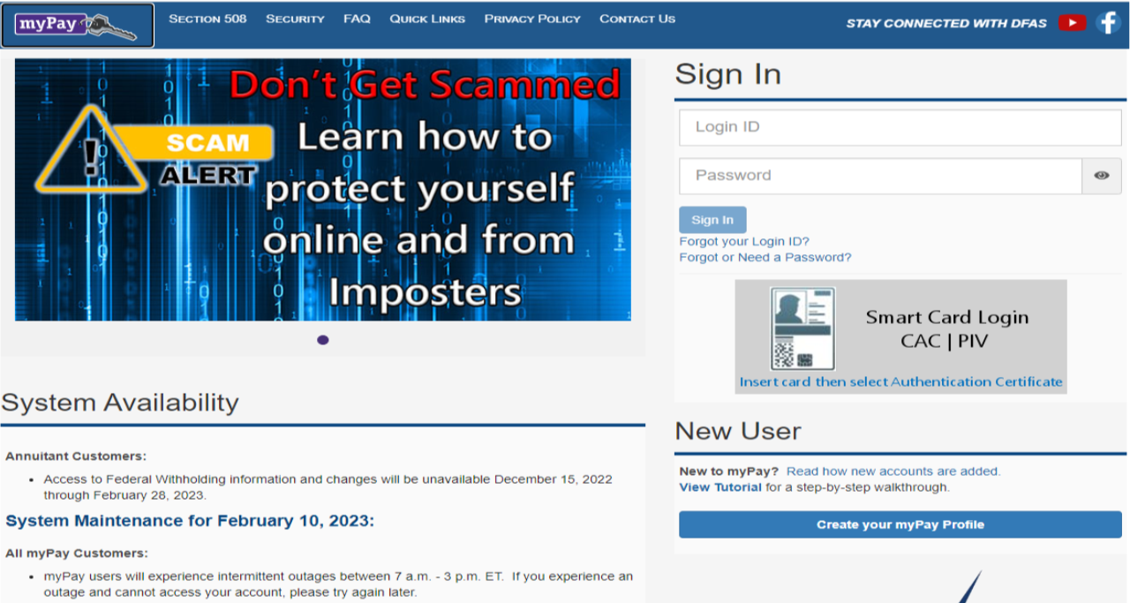
MyPay Overview
Notes:
FACILITATOR GUIDE:
MyPay is the Defense Accounting & Finance (DFAS) website where active duty, guard & reserve members can view, print, and save leave and earnings statements (LES), view and print tax statements, manage the delivery method for all your statements, change federal and state tax withholdings, update bank account and electronic fund transfer information, make address changes, view and print travel vouchers, and control Thrift Savings Plan enrollment.

Slide 13
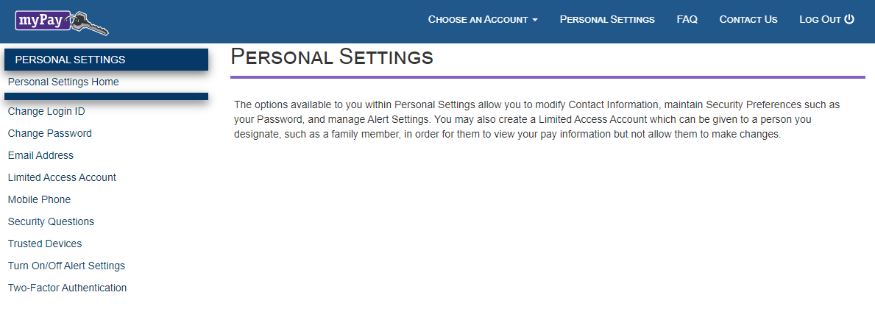
MyPay Overview
What is two-factor authentication and how does it work?
Two-factor authentication is a login process that requires something you know (your login ID and password) and something you have (a one-time PIN you receive via email or text). Two-factor authentication requires you to request and input a one-time PIN when you log in to your myPay account with a login ID and password
Why should you register / update your mobile number with myPay?
myPay will use your mobile number to send two-factor authentication PINs. myPay will also send you text message notifications, in addition to emails, when you take specific actions on your account
Why should you register / update your email address with myPay?
myPay will use your email address to send two-factor authentication PINs
Notes:
FACILITATOR GUIDE:
Once you have logged into MyPay it is important to update your personal settings like your email address and phone number.

Slide 14
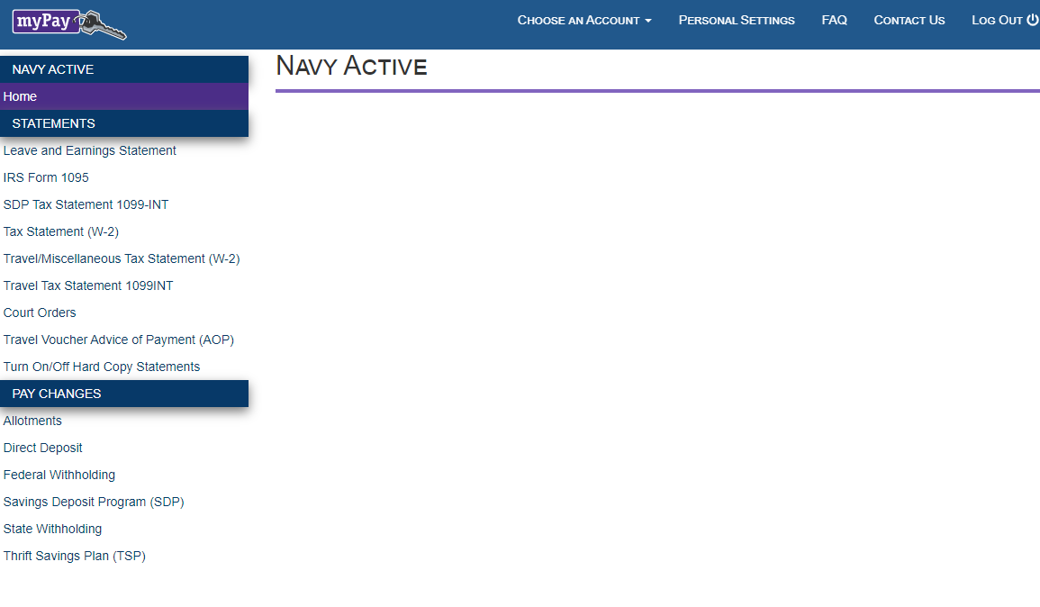
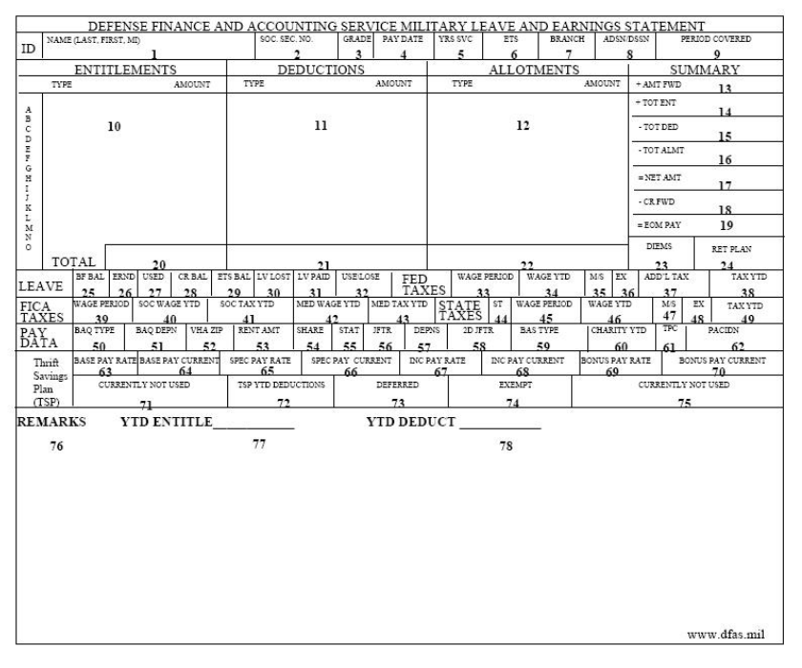
MyPay Overview
Review Your Leave And Earnings Statement (LES) To Confirm Accuracy
It is very important and your responsibility to review your LES each pay day to ensure that proper deductions are being withheld
How to read an Active Duty Navy
Leave and Earnings Statement
This is a guide to help you understand your Leave and Earnings
Statement (LES). The LES is a comprehensive statement of a
member's leave and earnings showing your entitlements,
deductions, allotments, leave information, tax withholding
information, and Thrift Savings Plan (TSP) information
Notes:
FACILITATOR GUIDE:
Your Leave and Earning Statement (LES). The LES is a comprehensive statement of a member's leave and earnings showing your entitlements, deductions, allotments, leave information, tax withholding information, and Thrift Savings Plan (TSP) information. It is important that you log in monthly to ensure accuracy of your LES. The QR code on the bottom right of the screen is a guide to help you understand your Leave and Earnings Statement
* QR codes will also be provided at the end of the presentation

Slide 15
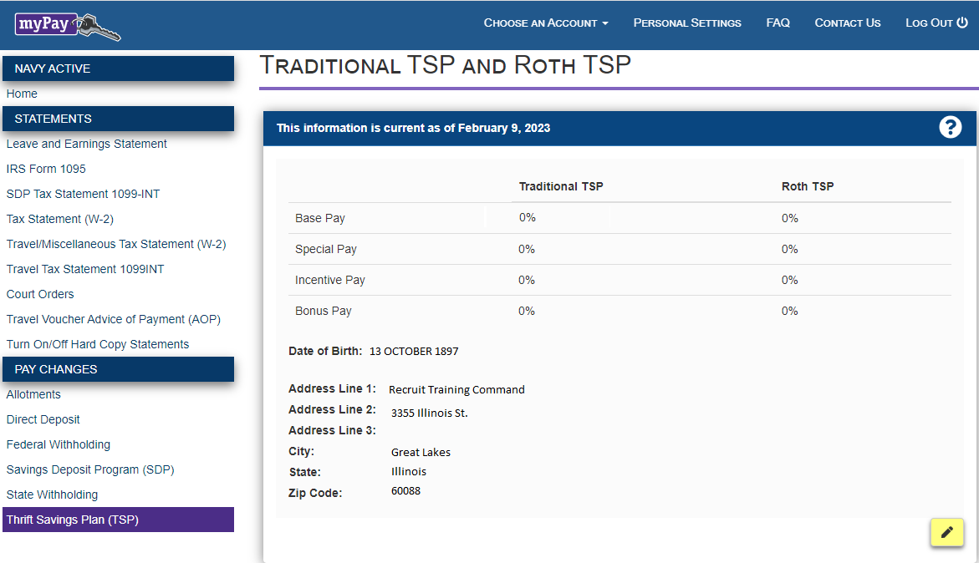
MyPay Overview
Starting your TSP contributions
The first step in planning participation in TSP is reviewing current pay, bonuses and deductions. This will allow you to determine what percentages of your basic pay, special and incentive pays, and bonuses are available for contribution elections
Review Your Leave And Earnings Statement (LES) To Confirm Accuracy
To participate in TSP, you must have elected a minimum of one percent of your basic pay for either traditional or Roth TSP contribution
Access Your TSP Features
Explore the new TSP experience redesigned to
help you manage your retirement savings with
new features and tools, flexible access to My
Account, additional options for support from
TSP representatives, and more transactions
you can complete smoothly and securely online.
Make sure your current address is up to date
Once updated your TSP address change will be posted to your military pay account at the next update
Traditional, Roth, or Both?
You may elect Roth or traditional TSP contributions
Notes:
FACILITATOR GUIDE:
Your Thrift Savings Plan contributions/allotments start in MyPay. On this tab it is important to update your current address, Once updated your TSP address change will be posted to your military pay account at the next update; and sent to update your Federal Retirement Thrift Investment Board personal account information after the first update of the next full processing month.
Additional Notes:
Address updates will be sent to update your Federal Retirement Thrift Investment Board personal account information.
Traditional TSP contributions are deducted pre-tax; taxes are deferred until you withdraw your contributions. Roth TSP contributions are taken after-tax.
*Remember, traditional and Roth contributions are based on your elections of percentages of pay and not on dollar amounts.

Slide 16
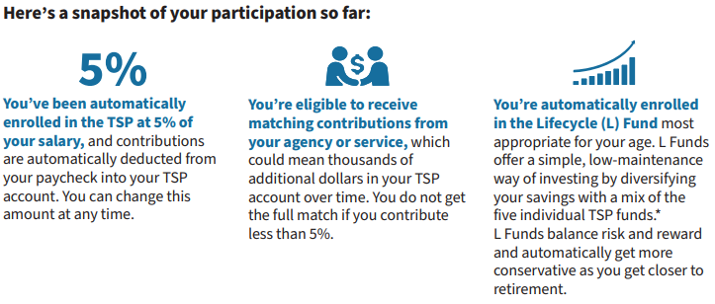
TSP Overview
You can change your investment election for new money coming into your TSP account and move money among funds. within your account when you log in to My Account
How to invest?
TSP offers a variety of investment options. You can choose your own mix of investments from a short-term U.S. Treasury security to index funds made of stocks. Or choose a Lifecycle (L) Funds that uses a professionally determined investment mix designed to deliver a balanced approach to investing
Set up your login to My Account on tsp.gov and manage your TSP savings efficiently and securely.
When you log in to My Account, you can check your account balance, change your investment choices, submit secure transaction requests, and designate your beneficiaries
Notes:
FACILITATOR GUIDE:
WELCOME TO THE THRIFT SAVINGS PLAN! – Now that you have updated your address and verified your contributions
You’re now part of the TSP, a long-term retirement savings and investment plan similar to 401(k) plans offered by private companies. Whether you’re new to government or returning to federal service, know that TSP be there to support your financial goals throughout your career, into retirement, and beyond.
Setting up My Account security features and keeping your contact information up to date is essential to protecting your account from fraud and making sure you receive TSP correspondence.

Slide 17
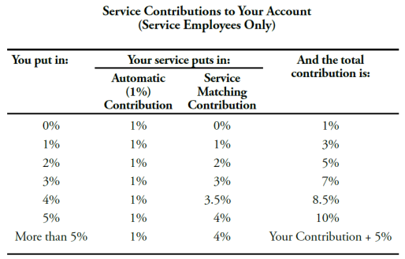
Blended Retirement System
How your contributions matchup
Service Matching Contributions
In addition, your service will match up to an additional 4% of your basic pay
Service Automatic (1%) Contributions
Your service will begin contributing an amount equal to 1% of your basic pay into your TSP account each month
militarypay.defense.gov/blendedretirement/
Notes:
FACILITATOR GUIDE:
The Blended Retirement System combines elements of the legacy retirement system with benefits similar to those offered in many civilian 401(k) plans
The BRS has three parts: a Thrift Savings Plan, which is like a civilian 401(k) retirement savings plan; a “continuation pay” bonus after 12 years of service if you choose to reenlist and an annuity payment.
For more information please utilize the QR code on the screen or visit militarypay.defense.gov/blendedretirement/

Slide 18

The Servicemembers Civil Relief Act
Benefits and Protections
One of the most notable protections of SCRA is the requirement for creditors to reduce interest rates to 6% on debt incurred prior to entering active duty. This includes individual debts, as well as those held jointly with your spouse.
Termination of residential housing and automobile leases without penalty
Protections against default judgments in civil cases
Protections against foreclosure on your home
Protections against repossession of their property
Know Your Rights
https://www.militaryonesource.mil/financial-legal/legal/servicemembers-civil-relief-act/
Notes:
FACILITATOR GUIDE:
The Service members Civil Relief Act, or SCRA, supports military personnel by limiting, postponing or suspending a broad range of financial and civil obligations during periods of military service. The SCRA was designed to allow service members to focus solely on their mission of defending our nation. Its protections have specific, situation-based requirements. Speak with a legal representative to discuss how these requirements apply to your individual situation.

Slide 19
MyNavy Financial Literacy Mobile Application
The MyNavy Financial Literacy application provides personnel with information to achieve their personal financial goals and meet the Navy’s financial literacy education requirements.
The application is divided into the following sections for ease of use:
  Financial Readiness Touchpoint Training Courses (required)
  Financial Literacy Resources
  Blended Retirement System (BRS)
  Future Sailor Financial Readiness Guide
  Debt Destroyer® Workshop
  Calculators
NOTE: If you complete the touchpoint training courses on the app, and enter your information at the end of the course, it should transfer to your profile and mark you as completing the required “touchpoint training courses”
Notes:
FACILITATOR GUIDE:
https://finred.usalearning.gov/NavyResource

Slide 20
Best Practices
Understand Your Pay:
  Familiarize yourself with military pay structure (e.g., base pay, allowances, bonuses).
  Review your LES (Leave and Earnings Statement) regularly to spot errors
Create a Budget:
  Track monthly income and expenses, including mandatory deductions
  Set aside funds for savings, emergencies, and discretionary spending
Build an Emergency Fund:
  Aim to save at least three months' worth of essential expenses
  Start small, with regular contributions from your paycheck
Take Advantage of Military Benefits:
  Utilize the Savings Deposit Program (SDP) for deployments in combat zones
  Research Thrift Savings Plan (TSP) options for long-term retirement savings

Slide 21
Best Practices
Manage Credit Wisely:
  Limit credit card usage to necessities and pay balances on time
  Monitor your credit score to maintain financial health
Plan for the Future:
  Understand PCS (Permanent Change of Station) costs and budgeting
  Save for personal goals like education or purchasing a vehicle
Seek Financial Advice:
  Use free resources such as on-base financial counseling programs
  Consider using Military One Source for financial tools and resource

Slide 22
Knowledge Check
How often should you log in and review your LES?
How do you start, adjust, and stop your TSP allotments?
Under the BRS system, what is the maximum service matching contributions?
What protections are offered to you under the Servicemembers Civil Relief Act (SCRA)?
Notes:
FACILITATOR GUIDE:
How often should you log in and review your LES? Answer: Monthly.
How do you start, adjust, and stop your TSP allotments? Answer: Under the Thrift Savings Plan tab of myPay.
Under the BRS system, what is the maximum service matching contributions? Answer: 5%
What protections are offered to you under the Servicemembers Civil Relief Act (SCRA)? Multiple Answers possible: Cap 6% interest for prior debt & protections on home/loan default.

Slide 23
Review and Summary
Financial Readiness
Basic Pay, Basic Allowance for Housing and Basic Allowance for Subsistence (BAH and BAS)
Special Pay
Savings Deposit Program (SDP)
MyPay functions
Thrift Savings Plan (TSP)
Blended Retirement System (BRS)
Servicemembers Civil Relief Act (SCRA)
MyNavy Financial Literacy Mobile Application

Slide 24
Questions?

