Slide 1
Reenlistments and Extensions
Notes:
Time Required: 55 min

Slide 2
Enabling Objectives
DEFINE reenlistment and extensions
IDENTIFY the difference between EAOS and SEAOS
IDENTIFY the difference between EREN and SEREN
IDENTIFY the eligibility factors for reenlistments
DETERMINE when leave sell-back is authorized
IDENTIFY the eligibility factors for extensions of enlistments
IDENTIFY the reasons for extension cancellations
IDENTIFY when the OBLISERV to Train (OTT) option is available/applicable
IDENTIFY when Page 13 in lieu of OBLISERV is available
Notes:
FACILITATORS GUIDE:
Review objectives.

Slide 3
References
MILPERSMAN 1160-020: Reenlistment Ceremony
MILPERSMAN 1160-030: Reenlistments under Continuous Service Conditions
MILPERSMAN 1160-031: Required Counseling upon Reenlistment
MILPERSMAN 1160-040: Extension of Enlistments (cancellation as applicable)
MILPERSMAN 1160-050: Retain in Service (RIS) due to medical/LIMDU
MILPERSMAN 1160-060: Agreements of Enlisted Naval Reservists to remain on Active Duty
MILPERSMAN 1160-120: High Year Tenure (AC/TAR)
NAVADMIN 277/23: High Year Tenure Plus Pilot Indefinite Extension
MILPERSMAN 1160-135: High Year Tenure (SELRES)
Notes:
FACILITATOR GUIDE:
Review references.

Slide 4
References
(cont.)
MILPERSMAN 1160-140: Career Waypoints
MILPERSMAN 7220-340: Lump-Sum Payment for Accrued Leave
OPNAVINST 1160.8B: OBLISERV to Train (OTT)
Notes:
FACILITATOR GUIDE:
Review references.

Slide 5
Career Decision
Career Milestone
Department Career Counselor will:
Determine difference between EAOS/SEAOS
Monitor SEAOS 15 to 18 months
Example SEAOS 2027 07 04
- 1 6 <=18 months = 1 YR 6 MOS
-----------------------
2026 01 04 => JAN 2026 CDB
Prep CDB: Screen CIMS "Alpha Roster" BR/CL
    BR/CL: Identify BR/CL 11 & BRA/CL 32 Sailors
Identify Career Decision: Reenlist, extend, separate or SELRES
Track and take action to reenlist, extend or separate the Sailor
Verify forms are processed in a timely manner
Notes:
Screen Sailors approaching 18 months End of Contract as Extended aka SEAOS
2. SEAOS by BR/CL Data source: CIMS / Career Information Management / Alpha Listing (provides BR/CL and SEAOS)
Branch/Class 11 (Active Component) SEAOS
Branch/Class 32 (TAR*) SEAOS
3. Know the difference between EAOS/SEAOS
a. EAOS = End of ACTIVE obligated Service (end of enlistment contract)
Example: EAOS = 2026 07 04
b. SEAOS = Soft End of ACTIVE obligated (adding 1-48 months to above EAOS if needed to obtain benefit/meet requirement)
Example: SEAOS = 2027 07 04 (Sailor has 12 months added to EAOS 2026 07 04 to receive SRB benefit, OBLISERV, or Advancement)
NOTE1: SEAOS = Stays “soft” i.e. pending status which means the contract can be canceled
before the contract changes from “soft” to a permanent contract, when cancel policy requirements are met
NOTE2: After an extension contract becomes “operative” (i.e. permanent), then the EAOS & SEAOS dates will match
Example: EAOS 2027 07 04 SEAOS 2027 07 04
4. Screen/Identify for BR/CL 32 TAR* Sailors, extra contract generated if making changes to EAOS/SEAOS.
5. DDCC Takeaway:
Department CDB => CIMS List “Loss” report = 18 months prior to SEAOS = Decision Making (reenlist, extend or separate)
SEAOS 2027 07 04 (18 months = 1 year and 6 months)
- 1 6
-----------------------
2026 01 04 (CDB Nov or Dec 2025)
*BR/CL 32 TAR = Training and Administration of Reserves (will always have two contracts: Active Duty and Reserve Duty contract; without BOTH contracts SEAOS/SEREN having same date, TAR Sailors will lose their TRICARE medical benefit coverage; Example: sign 1070/601 Active Contract & 1070/621 Agreement to Recall/Extend Active Duty Reserve Contract)

Slide 6
Career Decision
Forms
Form Locations:
    MyNavy HR > References > Forms > NPPSC Forms
    NAVPERS 1040/4: Career Waypoints Application
    NPPSC 1160/1 Command Career Request
    NPPSC 1160/2 CPPA Reenlistment Checklist
    NOTE: NPPSC 1160/1 is a multi-use PDF for both reenlistments and extensions requests
Notes:
FACILITATOR GUIDE:
None.
DDCC GO LIVE TO MYNAVYHR – demonstrate ability to download. Select Reenlistment. Then select Extension.

Slide 7
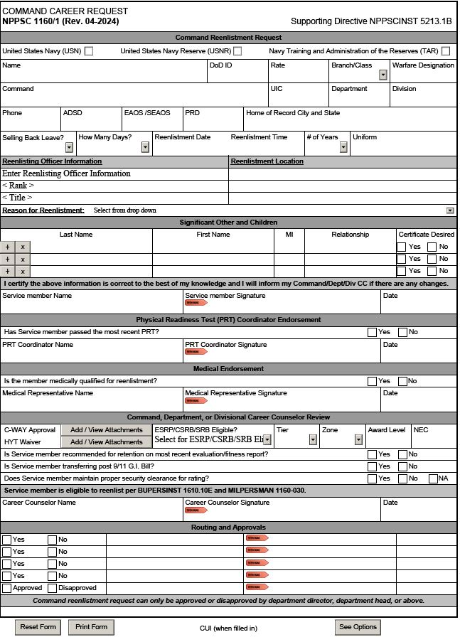
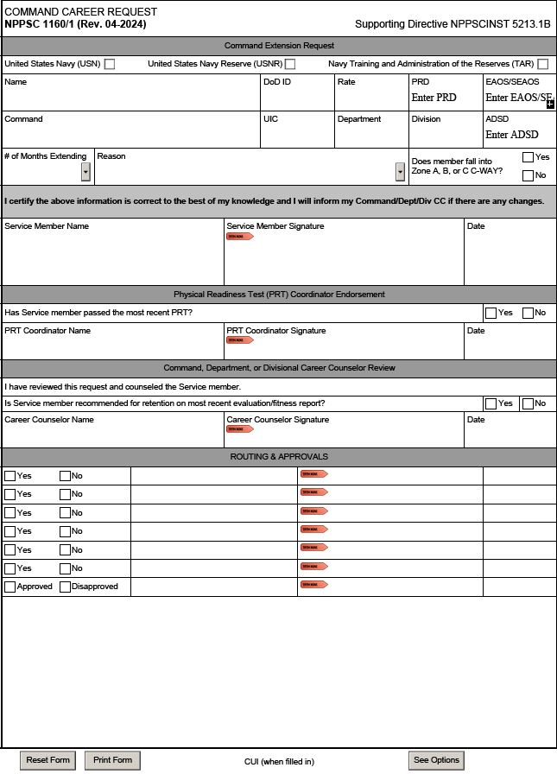
Career Decision
NPPSC 1160/1
Reenlistment Career Request
Extension Career Request
SAMPLE
SAMPLE
Used for both reenlistments and extensions
Notes:
FACILITATOR GUIDE:
See screenshot.
Must download form from MyNavyHR / References / Forms / NPPSC.
It can be tricky to download and may require a few attempts to open document. Sailor must select either "reenlistment" or "extension".
DDCC must ensure accuracy of data on the Sailors section (top part of form).
3a. Filling out electronically (with electronic signatures) are preferred. See your command career policy to see if pen/ink signatures will be authorized (i.e. due to connectivity issues).
4. DDCC will be verifying the form is accurate in all sections (i.e. missing check marks, signatures) and TIMELY routed.
5. Review the Career Counselor sections on both forms. These areas required validation by the CC (review record for evaluation or have evaluation provided for recommendation).

Slide 8

Career Decision
Reenlistment Ceremony
MILPERSMAN 1160-020 Prepare Ceremony (i.e. Certificates)
“During a reenlistment ceremony, the reenlisting Sailor makes a personal commitment in a public forum to wear the cloth of the nation with honor, courage and commitment.”
          Who CAN ADMINISTER THE OATH?: Per 10 U.S.C. 502(a), The President, Vice President, Secretary of Defense, and any commissioned officer and any other person designated under regulations prescribed by the Secretary of Defense
          Where: Venue shall reflect pride, professionalism and dignity for the oath and Navy
          Attire: Must be in Uniform.
          Senior enlisted CANNOT administer the Oath of Enlistment.
Notes:
FACILITATOR GUIDE:
Ensure to emphasize that Senior Enlisted cannot administer the Oath of Enlistment. This also includes civilian family members (spouse, kids, etc.).
Who: Per reference (a) (10 U.S.C. 502(a) ), the President, the Vice-President, the Secretary of Defense, any commissioned officer, and any other person designated under regulations prescribed by the Secretary of Defense may administer the reenlistment oath. Senior enlisted CANNOT officially administer the Oath of Enlistment
Where: Each reenlistment shall be performed in uniform and should be memorable with the right tone and venue to reflect pride, professionalism, respect, and dignity for the oath and the United States Navy. Examples include members command (standing on the anchor, under the ship while in dry dock, etc.), sporting events (on the field during a game), landmarks (USS MIDWAY, beach), or a location significant to the member.
Attire: Both the Sailor reenlisting and the reenlisting officer are required to be in uniform.

Slide 9
Career Decision
Reenlistment Eligibility
Recommended for retention on most recent evaluation
Maintained proper security clearance for rating
Reenlistment cannot exceed established HYT limit without PERS approval
Be in compliance with physical fitness assessment (PFA) standards [verify current policy]
Medically Qualified for reenlistment in current or future rating change
OBLISERV submitted and approved, MNA/verified CWAY
Reason to Reenlist – Benefits of Rate, Conversion (STAR, AC2TAR, TAR2AC, OTT [verify eligibility), Bonus (SRB, ESRP) pre-approval received
Selling back leave, 60 days max in Naval career
Notes:
FACILITATOR GUIDE: MPM 1160-030 Enlistments under continuous service conditions. Screen NPPSC 1160/1 & counsel as needed with SVM eligibility and any applicable updates.
1. Where is the source for reenlistment recommendation? E1-E6 EVAL Block 47 = retention recommendation, when "Yes" is marked, SVM meets first requirement in eligibility to reenlist or extend.
2. The Command Career Request Form OPNAV 1160.1., the DDCC is to verify current security clearance status with Security Manager. NSIPS/ESR does not always reflect the most current Security Clearance status. Security Clearance status is not specifically stated as a requirement in MPM 1160-030. However, if a Sailor is not eligible for a clearance or does not have the required level clearance for their rate, a reenlistment will not be authorized.
3. Verify member's intended reenlistment date + (reenlistment years) does not exceed the Sailors HYT date. [ ADSD + HYT limit (current paygrade) for example: Reenlistment Ceremony 10/1/2025 + 4yr = 9/30/2029 compare with current paygrade HYT limiting date E4 Sailor; ADSD 9/30/2017+ 10 yr E4 HYT limit = 09/30/2027. This sailor's reenlistment of 4 years not authorized because it exceeds 09/30/2027.
4. In the Navy, failing two consecutive PFA (Physical Fitness Assessment) tests does not automatically lead to separation or prevent reenlistment, but it does have consequences. Sailors who fail one PFA are placed in the Fitness Enhancement Program (FEP) and are ineligible for promotion or “frocking” until they pass the next official PFA. For two consecutive failures, the Navy provides commanding officers (COs) with discretion on retention recommendations, rather than automatically triggering separation. As of 5.14.2025, the NAVADMIN 123/24 Physical Readiness Program update: IRT reenlistment and extension recommendations and Physical Readiness Program failures which is based on a single calendar year (Jan-Dec): CO's are encouraged to document a member's progress and initiated in attaining current physical fitness standards in the narrative sections (Block 41-CHIEFEVAL, Block 43-EVAL) AND suitability for retention (EVAL Block 47). Retention recommendations are at the discretion of the CO and in the best interest of the Navy (qualified for continued service to perform function of their rate without physical or medical limitation at sea, shore or isolated duty & likelihood of improvement in meeting PFA standards within next 12 months). IF retention (or reenlistment eligibility) is removed, the CO may submit a special evaluation report to restore eligibility.
5. The Command Career Request NPPSC 1140/1 has a section for medical to review member's eligibility to perform the duties of current rate. IF NOT medically qualified, then seek guidance from CCC/MEDICAL team. An extension request may be considered.
6. Sailor received PCS Orders? Review orders new PRD for Service Obligations (i.e. OBLISERV). CC annotates OBLISERV intent on MNA website (this update will send OBLISERV intent to Career Waypoints system. CC must verify Career Waypoint "report" showing OBLISERV approval for reenlistment in current rate).
7. If Sailor is reenlisting for a special program (i.e. STAR, AC2TAR, TAR2AC, Bonus – SRB), these approvals are needed prior to submitting reenlistment request. Plan ahead. For example: Reenlistment Bonus must be "pre-approved" 35=120 days
7a. Ensure you review Professional Growth Criteria. Must be an E3 with SRB to reenlist, etc. Review the MPM on this slide.
8. Selling back leave counseling – must indicate on NPPSC Form as well as counsel sailor that 60 day max & the leave is only base pay (does not include BAH, BAS, etc).

Slide 10
Career Decision
Reenlistment Eligibility (cont.)
Reenlistment:
  Meet PCS OBLISERV
  SRB
  Transferring Post 9-11 benefits
  Benefits of rate
Ceremony:
  Reenlist in proper uniform
  Refer to MILPERSMAN 1160-020
Required counseling:
  UCMJ 1070/613
  Refer to MILPERSMAN 1160-031
Notes:
FACILITATOR GUIDE: MPM 1160-020 (REENLISTMENT CEREMONIES) must be considered with Sailor at time of Command Career Request to ensure ceremony follows protocol.
In the Sailor's raising of their right hand, there is no higher honor than this commitment to our nation. The ceremony shall also represent this dedication to the Sailor and represent the nation accordingly.
Speak on unique/significant reenlistment ceremonies you have facilitated or witnessed that stood out (fun location, deployments, etc.).
Special locations do take more time to arrange so need more lead time (as applicable).
The CO should preside and in her/his absence, the Executive Officer should preside.
Per reference (a), section 2261, and reference (b), commands may use appropriated funds to purchase recognition items of nominal or modest value (less than $50 per item). Grant reenlistment leave or special liberty.
Ensure that NPPSC 1160/1 has been reviewed (ceremony items requested), submitted to Personnel Dept/N1 in timely manner.
Ensure that Certificates for Sailor and family (as applicable) are generated (locally or CIMS) and signed.
Ensure that the 5 w's of the ceremony (who, what, when, where and why- ceremony of course) are confirmed with COC/event attendees prior to event.
Ensure photographer GTG. Command announcement (i.e. display) - optional but nice benny when possible.
CC's will ensure 1) Ensure that MNA authorization is submitted (i.e. OBLISERV) for all rated E3-E6 <14 years of service [when applicable, PCS negotiation]
2) Immediate Reenlistment Contract is signed both Reenlisting Officer and SVM
3) NAVPERS 1070/613 (i.e. UCMJ Page 13) additional required counseling signed by all
4) Turn in signed #1-3 above to Personnel/N1 to process through SALESFORCE

Slide 11
Career Decision
Reenlistment Policy
Terms of reenlistment are 2, 3, 4, 5, or 6 years
  New contract must equal or exceeds period of service member is already obligated
  SRB reenlistments require minimum term of 3 years and new EAOS must be in the next zone
  SRB Precertification requirement 35+ to 120 days before reenlistment date
  Conditional Reenlistments (current contract exceeding 48 months extension)
Notes:
FACILITATOR GUIDE:
Speak on unique/significant reenlistment ceremonies you have facilitated or witnessed that stood out (fun location, deployments, etc.).
Early reenlistments:
No requirement to forward to PERS-811 for approval
The term of new enlistment contract must be equal or exceed the period of service for which the member is already obligated
Members reenlisting under SRB that require additional OBLISERV requirements see MPM 1160-040 Paragraph 6b.
If considering transferring education benefits, reenlisting early could interfere with those benefits.
benefits
Applies to all Sailors regardless whether or not the member is subject to CWAY approval
Conditional reenlistments - requires approval from
BUPERS 328- AC/TAR members
BUPERS 352 – RC members
Conditional Reenlistments can be requested when SVM has 48 months operative extension on current enlistment, is eligible for reenlistment, meets one of following criteria:
AC/TAR requires additional OBLISERV to transfer to Fleet Reserve date
Has approved application for special duty
Required additional OBLISERV to attend service school, or duty (when extension cannot be executed)
There are a few more reasons, see MPM 1160-030 "conditional reenlistments" (i.e. combat illness, injury, etc)

Slide 12
Career Decision
Lump-Sum Payment for Accured Leave
MILPERSMAN 7220-340
  Members generally cannot sell more than 60 days in a military career
Monetary entitlement payable
  Reenlistment
  Separation from Active Duty
  The effective date of a first extension of enlistment.
  Death – exception for 60-day max sell back
LSL Calculation
  Base Pay/30= Daily Norm or Daily Base Rate (DBR)
  DBR x number of days = LSL
Notes:
FACILITATOR GUIDE: SEE MPM 7220-340 if needed
None.

Slide 13
High Year Tenure
(HYT)
References
      AC/TAR: MILPERSMAN 1160-120 (ADSD + HYT Limit)
      SELRES: MILPERSMAN 1160-135 (PEBD + HYT Limit)
Purpose
      Vital and effective force management tool
      Manages length-of-service (LOS) gates by pay grade
    A waiver process is available to retain the right number of members
    Note:
      Reference HYT specific NAVADMINS for changes.
Notes:
FACILITATOR GUIDE: Screen to ensure that any reenlistment or contract time does not exceed HYT limit (per paygrade). If considering contract to go beyond this limiting date, a HYT waiver must be request in advance (it takes time to receive HYT waiver approval – 30, 60, 90 days or more).
Inform CDT to always verify current MPM and NAVADMINs that address HYT policy to determine a member’s eligibility.
Note: SELRES/IRR/USNR-S1 have a higher Length of Service (LOS) Gate than AC/TAR. Example: E-5 SELRES HYT is 20 years.

Slide 14
High Year Tenure
Gates
Active and TAR Sailors
E-1 TO E-2 | 4 Years
E-3 | 6 Years
E-4 | 10 Years
E-5 | 16 Years
E-6 | 22 Years
E-7 | 24 Years
E-8 | 26 Years
E-9 | 30 Years
SELRES, IRR and USNR-S1
E-1 TO E-2 | 6 Years
E-3 | 10 Years
E-4 | 14 Years
E-5 | 20 Years
E-6 | 22 Years
E-7 | 24 Years
E-8 | 26 Years
E-9 | 30 Years
Reference HYT specific NAVADMINS for changes
  https://www.mynavyhr.navy.mil/Career-Management/
  Community-Management/Enlisted-Career-Admin/High-Year-Tenure/
Notes:
FACILITATOR GUIDE:
Review HYT limits…discuss any recent changes if applicable.

Slide 15
High Year Tenure
HYT Plus Program
This program was piloted in FY-23
Improves the end strength of AC, TAR, SELRES
HYT Plus does not eliminate the HYT policy
Utilize current HYT Plus NAVADMIN 277/23

Slide 16
Career Decision
Extension of Enlistments
MILPERSMAN 1160-040
“Conditional Extension” Contract
  Contract periods of 1-48 months
  Screen for current extensions – if existing extensions, combined extensions cannot exceed 48 months
  2-step process:
    Execution date = the date signed
    Operative date = date the extension goes into effect (EAOS + 1 day)
  Two types of Contracts: 1070/621 & 1070/622
    BR/CL 32 TAR Sailors execute and make operative both contracts 1070/621 & 1070/622
Notes:
FACILITATOR GUIDE:
Extensions are only authorized for prescribed conditions, seee MPM 1160-040 for these conditions (i.e. match PRD, HYT, Fleet Reserve, mission/deployment, etc)
DDCC should verify service record to ensure how many extensions are currently executed and operative. Sailors cannot exceed a total of 48 months extension.
If member exceeding 48 months of extension, they cannot execute another extension. Therefore, consider "conditional reenlistment' MPM 1160-030 as a possibility.
Extensions confuse Sailors because of the two step process. When Sailor signs contract is executed (added to current contract but not "operative" until current contract expires).
TAR Sailors (BR/CL 32) are both Active Component and Reserve Component. So both their Active and Reserve contracts have to be executed. Therefore Two forms MUST BE signed 1070/621 and 1070/622 at time of an extension.
NOTE TO TAR SAILOR CC's: Ensure that after a extension contract is signed, ensure that both the SEAOS and SEREN match. Common issue, but it will affect this TAR Sailor's medical benefits and PCS/MNA negotiation in the future. SEAOS – Soft End of Active Obligated Service; SEREN – Soft End of Reserve Enlistment

Slide 17
Career Decision
Extension of Enlistments
COs and OICs can authorize extension contracts without PERS approval, if they are for one of the following “conditional” reasons
    Match EAOS with PRD
    Match HYT date / RET / FLTRES
    Maternity Care-Pregnancy (member or spouse)
    Obligated Service for PCS Orders
    Obtain OBLISERV as required by Navy directives, NAVADMIN, or MILPERSMAN
      Example: Extend to receive continuous SUBPAY on shore duty. (2 years past shore duty PRD)
Exception
  Nuclear Trained Sailors seeking extensions beyond 23 months require approval from OPNAV N133
Notes:
FACILITATOR GUIDE:
None.

Slide 18
Career Decision
Extension of Enlistments
Extensions may be cancelled if
    Reenlists beyond the current SEAOS date
    Sailor extends for benefit, but it is not received NO fault of member
    Disenrolled from specialized course NO fault of their own
    Is no longer recommended for retention
      Loss of required security clearance
Note
    Extensions that have become OPERATIVE cannot be cancelled
    Any extension in which a member received a significant benefit CANNOT be cancelled even if it meets other cancellation requirements
Notes:
FACILITATOR GUIDE: Must receive BUPERS 328 approval prior to cancelling extension. MPM 1160-040
Examples of extension with benefits are:
School
Accelerated advancement
Did not execute PCS orders
Enlistment bonus

Slide 19
Career Decision
Extension of Enlistments
Extensions requiring PERS-832 approval:
Conditional Reenlistments (MPM 1160-030)
OBLISERV to Train (OTT) (OPNAVINST 1160.8B)
Extension Cancellation (as applicable;
(MPM 1160-040)
Retain in Service (RIS) due to medical/LIMDU (MPM 1160-050)
Pg. 13 in lieu of hard OBLISERV
Exception to Policy (ETP)
Following information required:
Rate/Name
EAOS/SEAOS
CWAY Status
SRB/CSRB eligibility
Reason for submission
Aggregate extension months executed prior to request
CO comments
Command POC Information
https://www.mynavyhr.navy.mil/Career-Management/Community-Management/Enlisted-Career-Admin/
Notes:
WEBSITE: MyNavyHR / Career Management / Community Management / Enlisted Career Admin / Reenlistments-Extensions
Or
https://www.mynavyhr.navy.mil/Career-Management/Community-Management/Enlisted-Career-Admin/Reenlistment-Extensions/

Slide 20
Career Decision
CCC Best Practices
Ensure you communicate SRB timelines with your Sailors
  CCC submits SRB precertification in CIMS 35-120 days prior to reenlistment day
  Submit reenlistments for routing in a timely manner to meet this hard deadline
Discuss Post 911 GI Bill transferability requirements
  Minimum of 6 years of service required with a 4-year obligation
  Sailors have 30 days from date of reenlistment to transfer benefits with a 4-year reenlistment
  Provide handout or link for next steps
  Sailors miss this opportunity ALL the time
Notes:
FACILITATOR GUIDE:
Add any best practices/experiences you have here.
Show example of 15 month roller.
Is there a specific template you want your Dept/Div CC’s to use? If so, train to it so they are aware of your expectations.

Slide 21
Career Decision
CCC Best Practices
Update SGLI Online Enrollment System (SOES) and Page 2 (RED/DA) - changes to family relationship ships.
Educated Sailor on the importance after the ceremony
    New CAC ID needed
    Did AC Sailor EAOS and SEAOS change
    TAR Sailor EREN/EAOS and SEREN/SEAOS all four dates must match for reenlistments
  Follow up 15-30 days
    NSIPS ESR closeout reflect changes to OMPF
    Check LES for SRB payment (check bottom "notes" section)
    Verified approval of TEB Post 9-11 GI Bill (i.e. Milconnect /Benefit /Post 9-11)
Notes:
FACILITATOR GUIDE:
Add any best practices/experiences you have here.
Show example of 15 month roller.
Is there a specific template you want your Dept/Div CC’s to use? If so, train to it so they are aware of your expectations.

Slide 22
Knowledge Check
Use the Sailor details below to answer the questions
    BM1 Jasmine Navy BR/CL 11
    ADSD: 10/31/2008
    EAOS: 03/01/2026
    SEAOS: 03/01/2027
    Requested reenlistment date: 07/04/2025
    Not eligible for SRB
    Can BM1 Jasmine Navy reenlist on the requested date? Explain your answer and the reference?
    What is the maximum amount of time BM1 could reenlist for and why?
    Is she affected by the current HYT policy and require a HYT waiver?
    If she changed her mind and wanted to consider an extension to match HYT, how much time could she extend?
Notes:
ANSWERS:
YES, Member could reenlist as early as they want as long as their new EAOS exceeds past their current SEAOS. If not currently on SRB and no future SRB on new reenlistment. Reference MPM 1160-030.
Maximum of 5 years reenlistment from July 04, 2025 to HYT limit
- Calculate HYT: PO1 = ADSD + 22 HYT limit + ADSD = 2008 10 31 + 22 = 2030 10 30
- Calculate REENL/HYT difference: 2030 10 30 – 2025 07 04 = 05 year 03 mo 26 days
- 2025 07 04 + 5 reenlistment years = 2029 07 03 = NEW EAOS/SEAOS
No waiver needed for this sailor reenlisting 2, 3, 4, 5 years.
Not eligible to extend to HYT. Policy states maximum extension is up to 48 months. She needs 60 months. Also, she is already on 12 month extension, could only add 36 months extension contract.

Slide 23
Summary and Review
In this lesson we discussed:
  Defined reenlistment and extensions
  The eligibility factors for reenlistments and extensions of enlistments
  HYT
  Reenlistment incentives
  Reenlistment ceremonies
  OBLISERV to Train (OTT)
  Extension cancellations
  Leave sell-back

Slide 24
Questions?

