Slide 1



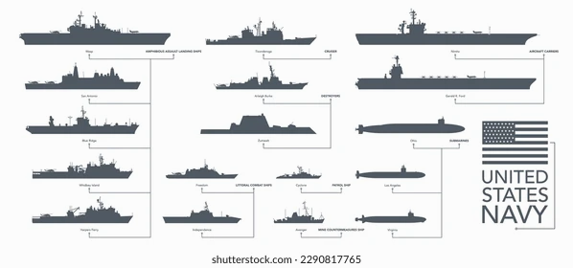

Advancing Your Career
Promotion Pathways
Use Billet Based Advancement (BBA) to apply for positions tied to promotion.
Study for and pass the Rating Knowledge Exam (RKE) and the Navy-Wide Advancement Exam (NWAE).
Compete in Meritorious Advancement Program (MAP), Command Advance to Position (CA2P) and Advance to Position (A2P).
Career Planning
Use Career Development Boards (CDBs) to map out your future.
Skill Development
Gain credentials through USMAP (apprenticeships) and Navy COOL (civilian certifications).
Leadership Training
Complete Enlisted Leader Development (ELD) courses required for each rank from E5 to E7.
Useful Navy Websites
MyNavy Portal:
https://www.my.navy.mil
MyNavy Assignment (MNA): https://mynavyassignment.navy.mil
NSIPS: https://www.nsips.cloud.navy.mil
BOL (BUPERS Online): https://www.bol.navy.mil
PRIMS: https://www.mnp.navy.mil/group/performance
TWMS: https://twms.dc3n.navy.mil
Navy College: https://www.navycollege.navy.mil
Navy COOL: https://www.cool.osd.mil
Welcome to First Term Success Workshop
Common Terms & Acronyms
RKE: Rating Knowledge Exam
ADSD: Active Duty Service Date
PRD: Projected Rotation Date (when you're due to transfer)
EAOS: End of Active Obligated Service. SEAOS: Soft EAOS (EAOS with extensions)
TIR: Time in Rate (time served in current rank)
TIS: Time in Service (overall time in the Navy)
CDB: Career Development Board
PMK-EE: Professional Military Knowledge Eligibility Exam
MAP: Meritorious Advancement Program
BBA: Billet Based Advancement
OMPF: Official Military Personnel File
IMR: Individual Medical Readiness

Slide 2




WELCOME MESSAGE
What to Expect in Your First Few Years
Professional Growth
Start learning your job and qualifying in your role.
Participate in Career Development Boards (CDBs) to talk about your goals.
Pay, Benefits, and Financial Management
Pay and Leave Statements:
Use MyPay to view your Leave and Earnings Statement (LES) and Thrift Savings Plan (TSP) contributions:
https://mypay.dfas.mil
Special Pays and Bonuses:
You may qualify for Sea Duty Incentive Pay (SDIP), Billet Based Advancement (BBA), or Selective Reenlistment Bonuses (SRB).
Financial Support:
Fleet and Family Support Center (FFSC) offers budgeting and financial counseling.
Navy-Marine Corps Relief Society (NMCRS) provides emergency loans and financial education.
Command financial specialist (CFS) designated sailor(s) onboard to assist with basic and complex financial needs and education.
Starting your first assignment in the U.S. Navy is a major milestone. This workshop is designed to guide you through your early years by introducing key programs, tools, and support resources to help you succeed professionally and personally.
Sea Duty vs. Shore Duty
Sailors rotate between sea and shore assignments.
Billet Based Advancement (BBA) allows Sailors to promote by applying for and filling priority positions using MyNavy Assignment (MNA).
Sailor's Creed:
I am a United States Sailor.
I will support and defend the Constitution of the United States of America, and I will obey the orders of those appointed over me.
I represent the fighting spirit of the Navy and those who have gone before me to defend freedom and democracy around the world.
I proudly serve my country’s Navy combat team with honor, courage, and commitment.
I am committed to excellence and the fair treatment of all.
Career Tools
Use platforms like MNA, NSIPS, and BUPERS Online (BOL).
Maintain updated personal and medical records.
Explore reenlistment, job conversions, and officer programs.

