Slide 1
Monthly Flight Pay
Aviation Incentive Pay (AvIP)—Flight Pay
Baseline Flight Pay
  YAS Monthly Rate
  <2 $125
  >2 $156
  >3 $188
  >4 $206
  >6 $650
  >14 $840
  >22 $585
  >23 $495
  >24 $385
  >25 $250
Payments on the milestone rate start with DH selection
Milestone Flight Pay
  YAS Monthly Rate
  <2 $125
  >2 $156
  >3 $188
  >4 $206
  >6 $650
  >10 $1000
  >22 $700
  >24 $450
Return to Baseline Flight Pay after 2xFOS for Milestone (CO or Major Cmd)
Notes:
YAS (Years of Aviation Service) starts with report/check-in date to Primary
This is often confused with years of active service (which your LES keeps track of)
Your flight pay will not increase to the next higher rate until you reach the appropriate anniversary of checking in to Primary
If you were previously enlisted aircrew, those years DO NOT count toward YAS
In April 2018, the milestone flight pay rate was introduced
Now, if you screen for DH, your flight pay jumps from $650 to $1000 at 10 YAS (instead of $650 to $840 at 14 YAS)
If you reach 10 YAS and have not screened for DH, you will remain at $650/month until screening for DH (and then it will increase to $1000/month) or until 14 YAS (and then it will increase to $840)
If you screen for DH/CMD, but do not screen for the next milestone, your flight pay will revert back to the baseline flight pay rate after 2xFOS for that milestone (or 2xFOS for the next rank)
If you 2xFOS for Command or Major Command, your flight pay will go back to the baseline rate, effective the date the board results are released

Slide 2
Flight Gates
Years of Aviation Service | Months of Flying | AvIP Eligibility Extended to
12 | 96 | 18 Years
18 | 120 | 22 Years
18 | 144 | 25 Years
  YAS – Starts when you check in to Primary
  MOF – Accrued while on DIFOPS orders
    Must be assigned to DIFOPS on or before the 15th
    Must detach from DIFOPS after the 15th of the month
  Check MOF on Officer Data Card
Notes:
As long as you remain a 131X/132X, you will get continuous flight pay until reaching 12 YAS provided you keep an “up chit”
This is regardless of whether or not you are on DIFDEN or DIFOPS orders (if you go teach ROTC, you’ll still get flight pay even though you’re not flying)
Once you reach the 12-year gate (typically around DH tour), you must have at least 96 MOF to keep your continuous flight pay to 18 YAS
Months of Operational Flying (MOF) are only accrued while on DIFOPS orders
If you teach ROTC (or any other DIFDEN tour) right after your first sea tour, you will still get flight pay, but you will NOT accrue MOF toward keeping your flight pay past 12 YAS
For a partial month to count, you must have checked in to the DIFOPS orders on or before the 15th or checked out after the 15th
If you are going from DIFOPS to DIFDEN orders, highly recommend checking out on the 16th of the month or after so that your last partial month counts as a full month!
If you are going from DIFDEN to DIFOPS orders, highly recommend checking in prior to the 15th of the month so that the first partial month counts toward MOF
If you have only 95 MOF at 12 YAS, you WILL NOT get to keep continuous flight pay to 18 YAS
The next gate is at 18 YAS
If you have at least 120 MOF at 18 YAS, you keep continuous AvIP until 22 YAS
If you have at least 144 MOF at 18 YAS, you keep continuous AvIP until 25 YAS
At 25 YAS, continuous AvIP stops FOR EVERYONE – still eligibility for conditional AvIP if you’re still in a DIFOPS billet and actually flying.
On Officer Data Card on Bupers On Line, you can check your MOF count
Block 27 tells you your Aviation Service Entry Date (should match when you started Primary) – this is how YAS/gates are calculated
Block 28 tells you how many MOF you currently have
Block 29 tells you have many Months To Gate until you reach your next gate
If the MOF you need to reach your next gate is MORE than your MTG, you will likely FAIL that gate
Ie you currently have 80 MOF (need 16 MOF for 96), but only have 10 MTG, you will reach your next gate with less than 96 MOF (even if on DIFOPS orders, you cannot get 16 months within a 10-month period)
More information is available by clicking on the block titles, but be aware that the ODC has outdated MOF requirements listed for each gate – use the ones in this presentation!

Slide 3
Options After Gate Failure
  Conditional Flight Pay
    Must be on DIFOPS orders
    Fly an average of 4 hours/month
    Start request and annual FY verification through PERS-435
  Gate Waiver
    Submitted to DASN via PERS-435
    Submission window is one year prior to gate failure to two years after gate failure
    If approved, waives MOF requirement to pass gate
      Typically only approved if continuing to fly and screen for the next aviation administrative milestone (DH, …)
Notes:
If you have failed a gate (or already reached 25 YAS), you can request conditional flight pay
Conditional flight pay is offered at the exact same pay rates as continuous flight pay, BUT you must be on DIFOPS orders AND fly an average of at least 4 hours/month
Your LES won’t be able to tell the difference between continuous and conditional flight pay, but there are more requirements for the recipient, including a request to start conditional flight pay and annual flight hour verifications (to ensure that 4 hours/month were flown – if not, payments for months not meeting the requirement will be recouped)
Start request and upchit are emailed to PERS-435, annual flight hour verification and endorsements are required to keep AvIP payments for each FY
If you failed the 12- or 18-year gate, you can submit a flight gate waiver request to Deputy Asst SECNAV, via PERS-435
Gate waivers can be submitted one year prior to gate failure up until two years after gate failure
Generally only approved for aviators who have screened (or remain eligible to screen) for the next aviation administrative milestone (DH, CMD, Maj CMD) and continue to fly
Current process typically takes 6-12 months to receive adjudication
If approved, the MOF requirement to pass the particular gate will be waived and you will get continuous flight pay back until the next gate
Date your continuous flight pay starts again is the latter of gate failure date or date waiver was originally requested – so best to request PRIOR to failing the gate
If you were on conditional flight pay while waiting for your waiver request to be adjudicated, conditional flight pay requirements will no longer be required

Slide 4
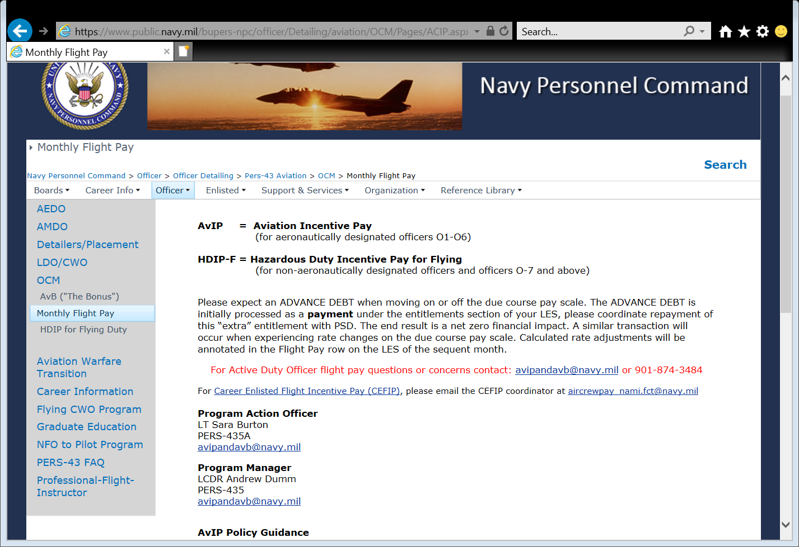
Flight Pay Website
Notes:
website has
contact information for AvIP Program Action Officer and Program Manager
Links to instructions for AvIP
Gate Waiver Template
Conditional Flight Pay templates/information
If contacting the AvIP/AvB office, please use the functional email account avipandavb@navy.mil

