Slide 1
Performance
Summary Report (PSR)
Records Maintenance
Updated Jan 2022

Slide 2
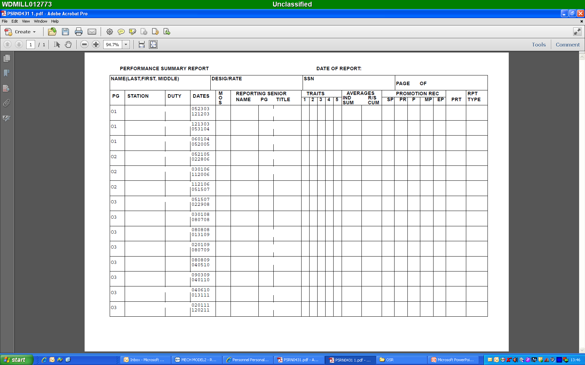
Full Name
Auto-fill
Auto-fill
RG
NO GAP … Next Day.
RG
NO GAP … Next Day.
Validate the correct PFA codes: P, F, M, W, B, and/or N
RG
NO GAP … Next Day.
RG
NO GAP … Next Day.
RG
NO GAP … Next Day.
RG
NO GAP … Same Day is OK.
RG
NO GAP … Next Day.
RG
NO GAP … Next Day.
RG
NO GAP … Next Day.
RG
NO GAP … Next Day.
RG
Continuity Before and After!
Concurrent FITREP (GSA/IA) …
CC
RG
NO GAP … Next Day.
RG

Slide 3
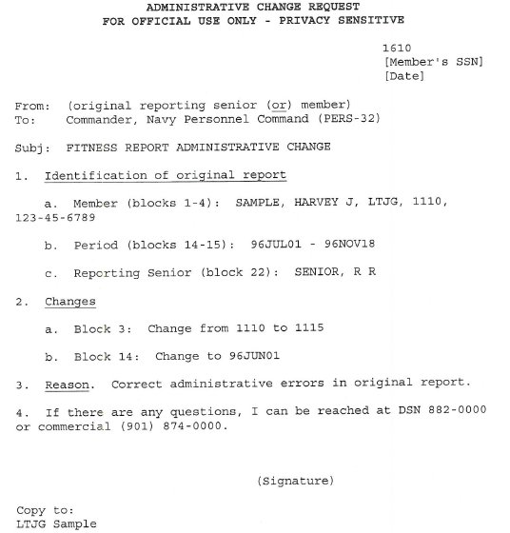
“How To” Guide
Notes
Admin Change Request: To correct an existing gap in your PSR, you will need to submit an Admin Change Request (sample to the right). Once you complete your Admin Change Request, send it to the Career Counselor at supply_corps_cc@navy.mil for forwarding to PERS-32.
** To fix a gap in your PSR, you will need to change either Block 14 or 15 on an existing FITREP …

Slide 4
Important!
When signing your FITREP, ensure CONTINUITY! Have your PSR and previous FITREP present to compare it against. Also review your OMPF for Letters of Extension or other Letters that have modified your Reporting Periods.
Overlap of dates is ok (not to exceed 90 days), but not preferred.
Ensure your SSNs and your R/S’s SSN are accurate…many mistakes stem from incorrect SSNs.
It takes 90-120 days for the RSCA to post in the PSR after the report submission month.
Ensure continuity on the front and back end of concurrent FITREPs. Concurrent Regular FITREPs count towards continuity.
Run the Performance Evaluation Continuity Report (BOL Main Page – CCA/FITREP/Eval Reports) to identify potential gaps.
The OSR and PSR are the only documents viewed by the selection board in the voting tank.

