Slide 1
FY-25 HR 1200 CAPT Selects
Selects (13 total)
CAPT (Sel) Daniel Nelson
CAPT (Sel) Endia Mendez
CAPT (Sel) Gina Becker
CAPT (Sel) Kaitlin McLeod
CAPT (Sel) Karen Sankesritland
CAPT (Sel) Kristin Shepherd
CAPT (Sel) Lacey Vestal
* Merit Reorder selection
** Below Zone selection
CAPT (Sel) Lauren Zack
CAPT (Sel) Leslie Huffman
CAPT (Sel) Patrice Hentz *
CAPT (Sel) Robert Dafoe
CAPT (Sel) Robert Liberato
CAPT (Sel) Shaina Hogan **
Note: The most important distinction for promotion selection is sustained superior performance in all assigned duties. HR Community values are listed in order of significance for each paygrade. Superior performance is demonstrated in a member’s trait average relative to their summary group average and reporting senior cumulative average with clear “soft” and “hard” breakouts and promotion recommendations during a tour. While the below statistics are useful, it is an officer’s entire record (Community Values + FITREPs) compared to their peers that matters. Often an Officer can help improve their record by adding additional community values to their record, but it isn't the singular answer. The Officer who has a combination of strong performance in demanding positions and who seeks out and achieves the items in the HR community values will have the best opportunity for promotion.

Slide 2
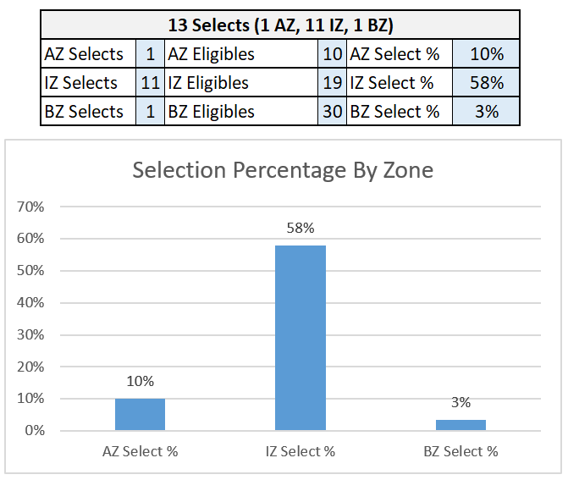
Selection Percentage By Zone

Slide 3
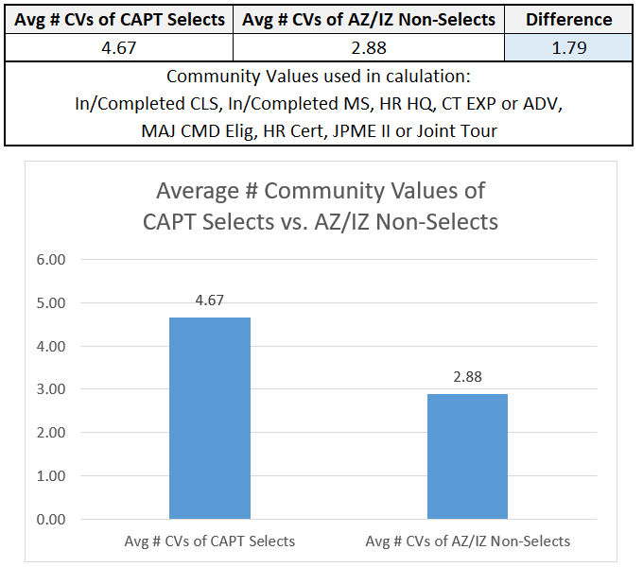
Average # Community Values Attained of CAPT Selects vs Non-Selects

Slide 4
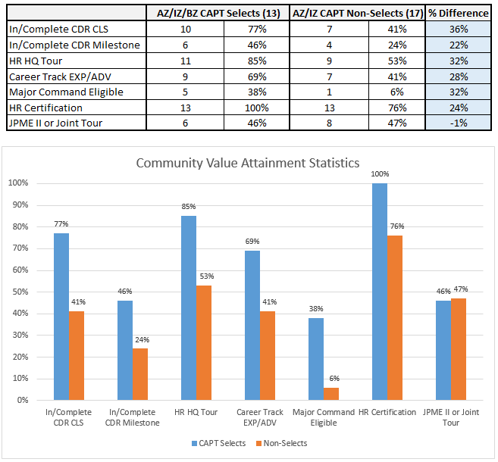
Community Value Attainment Statistics
Data pulled using EOM December 2023 information contained in Navy databases.

Slide 5
Key Observations
All community values showed a significant difference in average attainment between selects and non-selects with the exception of JQO progression.
100% of selects had a current HR certification
Three selects had two key (Command, Leadership, or Milestone) CDR tours

