Slide 1
FY-25 HR 1200 CDR Selectees
Selects (25 total)
CDR (Sel) Alejandro Calvo
CDR (Sel) America Estevezguerrero
CDR (Sel) Amy Younger
CDR (Sel) Ashley Morrison
CDR (Sel) David Mundell
CDR (Sel) Donald Todorowski Jr.
CDR (Sel) Emmanuel Mamaril
CDR (Sel) Erin Thorpe
CDR (Sel) Heather Hutchison
CDR (Sel) Jacqueline Kyzer *
CDR (Sel) James Barfoot
CDR (Sel) John Allen
CDR (Sel) Jonathan Tibbetts
CDR (Sel) Katherine Martinezalvarez
CDR (Sel) Kelly Agha
CDR (Sel) Luke Freeman
CDR (Sel) Mark Wilson
CDR (Sel) Matthew Reising
CDR (Sel) Nicholas Allen
CDR (Sel) Nicole Evans **
CDR (Sel) Robert Terranova Jr.
CDR (Sel) Ryan Decker
CDR (Sel) Samuel Chen
CDR (Sel) Simon Davies
CDR (Sel) Veronica Baker
* Merit Reorder selection
** Below Zone selection
Note: The most important distinction for promotion selection is sustained superior performance in all assigned duties. HR Community values are listed in order of significance for each paygrade. Superior performance is demonstrated in a member’s trait average relative to their summary group average and reporting senior cumulative average with clear “soft” and “hard” breakouts and promotion recommendations during a tour. While the below statistics are useful, it is an officer’s entire record (Community Values + FITREPs) compared to their peers that matters. Often an Officer can help improve their record by adding additional community values to their record, but it isn't the singular answer. The Officer who has a combination of strong performance in demanding positions and who seeks out and achieves the items in the HR community values will have the best opportunity for promotion.

Slide 2
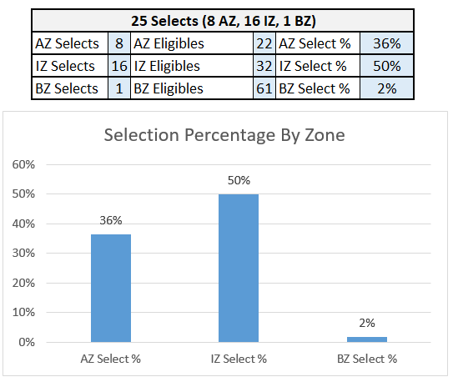
Selection Percentage By Zone

Slide 3
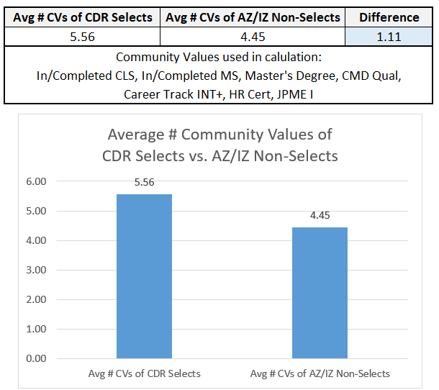
Average # Community Values Attained of CDR Selects vs Non-Selects

Slide 4
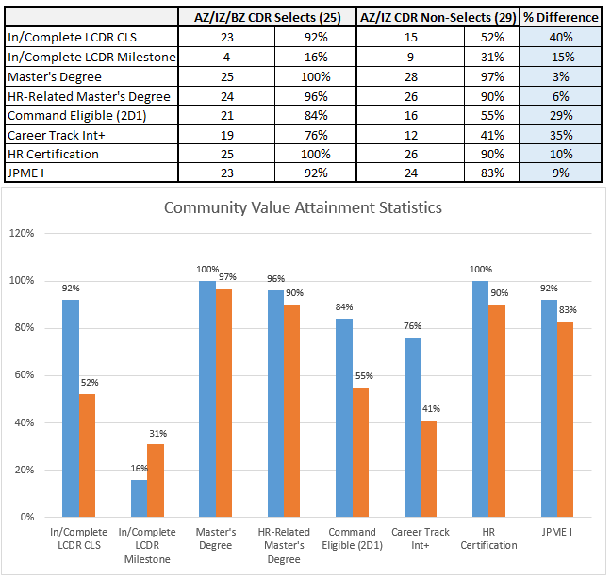
Community Value Attainment Statistics
Data pulled using EOM January 2024 information contained in Navy databases.

Slide 5
Key Observations
Three significant statistical differences between selects and non-selects
  CLS tour: +40% for selects
  Career track competency of intermediate or higher: +35% for selects
  Command eligible (2D1): +29% for selects
All selects had a current HR certification
All selects declared a career track vs six non-selects without a declared career track
Two selects had two key (CLS or MS) LCDR tours

