Slide 1
FY-25 HR 1200 LCDR Selects
Selects (36 total)
LCDR(Sel) Ashley Corbett
LCDR(Sel) Blayre Desormo
LCDR(Sel) Bradley Albritton
LCDR(Sel) Carrington Lewis *
LCDR(Sel) Christopher Chiles
LCDR(Sel) Crystal Watkins
LCDR(Sel) Diamond Latham
LCDR(Sel) Emily Guinn
LCDR(Sel) Emily Marshall *
LCDR(Sel) Eric Lehmann
LCDR(Sel) Erik Vargas
LCDR(Sel) Felicia Goodell
LCDR(Sel) Francesca Lawson
LCDR(Sel) Harvey Mercado
LCDR(Sel) James Wilker
LCDR(Sel) Jeffrey Haller
LCDR(Sel) Jeremy Berg
LCDR(Sel) Jonathan Garing
LCDR(Sel) Jude Akpunku ***
LCDR(Sel) Kathleen See
LCDR(Sel) Loren Bolena
LCDR(Sel) Mariano Veloria
LCDR(Sel) Meagan Barron
LCDR(Sel) Megan Johnson
LCDR(Sel) Meghan Hoover
LCDR(Sel) Olivia Davis
LCDR(Sel) Paige Mita
LCDR(Sel) Romeo Aka
LCDR(Sel) Shanell Dawkins
LCDR(Sel) Shannon Willings *
LCDR(Sel) Stanley Linton V *
LCDR(Sel) Thong John Nguyen
LCDR(Sel) Vashthai Wallace **
LCDR(Sel) Winter Wellman
LCDR(Sel) Yixuan Liu **
* Merit Reorder selection
** Denotes Below Zone selection
*** Merit Reorder & Below Zone selection
Note: The most important distinction for promotion selection is sustained superior performance in all assigned duties. HR Community values are listed in order of significance for each paygrade. Superior performance is demonstrated in a member’s trait average relative to their summary group average and reporting senior cumulative average with clear “soft” and “hard” breakouts and promotion recommendations during a tour. While the below statistics are useful, it is an officer’s entire record (Community Values + FITREPs) compared to their peers that matters. Often an Officer can help improve their record by adding additional community values to their record, but it isn't the singular answer. The Officer who has a combination of strong performance in demanding positions and who seeks out and achieves the items in the HR community values will have the best opportunity for promotion.

Slide 2
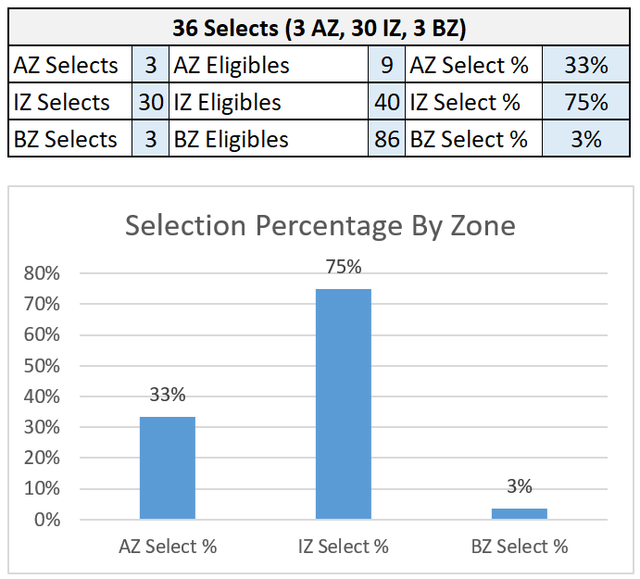
Selection Percentage By Zone

Slide 3
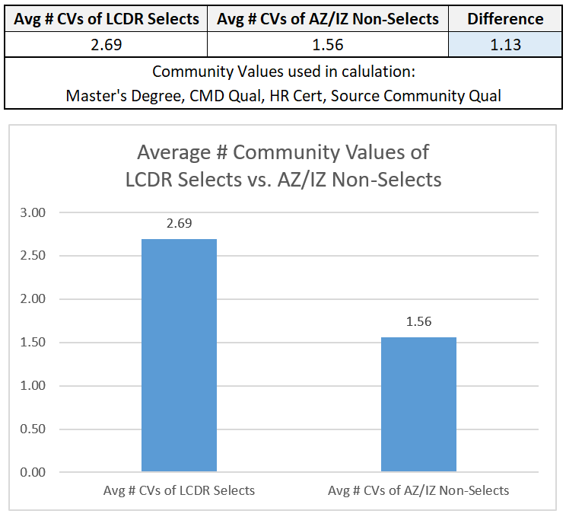
Average # Community Values Attained of LCDR Selects vs Non-Selects

Slide 4
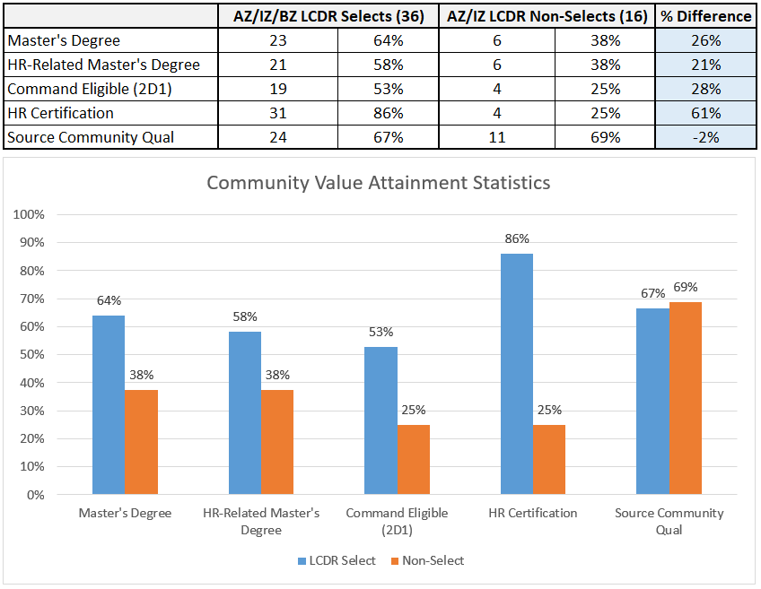
Community Value Attainment Statistics
Data pulled using EOM April 2024 information contained in Navy databases.

Slide 5
Key Observations
Three significant statistical differences between selects and non-selects
  HR Certification: +61% for selects
  Command Eligible (2D1): +28% for selects
  Master’s Degree: +26% for selects
Four of five the merit reorders selections completed overseas assignments
Note: Used completion of a master’s degree in the community value statistics, however, progress towards a master’s degree meets the community value requirement.

