Slide 1

FY-28 Reserve Limited Duty Officer (LDO)/Chief Warrant Officer (CWO) Commissioning Program Recruiting Community PRELIM Brief Goal: 105 NRCs
United States Navy Reserve
Last updated: 07 MAR 2026

Slide 2
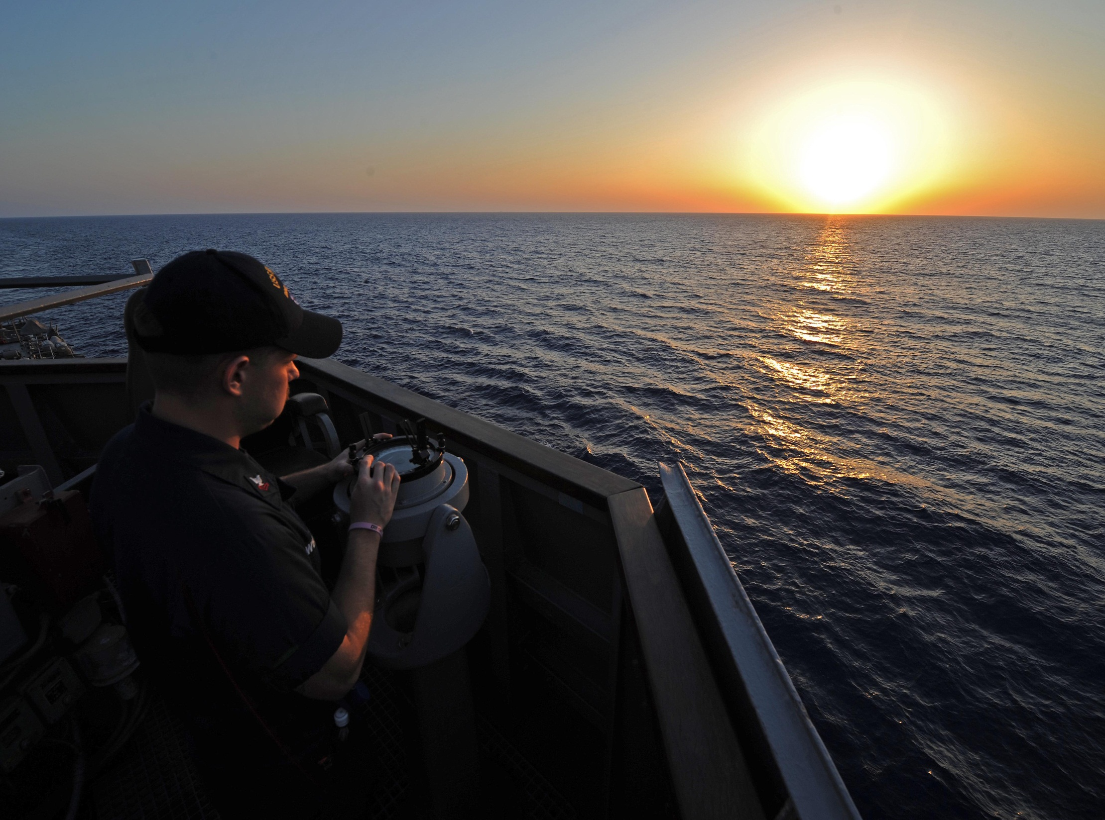

Navigate your way…
…to the bright side!

Slide 3
LDOs and CWOs Mission
The Limited Duty Officer and Chief Warrant Officer Community support the war-fighting capability and readiness of Naval Forces through leadership, technical proficiency, and experience.
They are the primary manpower source for technically specific billets not best suited for traditional Unrestricted Line, Restricted Line or Staff Corps career path Officers. Using critical enlisted experience, we are committed to the continuous leadership, improvement, training and mentoring of Sailors.

Slide 4
Why?
Increased leadership opportunities
Increased responsibilities, including taking Command
Mob, ADOS, ADT and training opportunities
Effect real change
Prestige of being a Naval Officer
Leadership, management, training, and experience can apply to your civilian career
Increase in drill and retirement pay
‘All Fully Qualified’ will promote up to CWO3 and O-3E (without board or testing)

Slide 5
Who? LDO and CWO Eligibility Requirements
SELRES in a drill status for 1-year (TARs are only eligible for AC LDO/CWO ISPB)
U.S. citizen
No age restrictions
High school graduate or GED (College degree not required)
Meet physical fitness standards
No court martial, civilian conviction (other than minor offenses), or NJP within 3 years of the year applying.
Must be recommended by commanding officer
RC LDO/CWO webpage has specific requirements: https://www.mynavyhr.navy.mil/Career-Management/Community-Management/Officer/Reserve-OCM/Selected-Reservists/RC-LDO-CWO/
LDO | CWO
Window: TIS 8 – 14 years prior to October 1st of FY for which applying (certain TIS Waivers are considered) | Window: TIS 14 - 20 years prior to Oct 1st of FY for which applying (certain TIS Waivers are considered)
Open to PO1 through MCPO | Open to CPO through MCPO
WAIVERS OF TIS REQUIREMENTS ARE ADDRESSED ON SLIDE 8,
EXCEPTIONS TO POLICY (ETP) ARE NO LONGER ACCEPTED

Slide 6
PO1’s Additional Requirements
PO1s must serve at least 1 year time in rate prior to October 1st of the FY the LDO application is submitted
Example from the LDO/CWO page
“YN2 Smith is a selectee for YN1 from the March 2016 advancement cycle. Her TIR for E6 is 1 July 2016. She will complete 1 year as an E6 on 1 July 2017 and is eligible to participate in the January 2017 CPO advancement cycle for LDO purposes, if she is submitting an LDO application for 1 October 2017”.
Submit a Special Request Chit to take the CPO exam for LDO purposes early enough to order an exam.
Must pass E-7 exam and be board eligible in same calendar year of applying for LDO.
Reference: LDO Eligibility: LDOEligibility_NOV22.pdf

Slide 7
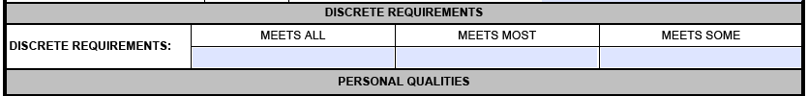
FY27 Reserve Discrete Requirements
To ensure technical qualification, candidates are strongly encouraged to review the specific Discrete Requirements for their intended designator. These requirements outline the professional experience and leadership milestones the board uses to gauge candidate readiness.
Objective is to select applicants that are technically, operationally and administratively proven while demonstrating Sustained Superior Performance (i.e. Consistent Hard/Soft evaluation breakouts; above RSCA etc.) in increased levels of technical management within their specialty.
If a candidate does not meet all the criteria for being fully qualified, they are considered to have met some of the discrete requirements.
If a fully qualified candidate does not meet all the criteria to be among the best qualified, they are considered to have met most of the discrete requirements.
If a candidate meets all the criteria for being among the best qualified, they are considered to have met all the discrete requirements

Slide 8
Time In Service (TIS) Eligibility (Total Qualifying Service (TQS) - NOT to include IRR Service)
TIS Eligibility is calculated as of 1 October for the fiscal year you are applying
(ie...if applying for FY28, then 1 October 2027 is the year for which you are applying)
The Annual Statement of Service History (ASOSH) serves as the official record for TQS and must be included as an enclosure in the applicant’s package.
The primary source to review point capture is to log into Navy Standard Integrated Personnel System (NSIPS) to view the Naval Enlisted/Officer Participation System (NEOPS).”
TIS Waivers will only be considered in accordance with annual NAVADMIN
FY28 Time in Service Waiver Windows - LDO: 14.1 - 20.0 TQS - CWO2 (E7/8): 12.0 - 13.9, 20.1 - 22.0 TQS - CWO3 (E9): 20.1 - 25.0 TQS (No further exceptions will be entertained)
Reserve Time in Service (TIS) Waiver Template & Guide to properly calculate TQS are located on the RC LDO/CWO page
All waiver requests must also be addressed/endorsed by their Commanding Officer in the endorsement portion of the application (no longer a separate submission process)

Slide 9
Limited Duty Officer (LDO)
Leadership and Management Positions
ENS through CAPT level that require technical background and skills not attainable through normal development within other officer designators
Technical Managers
LDOs are Naval Line or Staff Corps Officers that progressively advance within broad technical fields related to their former enlisted ratings
LDOs serve as, but are not limited to, DIVOs, DEPT Heads, OICs, XOs and COs
The Rank of CAPT is the pinnacle goal!

Slide 10
Where? FY27 LDO “OPEN” Career Fields and Selections…
Community | Specialty | Designator | Quota | Selected
Submarine | Eng/Repair (open to SURF ratings) | 6235 | 2 | 2
Submarine | Electronics (open to SURF ratings) | 6285 | 0 | 0
Submarine | Communications | 6295 | 0 | 0
Aviation | Maintenance | 6335 | 2 | 2
Services | Administration | 6415 | 2 | 2
Expeditionary | Security | 6495 | 8 | 8
Expeditionary | Civil Engineer | 6535 | 0 | 0
Total |  |  | 14 | 14
FY28 Open Designators Released via NAVADMIN XX/26
Note: Eligible Sailors are encouraged to apply for the designators for which they are most qualified, regardless of current rating. Civilian skill will be considered but must be documented.

Slide 11
FY28 LDO Open Designators
Released via NAVADMIN XX/26
Pending Final FY28 Officer Programmed Authorization (OPA) (Billet Authorizations)
6235 – Submarine Engineering/Repair (open to surface ratings) 6265 – Submarine Ordnance
6285 – Submarine Electrician
6295 – Submarine Communications
6335 – Aviation Maintenance
6415 – Administration
6495 – Security
Note 1: Eligible Sailors are encouraged to apply for the designators for which they are most qualified, regardless of current rating. Civilian Skills are considered but must be documented.
Note 2: As a result of reduced Staff LDO OPA, applications will not be accepted for designator 6535 – Civil Engineer .

Slide 12
Chief Warrant Officer (CWO)
Subject Matter Experts
CWOs are Naval Officers that possess extensive experience and knowledge to direct the most difficult operations within a given specialty. They also serve as strategic advisors to senior officers throughout the Navy
Although intended primarily as technical experts, CWOs can also serve as DIVOs, DEPT Heads or OICs
Chiefs, Senior Chiefs, and “Frocked” Master Chiefs will commission to CWO2
Master Chiefs will commission to CWO3
CWO5s can stay in the Navy up to 33 years

Slide 13
Where? FY-27 CWO “OPEN” Career Fields and Selections…
Community | Specialty | Designator | Quota | Selected
Surface | Deck | 7118 | 7 | 5
Surface | Operations | 7128 | 2 | 2
Surface | Engineering | 7138 | 6 | 6
Surface | Special Warfare | 7158 | 1 | 1
Surface | SW Combatant Craft | 7178 | 1 | 1
Surface | Electronics | 7188 | 4 | 4
Information Warfare | Cryptologic Warfare | 7818 | 1 | 1
Information Warfare | Info Systems | 7828 | 1 | 1
Information Warfare | Intelligence | 7838 | 2 | 2
Total |  |  | 25 | 23
FY28 Open Designators Released via NAVADMIN XX/26
Note: Eligible Sailors are encouraged to apply for the designators for which they are most qualified, regardless of current rating. Civilian skill will be considered but must be documented.

Slide 14
FY28 CWO Open Designators
Released via NAVADMIN XX/26
Pending Final FY28 Officer Programmed Authorization (OPA) (Billet Authorizations)
7118 - Deck (Surface)
7128 - Operations (Surface)
7138 - Engineering (Surface)
7158 - Special Warfare Tech (Expeditionary)
7178 - Special Warfare Combat Craft Crewman (Expeditionary)
7188 - Electronics Tech (Surface)
7818 - Cryptologic Warfare (Information Warfare)
7828 - Information Systems Tech (Information Warfare)
7838 - Intelligence Tech (Information Warfare)
Note: Eligible Sailors are encouraged to apply for the designators for which they are most qualified, regardless of current rating. Civilian Skills are considered but must be documented.

Slide 15
Who? Common Selection Characteristics…
Sustained Superior Performers!
Meet the Community’s Discrete Requirements
Consistent break-outs in evaluations (Goal: always EP)
Key leadership (Leading Sailors) and technical positions
Equivalent civilian experience and expertise
Warfare qualified (where possible)
Navy Enlisted Classification (NEC)
Challenging and diversified assignments (no homesteading)
ADT, Mob, and ADOS
Culture of Fitness, Volunteer (MOVSM), Collateral Duties
Instructor duty
Continued education, personal and professional development

Slide 16
When?
Step One Feb Exam | Designate a LDO/CWO Mentor E6 submitted special request chit to take E7 exam for LDO purposes. Pass exam and are E7 board eligible.
30 May | Draft CO’s endorsement and route to your CO
Jun/Jul | NAVADMIN RC LDO/CWO Announcement (read)
01 Jul | Interviewer’s Appraisal Board completed, appraisal sheets delivered to CO
01 Aug | Completed package with CO’s endorsement submitted to mentor for review
01 Oct | Package submission deadline (received by) *
15 Dec | Addendums Deadline (i.e. any eval signed after 1 Oct)
TBA Jan | Selection Board convenes
Feb/Mar | Results announced by NAVADMIN
* Although a late submission may be accepted by MNCC, it will not be presented to the board.
(This represents the optimum timeline for a smooth application process)

Slide 17
How?
Application References in Priority Order
Discreet Requirements
RC LDO/CWO Procurement NAVADMIN XX/26
OPNAVINST 1120.12A (Appointment of LDO and CWO in the Navy Reserve) **ALL CANDIDATES SHALL READ IN ITS ENTIRETY** https://go.usa.gov/xsp6f
Reserve LDO/CWO OCM webpage: https://go.usa.gov/xuCS8 (case sensitive)
Administrative In-Service LDO/CWO Procurement Board Webpage: https://go.usa.gov/xuCSW (case sensitive)
LDO CWO Community Facebook Page

Slide 18
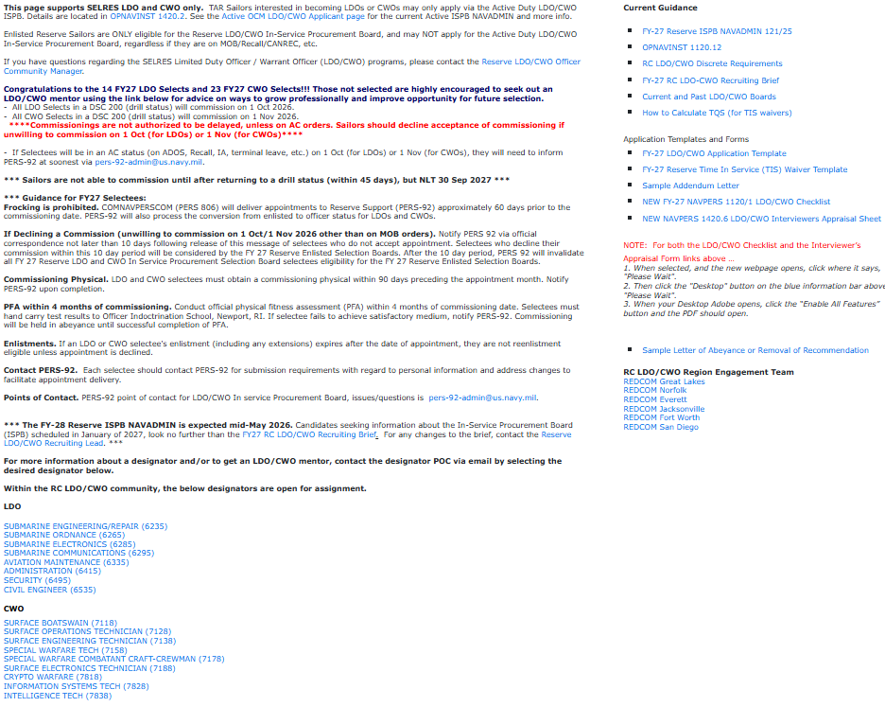
https://www.mynavyhr.navy.mil/Career-Management/Community-Management/Officer/Reserve-OCM/Selected-Reservists/RC-LDO-CWO/
Remember to seek a mentor! This has a lot of information, but your mentor will have more!

Slide 19
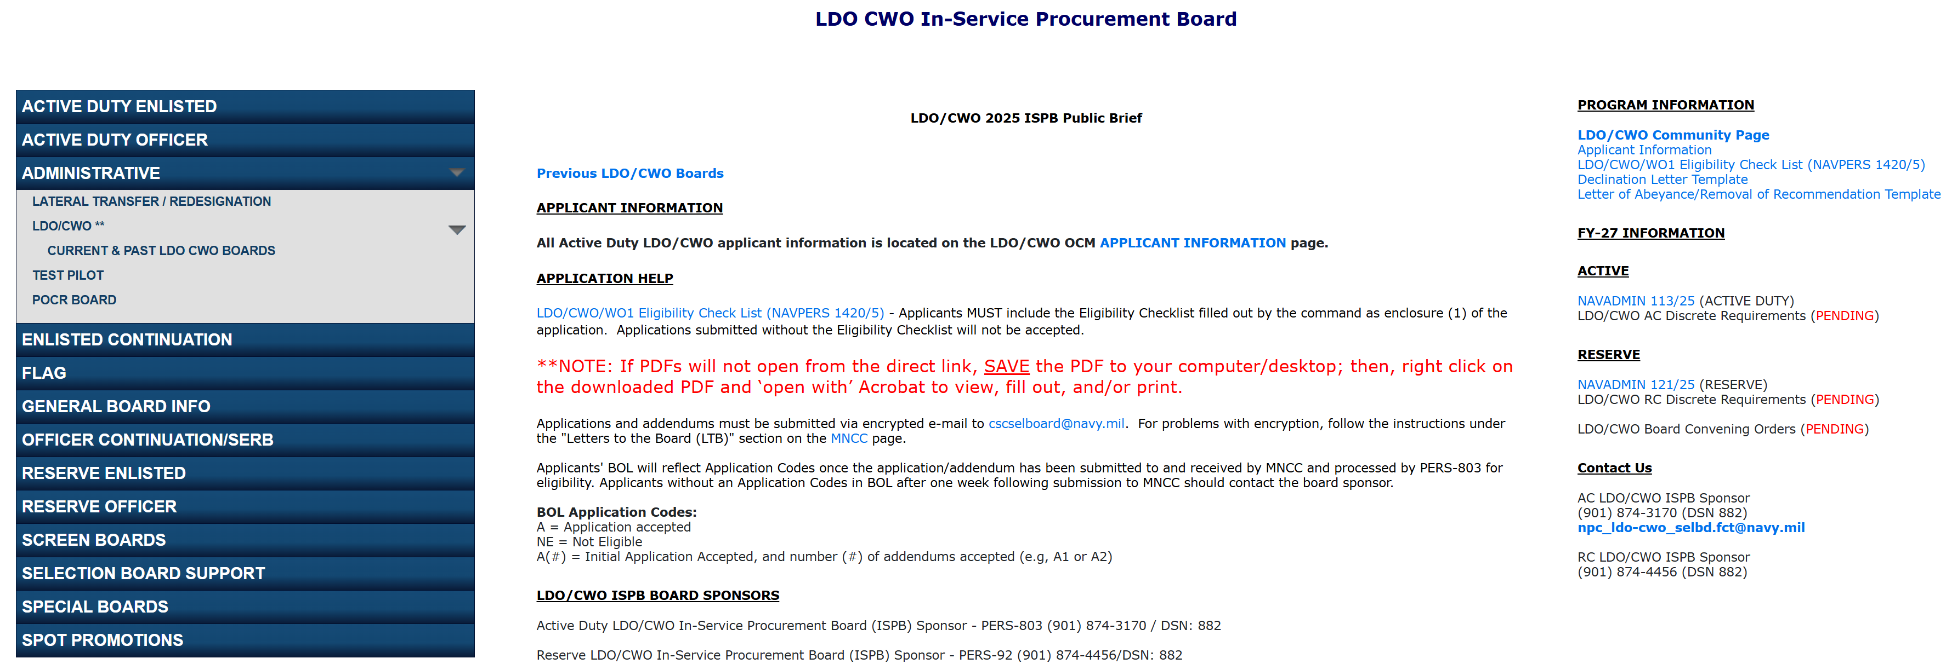
https://www.mynavyhr.navy.mil/Career-Management/Boards/Administrative/LDO-CWO/
Remember to seek a mentor! This has a lot of information, but your mentor will have more!

Slide 20
The Application
Officer Recruiters are not involved
You are responsible for your portion of the application, but not your CO’s endorsement (though it is prudent to provide a draft to your CO)
Seek out a Community Mentor (see slide 32) who will review your record, application, and provide designator specific guidance
Check your ASOSH, Official Military Personnel File (OMPF) and ESR/PSR in BUPERS Online (BOL). Look for missing/misfiled evaluations, qualifications, awards, etc. Make corrections ASAP. Any evaluation gaps must be explained in your application.
4 Critical Elements: Interview Appraisal Boards, CO’s Endorsement, Personal Statement, and ASOSH.

Slide 21
Interview Appraisal Board Requirements
Must be constructed of only (3) Reserve LDO/CWO officers.
The senior member of the panel must be….
→LDO Applicants: LCDR or above in the community for which the applicant is applying (i.e. 6415 LCDR or above must chair the board for an applicant who is applying for the 6415 designator).
→CWO Applicants: CWO4 or above in the community for which the applicant is applying (i.e. 7118 CWO4 or above must chair the board for an applicant who is applying for the 7118 designator).
If applying for two distinct LDO communities, the panel of (3) interviewers must contain two LCDRs or above from each community for which the applicant is applying (i.e. 6415 LCDR or above and a 6495 LCDR or above for an applicant who is applying for 6415 and 6495).
The names of the approved appraisal board members MUST be included in the CO/OIC endorsement and on each appraisal form.
Minimum grade for board members are LT or CWO3. CWO3 panel members MUST have at least 3 years time-in-grade.
Appraisal board members must meet paygrade (not in a select status) eligibility at the time of interview.

Slide 22
Interview Appraisal Board Preparation
Applicant preparation for appraisal boards is key!
Review your application.
Review discrete requirements for the designator(s) you are applying for.
Fully qualified vs Best and fully qualified
Training expectations
Job/billet expectations
Review of TQS eligibility via ASOSH and TQS calculation.
Having well thought out answers on technical expertise, leadership, and knowledge of the designator for which the candidate is applying, to include future career path if selected.
Being well versed in program requirements, policy and commissioning expectations.

Slide 23
Interview Appraisal Boards (cont.)
The LDO/CWO Interviewers Appraisal Sheet (NAVPERS 1420/6) is located at https://www.mynavyhr.navy.mil/References/Forms/NAVPERS/
Interviewers Appraisal Sheet (NAVCRUIT 1131/5) will not be accepted.
Applicants Preparing for the IAB!
Be prepared to answer varied questions about what it means to be an officer and an LDO/CWO (Mustang), assignments you can expect, goals, contributions, and requirements for your designator.
Assemble a small package of only pertinent documents for interviewers to review prior to board.
Recommended: Draft application, last 5 evals, awards, ESR/PSR from BOL, and ASOSH with TQS calculation.
Remember to remove all PII.
FY-28 Reserve ISPB NAVADMIN XX/26 is located at https://www.mynavyhr.navy.mil/References/Messages/NAVADMIN-2026/

Slide 24
CO’s Endorsement
CO’s Endorsement - provide a well written draft to your CO
If you’ve ever felt like you could fill more than just the space allotted in your eval, now is your chance!
CO can highlight your victories in precept language and using the discrete requirements
CO can explain and address past negatives, if needed
CO must receive IAB Appraisal sheets prior to finalizing their recommendation
CO’s endorsement MUST include the following statement and include how the applicant supports Navy Ethos
“Applicant meets all requirements outlined in OPNAVINST 1420.1B, OPNAVINST 1120.12A, and the physical fitness standards of OPNAVINST 6110.1K.” Must also clearly state the CO/OIC’s name and rank.
CO must address all waivers in their endorsement of the candidate

Slide 25
Additional Comments (Formerly Personal Statement)
Provide amplifying information the applicant feels is important and is not addressed elsewhere in the application
Provide amplifying information regarding breaks in service
Provide clarity to situations in your record that may be confusing
Address waivers here (submitted separately)
Address negative issues in the OMPF, for example
PFA Failures
DUIs
Captain’s Mast
Eval issues

Slide 26
Selection and Commissioning
The board meets for 2-3 weeks in January; results are usually released late February or early March
Work with PER-92 for scrolling and acceptance
Commissioned 1 Oct 27 or 1 Nov 27 (FY28)
After commissioning, be prepared to be assigned to a new unit. You may be cross-assigned or be required to travel to drill assignment.
All RC LDO/CWOs will attend LDO/CWO Academy course at Newport, RI for first AT (mandatory) – plan for Jan or Feb 2028 (more to follow)
All RC LDO/CWOs are highly encouraged to attend the Annual RC LDO/CWO Workshop – plan for April 2028 (more to follow)

Slide 27
Commissioning Requirements
Commissioned 1 Oct 27 or 1 Nov 27 next fiscal year (FY-28)
****Commissionings are not authorized to be delayed, unless on AC orders. Sailors should decline acceptance of commissioning if unwilling to commission on 1 Oct (for LDOs) or 1 Nov (for CWOs)****
If Selectee will be in an AC status (on ADOS, Recall, IA, terminal leave, etc.) on 1 Oct (for LDOs) or 1 Nov (for CWOs), are expected to commission within 45 days of returning to a drill status, and they will need to inform PERS-92.
Frocking is prohibited
Commissioning physicals must be within 90 days proceeding commissioning date.
Not eligible to reenlist past appointment date unless commission is declined.

Slide 28
Annual Retirement Pay
3600 Retirement Points
O5 = $36,098
CWO4 = $27,686
Senior Chief = $20,986
7200 Retirement Points
O5 = $72,196
CWO4 = $55,373
Senior Chief = $41,972
https://www.dfas.mil/MilitaryMembers/payentitlements/Pay-Tables/
30 Yrs
Notes:
Based on 1 JAN 2016 Pay charts
Annual retirement estimates based on 20 years, 3000 points, each high 3 is the pay at 20 years
Numbers from NSIPS/CIMS Retirement Calculator
Drill weekend pay from DoD Fiscal Year 2017 Green Book

Slide 29
Drill Weekend Pay
4 IDT Drill Periods
O5 = $1,604
CWO4 = $1,230
Senior Chief = $932
https://www.dfas.mil/MilitaryMembers/payentitlements/Pay-Tables/
Notes:
Based on 1 JAN 2016 Pay charts
Annual retirement estimates based on 20 years, 3000 points, each high 3 is the pay at 20 years
Numbers from NSIPS/CIMS Retirement Calculator
Drill weekend pay from DoD Fiscal Year 2017 Green Book

Slide 30
Engagement Team Overall Process
Candidates Begin Research
Candidates start building their package and communicated with unit CO
Community Briefs begin
LDO/CWO recruiting briefs at NRCs and/or online
Interviews begin
Candidates coord. w/ POCs and schedule interviews with LDO/CWO and other officers as necessary
Winter | Spring | Summer | Fall
Package due
Oct 1st
Direct candidates to application references
Offer guidance based on experience in the application process
Connect candidates with a designator POC (see next slide)

Slide 31
FY27 Mustang Selects
Limited Duty Officers (14)
Bennett, Joseph (6235)
Kransler, Benjamin (6235)
Cardenas, Jessica (6335)
Carroll, Bryan (6335)
Ciullo, Brandon (6415)
Verdin, Luis (6415)
Adams, Ryan (6495)
Baessell, Jared (6495)
Costello, Nicholas (6495)
Farkas, Michael (6495)
Gutcher, Robert (6495)
Puckett, Mark (6495)
Quevedo, Guillermo (6495)
Weart, Ruth (6495)
Chief Warrant Officers (23) .
Beesley, Jonathan (7118)
Corro, Kyle (7118)
Malakas, Karl (7118)
Oblima, Leolito (7118)
Wells, Javan (7118)
Guerrero, Robin (7128)
Salazar, Martin (7128)
Blair, Jondavid (7138)
Nicolas, Kristine (7138)
Perry, Ian (7138)
Pirkle, Matthew (7138)
Rangel, Roberto (7138)
Toala, Kleber (7138)
Bolwahnn, John (7158)
Meece Kyle (7178)
Bauer, Gary (7188)
Bird, Jason (7188)
Chen, Baron (7188)
Cortez, Robert (7188)
Mckean, James (7818)
Jones, Jayvon (7828)
Lam, Anne (7838)
Munoz, Jose (7838)

Slide 32

Questions?

