Slide 1
Command Overview
2019
CAPT Brent E. Cower
Commanding Officer
CDR Robert Carr
Executive Officer
Mr. Doyle Avant
Technical Director

Slide 2
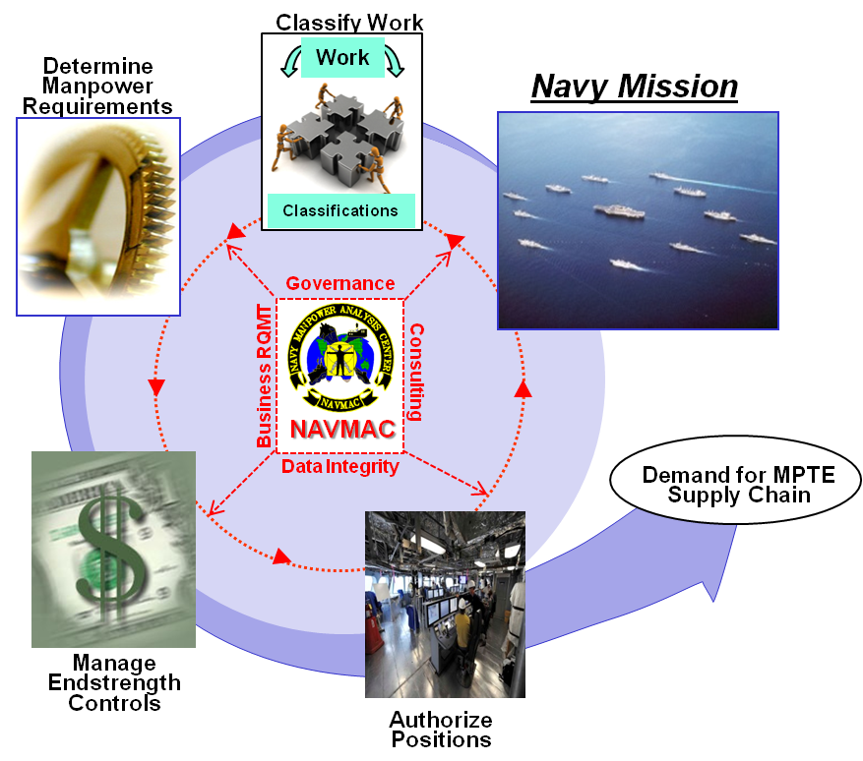
Navy Manpower Analysis Center Defining the Manpower Demand
…we define, translate, and classify the Navy’s work into a workforce structure and position demand signal to sustain a combat ready force…
Vision
…we lead the Navy in manpower solutions…
Adding value by defining Navy’s work and creating accurate manpower demand signals for FIT
2

Slide 3
Navy Manpower Analysis Center At a Glance
Navy’s Occupational Classification Systems
Fleet Manpower Requirements Determination
Navy’s Manpower Management Program Administration
Navy’s Manpower Information System Business RQMT
Mission
Areas
Primary Outcomes
Navy Military Manpower RQMTs
Effective Job & Qualifications Management
Military human resources structures (e.g., Rating, NEC, NEBC, Designator, AQD, NOBC, SUBSPEC)
Valid Ship/Squadron Manpower Requirements
209K RQMTs - 43% of Navy’s Military RQMTs
Effective Manpower Management Processes & Policies
Authoritative Activity Manpower Documents (AMDs) for 6,140+ Units & 7471 Positions
Effective Information System Performance of Manpower Processes
Activity Manpower Management (TFMMS) and FMRD support information system performance (40+ Outgoing Interfaces)
$16B
(fully funded)
Civil Service &
Contract
267,666
As of end Jan 2019
3

Slide 4
NAVMAC Core Business Processes
Define Navy’s Manpower Demand
Conduct Manpower Studies
(Manpower Documents (SMD, SQMD, FMD), Staffing Standards, Occupational Standards, Models)
Outcome
Proper Position Demand Signal
Perform Manpower Assessments
(PSMD, NTSP, ROC/POE, Manpower Change Request, Rating Mergers, SCRs, RISs, “What ifs”)
Manage Manpower Programs & Projects
(Manpower Instructions/Manuals, NOOCS & NEOCS, Configuration Control/Functional Review Boards)
Navy
Occupational
Classification Systems
Fleet
Manpower
Requirements Determination
Navy
Manpower Mgmt Program Administration
Navy Manpower Information
System
Business RQMT
Code 10
Codes 30 & 40
Code 20
FMO
4

Slide 5
Organizational Alignment Complex External Relationships
Echelon
1
DCNO (Manpower, Personnel, Training & Education)
(N1)
N1G Chief of Chaplains Support
N1N Nuclear Propulsion
N1P Personnel Liaison and Suppt Ofc
N1S Chief of Staff/Secretariat
N1X Special Projects
N1Z Strategic Affairs Office
N1B4 Analysis Modeling Simulation
N1B6 Information Management / MPTE CIO
Assistant DCNO (Manpower, Personnel, Training & Education)
(N1B)
MPTE Resource Management Div
(N10)
Total Force MTE Requirements Div
(N12)
MPT&E
Policy Div
(N13)
21st Century
Sailor Office
(N17)
Echelon
2
Chief of Naval Personnel
(CNP)
OPCON
BUPERS Washington
Deputy Chief of Naval Personnel
(DCNP)
BUPERS Millington
NEOCS /
NOOCS
Budget
Civilian HR
Remote Locations
BSO 22
Echelon
3
Dual-hat
Civilian
HR
Navy Manpower Analysis Center (NAVMAC)
Commander
Navy Recruiting Command
Ech-3: BUPERSINST 5450.49C
Commander
Navy Personnel Command

Slide 6
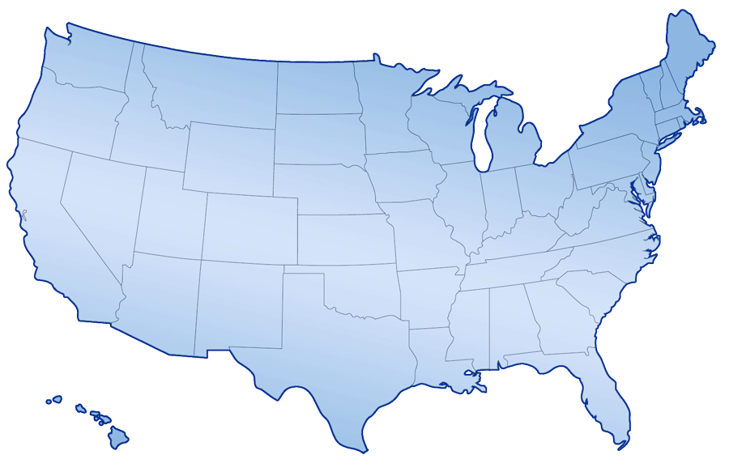
Organization & Workforce
Commanding Officer
CAPT Steven Milinkovich
Technical Director
Mr. Doyle Avant, GS-15
Executive Officer
CDR Shaletha Moran
Workforce Classifications
Code 10
LCDR Tim Shaffer
Manpower Programs
Code 20
Vacant, GS-14
Aviation Programs
Code 30
CDR Tim Ryan
Afloat Programs
Code 40
CDR Jenn Eaton
Administrative Support
LT Clarence Shelton
Functional Management Office
FMO
Mr. John Nickle, GS-13
Senior Analytical Staff
Manpower Analysis
Industrial Engineering
Organizational Psychology
Human Resources
Warfare Specialties
Integrated Team
14 Officers
51 Enlisted
44 Civil Service
0 Contractors
109 Total Workforce
Locations
Millington, TN
Orlando, FL
Plus-up to ~ 135
by end FY2020

Slide 7
NAVMAC Business Processes
Define Navy’s Manpower Demand
Conduct Manpower Studies
(Manpower Documents (SMD, SQMD, FMD), Staffing Standards, Occupational Standards, Models)
Outcome
Proper Position
And Human Resource
Demand Signal
Perform Manpower Assessments
(PSMD, NTSP, ROC/POE, Manpower Change Request, Rating Mergers, SCRs, RISs, “What ifs”)
Manage Manpower Programs & Projects
(Manpower Instructions/Manuals, NOOCS & NEOCS, Configuration Control/Functional Review Boards)
Navy
Occupational
Classification Systems
Fleet
Manpower
Requirements Determination
Navy
Manpower Mgmt Program Administration
Navy Manpower Information
System
Business RQMT
Code 10
Codes 30 & 40
Code 20
FMO
7

Slide 8
Defined & Approved Products Aligned to Command’s MFT
Mission Area | Function | Product/Service
M1 Navy’s Occupational Classification Systems (NOCS) | F1 Administer the Officer and Enlisted Occupational Classification Structure | P01 Navy Enlisted Occupational Standard (NEOS) Documents
 |  | P02 NEOCS / NOOCS Board Administration
 |  | P03 NOCS Governance Reviews (e.g., Instructions, Coding validation)
M2 Fleet Manpower Requirement Determination (FMRD) Program | F2 Develop and document manpower requirements for all fleet activities within the Navy | P04 Fleet Manpower Requirements Determination (FMRD) Documents
 |  | P05 FMRD Readiness Reviews (AMDs, MPTs)
 | F3 Provide manpower requirements determination support for Navy’s acquisition programs and initiatives | P06 Acquisition Manpower Documents (Supporting PSMD/PSQMD, MER)
 |  | P07 Special Tasking Manpower Documents
 |  | P08 Workload Document Reviews (e.g., NTSPs, ROC/POEs)
M3 Navy’s Manpower Management Program Administration | F4 Provide technical consulting services in all areas of manpower management to manpower managers, manpower Budget Submitting Offices (BSOs) and OPNAV sponsors | P09 Manpower Management (MM) Governance Reviews (e.g., Policy Documents, Policy Portal Topics, Conferences, SCRs, NOCS Requests, etc)
 |  | P10 Manpower Management Administration Special Tasking
 | F5 Provide direct support to CNO central authority to enforce policy or additional technical guidance needed to achieve objectives of total force manpower management | P12 AMD Position Data Compliance Reviews
 | F6 Provide direct support to Chief of Naval Operations (CNO) in managing the Navy Manpower Requirements Program | P13 Manpower Requirements Determination (MRD) Administration
M4 Navy’s Manpower Information System (IS) Business Requirement | F7 Provide functional management support for assigned manpower Automated Information Systems (AIS) | P14 Manpower Information System Configuration Control Boards (CCB) Administration
 |  | P15 Position Management Functional Review Board (PM-FRB) Administration
 |  | P16 Manpower Business Requirement (BURT) Documents
 |  | P17 Manpower Information System User Accounts
 |  | P18 Functional Manager Governance Reviews (e.g., DADMS, Audits)
 |  | P19 Manpower Information System Data Configuration

Slide 9
NAVMAC Navy-wide Customers Who gets our products (P01-20)
ECH I
OPNAV N1
N12
N13
N1B6
P02 NOOCS-NEOCS Boards /CCR
P03 NOCS Documents
P15 PM- FRB/RIS
P16 BURT Docs
ECH II
CNP/DCNP
BUPERS
SYSCOMs
Acquisition
Programs
SPAWAR
IT Service
Provider
NETC
BSOs
P13 MRD Program Administration
Supply
Chain
CIO
N7
Enterprises
USFF
TYCOMs
P14 Manpower CCB/SCR
P17 SAAR
P19 Data Configuration
P18 FM Reviews
ECH III
P06 Acquisition Docs
P08 Workload Reviews
P20 Model Reviews
NAVMAC
NETPDTC
(Rating Exams)
Activities
P04 Fleet MRD Docs
P05 Afloat Readiness Reviews
P07 Special MRD Docs
Learning Centers
(Curriculum
Development)
P09 Manpower MGMT Governance Reviews
P10 Manpower MGMT Special Tasking
P11 Shore Manpower Change Request
P12 AMD Compliance Reviews
P01 Occupational Standards
Authoritative Manpower Demand
Activity Manpower Documents (AMD)
Resource and Supply Chain Stakeholders
NAVMAC Products (P01-20)
Warfare/
Resource
Sponsor
Military Distribution
Community Mgmt
Mobilization Planning
Readiness Reporting
Training Managers
Manpower Managers

Slide 10
Manpower Management Process Where does NAVMAC fit
Suppliers
Occupational
Classification
Structure (Off/Enl/Civ)
Customers
Manpower Controls
Organizational
Structure
(Activities/UICs)
Fleet Manpower Requirement
Determination Program
Military Distribution
Manpower RQMT Determination Process
Shore Manpower Requirement
Determination Program
Budget Submitting Offices (BSOs)
Non-Navy Controlled (Joint)
Manpower Requirement
Determination Programs
Community Mgmt
Manpower Change Request (MCR) Process
Activity Manpower Documents (AMDs)
Officer / Enlisted
Civilian / Contractor
Requirements
Total Force Positions
Output
Valid
Demand
Signal
Input
Activity Mission / Workload
Individual Account (IA)
Manpower Requirement
Determination Program
Mobilization Planning
SYSCOMs
Manpower Managers Update
AMDs
&
Military
Controls
Billet Authorizations (BA)
& Programmed
Authorizations (PA)
Authorized Positions
Active / Reserve Military
& Civilian
Readiness Reporting
Input
Mission Priorities / Force Shaping
Manpower Authorization Process
Active / Reserve Military
Manpower Managers
Officer Programmed Authorizations / Enlisted Programmed Authorizations (OPA/EPA) Process
Military Programmed
E/S Controls
Manpower Managers
PPBES Process
Resource Controls
Civilian
PBIS Synchronize Process
PPBES
Managers
NAVMAC Business Functions
Notes:
This slide outlines the process that develops the demand signal -- from suppliers of the inputs, through processes/controls and change management, to the customers of the output (demand signal).
Suppliers
Changes in the Manpower demand signal are driven by various levels/suppliers at any given time to fill the needs of the Navy whether planned or emergent. Some of the primary inputs to MRD are Activity Mission and Workload, and to Authorizations are changes in priorities for Mission, Force Shaping, and Budgets.
Manpower RQMT Determination Process
The Navy’s Manpower Requirements Determination (MRD) program is divided into four categories.
Fleet Manpower Requirement Determination (FMRD) is performed by NAVMAC
Ship Manpower Document (SMD)
Squadron Manpower Document (SQMD)
Fleet Manpower Document (FMD)
Shore Manpower Requirement Determination is performed by the Budget Submitting Office (BSO)
Non-Navy Controlled (i.e., Joint) Manpower Requirements Determination is performed by the applicable Service
Individual Accounting (IA) / (i.e. Non-Force Structure) Manpower Requirement Determination are managed by OPNAV (N12)
Manpower Controls
The Manpower controls consist of both Workforce Classification and Organizational Structuring and will feed into various stages of the process.
The Workforce classification structure includes capturing and classifying the work and the classification of Jobs. This happens through the Navy Officer Occupational Classification System (NOOCS) and the Navy Enlisted Occupational Classification System (NEOCS) process.
The Organizational Structuring consists of new Unit Identification Codes (UIC), Mission realignments, Homeport changes, etc. An Activity Change Request is submitted to request changes to UIC information (UIC, Homeport, etc) on the Activity Manpower Document (AMD)
Both of these controls have an impact on the overall Manpower process.
Resource Controls
Programmed end Strength (E/S) controls feeds into various stages of the process through POM milestones, Budget cuts, Program cuts, also affecting the various stages of the Manpower process.
Manpower Change Request (MCR) process
In order to apply manpower changes to reflect the change to Navy’s needs, Manpower BSO’s and other major customers submit a Manpower Change Request for OPNAV N12 approval to change the Manpower skill attributes (Paygrade, Designator, NEC, etc.) or Programmed E/S on the Activity Manpower Document (AMD) . The changes reflect operation realities, account for work changes, new equipment, etc. and will reflect on the activities revised AMD.
Activity Manpower Document (AMDs) (Navy’s Authoritative Source for Manpower)
Through the Requirements Determination process NAVMAC and BSO’s create the initial manpower specifications for the Activity Manpower Document (AMD) that will display the Manpower Requirements both in quality and quantity. BSO’s prioritize work and manpower requirements and apply military end strength controls to manpower requirements to create the manpower authorizations that will ultimately send the signal to the personnel systems to get the right person to the job.
Output
The single output signal that the process provides is used by various customers. From the distribution/detailers to get the sailors where they need to be to Community Management and future planning, to Readiness Reporting keeping the levels where they need to be real-time, and to the Program Mangers and PPBES Managers that keep the funding levels where they need to be.

Slide 11
Navy Manpower Management Improvement Strategy & Initiatives
Three-pronged Strategy
Major NAVMAC Initiatives
Modernize Business Capabilities
Increase availability, access, accuracy & agility
Modernize Navy Manpower Information Support
New Activity Manpower Management (AMM) capabilities
Total Force Manpower Management System (TFMMS) 2.0
Aligning to MPTE 55-1 I system concept
Transforming FMRD Analytics capabilities
Now: Navy Manpower Requirements System (NMRS)
Future: User-defined models within MPTE Analytics as a Service (AaaS)
Improve Fleet Manpower Requirements Determination (FMRD) Model
Integrated at-sea and inport manpower requirements determination (MRD)
Updating Industrial Engineering allowances, factors, standards and modifiers (AFS&M)
Afloat Navy Availability Factor (NAF)
Personal, Fatigue and Delay (PF&D A) Allowance
Facilities Maintenance Cleaning Time Standards
Corrective Maintenance/Ship Aging Modifier
Squadron Staffing Standards
Modernize Navy Occupational Classification
Streamlined/automated Navy Military Occupational Classification processes and data
Deployed new Navy Job Analysis (NJA) tools
Delivered new NEC construct
Modernizing Ratings – Commonality Matrix
Developing formal IT support tools
Improve Manpower Processes
Assess and Update Current Process Inputs, Standards, Factors & Assumptions
Fully integrate at-sea and inport manpower studies into SMD
Develop New Data Collection & Computation Methods
Leverage External Resources
Science & Technology (S&T) Projects
Navy Analytic Office (NAO)
Annual Study Submissions
Survey & Database Capabilities
e.g., NETC Job Task Analysis
Navy Subject Matter Experts (SMEs)
Business Process Reengineering (BPR),
Functional Requirement Documents (FRD)
Business Case Analysis (BCA)
Formally
integrated
into FMRD
Production
Plan
BUPERS
11

Slide 12
NAVMAC Production Plan Number of Products/Services Produced
Mission Area | Product | Production Metric – Number Completed (Completed, not including Canceled) in FY | FY14 Actual | FY15 Actual | FY16 Actual | FY17 Actual | FY18 Actual | FY19 Planned
Navy’s Occupational Classification Systems (NOCS) | P01 | Number of Job Analysis Studies | 20 | 23 | 17 | 23 | 23 | 20
 | P02 | Number of NOCS Classification Change Requests (CCRs) | 124 | 163 | 236 | 194 | 194 | 184
 | P03 | Number of NOCS Tasks | 16 | 18 | 13 | 18 | 18 | 17
Fleet Manpower Requirement Determination (FMRD) Program | P04 | Number of Aviation Manpower RQMT Determination (MRD) Studies | 13 | 27 | 20 | 20 | 20 | 32
 |  | Number of Afloat / Exped MRD Studies | 8 | 21 | 2 | 9 | 9 | 12
 | P05 | Number of Aviation Readiness Reviews (SQMDs, MRWs) |  |  |  |  |  | 35
 |  | Number of Afloat Readiness Reviews (A-MPT, BCRs, SMDs) | 590 | 601 | 636 | 616 | 616 | 600
 | P06 | Number of Aviation Acquisition Documents | 6 | 5 | 8 | 13 | 13 | 9
 |  | Number of Afloat Acquisition Documents | 11 | 3 | 9 | 4 | 4 | 4
 | P07 | Number of Aviation Special Tasks | 2 | 1 | 1 | 1 | 1 | 2
 |  | Number of Afloat / Expeditionary Tasks | 2 | 4 | 9 | 11 | 11 | 4
 | P08 | Number of Aviation Workload Doc Reviews | 41 | 35 | 37 | 40 | 40 | 40
 |  | Number of Afloat / Exped Workload Doc Reviews | 113 | 85 | 72 | 43 | 43 | 50
Navy’s Manpower Management Program Administration | P09 | Number of Policy Reviews | 508 | 401 | 458 | 341 | 341 | 422
 | P10 | Number of Special Policy Tasks | 31 | 28 | 9 | 14 | 14 | 17
 | P11 | Number of Shore Manpower Change Requests (MCRs) | 4972 | 5414 | 5459 | 6590 | 6590 | N/A
 | P12 | Number of Activity Manpower Document (AMD) Position Reviews | 18714 | 3644 | 3592 | 3431 | 3431 | 3500
 | P13 | Number of MRD Tasks | 9 | 15 | 12 | 14 | 14 | 13
Navy’s Manpower Information System (IS) Business Requirement | P14 | Number of System Change Requests (SCRs) | 65 | 76 | 67 | 77 | 77 | 75
 | P15 | Number of Request for Information Services (RISs) | 1 | 1 | 0 | 1 | 1 | 3
 | P16 | Number of Business Requirement (BURT) Change Requests | 94 | 6 | 130 | 13 | 13 | 340
 | P17 | Number of User Account Requests | 554 | 634 | 853 | 1236 | 1236 | 400
 | P18 | Number of Manpower IS Policy / Governance Tasks | 409 | 409 | 452 | 450 | 450 | 640
 | P19 | Number of Data Configuration Tasks | 138 | 90 | 212 | 458 | 458 | 950
M1
M2
M3
M4
12
Notes:
P01 – FY09/10 were surge years to bring OCCSTDs into performance standard compliance. FY11 experienced a smaller count as the focus shifted from bring all OCCSTDs into compliance to initiating new reviews at a steady state rate to keep OCCSTDs in compliance with performance standard.
P02 – *Metric definition changed . CCR switched from individual classification elements submitted to packages (containing multiple elements) submitted. FY12 counts reflect a reduction in backlog achieved in FY11.
P05 – The number of planned AMD reviews is less based on the reduced number of analyst/experienced personnel available in TFMMS to conduct reviews. Since MPTs are linked to ship alts, we anticipate a lower number due to projected budget constraints where ship alt authorizations are concerned.
P09 - We expected the number of internal reviews and approval letter reviews to be fewer since all OCCSTDS and NAVSTDS were reviewed in 2010-2011. We are also seeing a trend towards fewer NP3 issues due to the improvements in communications and policy issue deliberation that the portal has provided over the last few years.
P11 – FY11 included a surge of MCRs to implement specific GFM-DI updates and OSI packets not covered by initial global AMD updates that won’t be repeated in FY12.
P12 – *Metric definition changed. AMD Positions switched from positions identified with compliance issues to positions reviewed.
P14 – FY09/10/11 counts reflected a reduction in backlog from many years of minimum to no effort on TFMMS and NMRS. FY12 count reduction projection reflects a more steady state environment
P16 – FY11 was a surge year that include an update to PM-BURT v1.1 and the creation of the new FMRD-BURT v1.0. FY12 reflects a projected maintenance level of effort.
P18 – *Metric definition changed. CIO Tasks expanded to include the monthly, quarterly and annual reporting requirements. Increased the FY12 count due to anticipated increase in CIO requests for participation in ADE/ADW, and other M&P related taskers. Also have added the ICD reviews to our production workload under the governance reviews.

Slide 13
NAVMAC Production Plan Key Performance Standard Metrics
Mission Area | Functions | Lead Office | Performance Standard Metric | FY14 Actual | FY15 Actual | FY16 Actual | FY17 Actual | FY18 Actual | FY19 Planned
Effective Navy Occupational Classification System (NOCS) | F1 Administer the Officer and Enlisted Occupational Classification Structure | Code 10 | Percent of Approved NEOS Documents Meeting Performance Criteria | 100% | 88% | 87% | 95% | 95% | 100%
 |  | Code 10 | Percent of Completed CCRs Meeting Cycle Time Standards FYTD | 26% | 78% | 63% | 79% | 79% | 65%
Valid Fleet Manpower Requirements Determination (FMRD) | F2 Develop and document manpower requirements for all fleet activities within the Navy | Code 30 | Percent of Approved FMRD Documents in Compliance with FMRD Performance Criteria | 51% SQMD 86% MRW 65% STSTD | 71% SQMD 81% MRW 65% STSTD | 86% SQMD 91% MRW 65% STSTD | 90% SQMD 91% MRW 65% STSTD | 90% SQMD 91% MRW 65% STSTD | 90% SQMD 91% MRW 78% STSTD
 |  | Code 40 |  | 43% SMD 54% FMD | 34% SMD 64% FMD | 33% SMD 59% FMD | 48% SMD 59% FMD | 48% SMD 59% FMD | 65% SMD 66% FMD
 | F3 Provide manpower requirements determination support for Navy’s acquisition programs and initiatives | Code 30 | Percent of Completed Manpower Workload Document Reviews Meeting Cycle Time Standards FYTD | 100% | 100% | 100% | 100% | 100% | 100%
 |  | Code 40 |  | 100% | 100% | 100% | 100% | 100% | 100%
Effective Manpower Management Program Administration | F4 Provide technical consulting services in all areas of manpower management to manpower managers, manpower Budget Submitting Offices (BSOs) and OPNAV sponsors | Code 20 | Percent of Manpower Management Policies Meeting Effectiveness Criteria Defined in the Manpower Management Policy Effectiveness Matrix Guide | 85% | 91% | 91% | 91% | 91% | 94%
 | F5 Provide direct support to CNO central authority to enforce policy or additional technical guidance needed to achieve objectives of total force manpower management | Code 20 | Percent of AMD Position Data Meeting Compliance Rules Documented in the OPNAVINST 1000.16 and Activity Manpower Management Guide (AMM-G) | 99.96% Distrib 95.83% Non-Dist | 99.98% Distrib 95.79% Non-Dist | 99.85% Distrib 98.25% Non-Dist | 99.94% Distrib 98.45% Non-Dist | 99.94% Distrib 98.45% Non-Dist | 99.5% Distrib 99.2% Non-Dist
 | F6 Provide direct support to Chief of Naval Operations (CNO) in managing the Navy Manpower Requirements Program | Code 20 | Percent of MRD Policies Meeting Effectiveness Criteria Defined in the Manpower Management Policy Effectiveness Matrix Guide | 85% | 91% | 91% | 91% | 91% | 94%
Effective Information System (IS) Performance of Manpower Process | F7 Provide functional management support for assigned manpower Automated Information Systems (AIS) | FMO | Percent of Manpower Business RQMT Met by Information System (IS) (TFMMS / NMRS) | 85% AMM 54% FMRD | 85% AMM 57% FMRD | 85% AMM 58% FMRD | 85% AMM 58% FMRD | 85% AMM 58% FMRD | 92% AMM 58% FMRD
M1
M2
M3
M4

Slide 14
NAVMAC Goals & Objectives
Strategic Goals
Goal 1
Goal 3
Goal 6
Improve Navy manpower products to support a skill-based workforce
Improve validity and administration of Navy Manpower processes and products
Foster an effective workforce to maximize NAVMAC capabilities
Business Objectives
1.2 Develop a Total Force process for conducting Job Analysis.
1.4 Develop a Total Force task-based classification system.
1.5 Develop Universal Task list
1.7 Develop and Implement Survey Capability
1.10 Develop Non-Traditional Sailor Position Descriptions (PDs)
1.11 Determination of Rating Structure
1.12 Development of Naval / Occupational Standard Performance Standards based on validation criteria
1.13 Align Officer Data Card (ODC) under correct stakeholders
1.14 Improve efficiency / effectiveness of and enterprise access to authoritative NOOCS / NEOCS processes & products
3.1 Increase Effectiveness of Navy Activity Manpower Management (AMM) Program
3.1.1 Establish AMM Program and formalize Program Mgmt ownership, roles, and responsibilities
3.1.2 Develop business plan to govern AMM Program
3.1.3 Implement protocol to assess manpower business change requests prior to submission to PM-FRB
3.1.4 Assess composition of PM-FRB voting members and propose changes where appropriate
3.1.5 Increase integration and participation of BSOs in PM-FRB processes and discussions
3.2 Increase Effectiveness of Navy Manpower Requirements Determination (MRD Program
3.2.1 Establish MRD Program and formalize NAVMAC/Code 20 Program ownership, roles, and responsibilities
3.2.2 Develop formal Business Plan for Navy MRD Program
3.2.3 Implement variable fatigue allowance for SMD MRD studies
3.2.4 Submit plan for new Fatigue, Personal Time, Unintentional, & Unavoidable Delay (PF&D) Allowances
3.2.5 Submit plan for new Corrective Maintenance standard for use in SMDs and FMDs
3.2.6 Improve manpower data collection, analysis, and warehousing capabilities within FMRD (e.g., OUS)
3.2.7 Develop common business requirements/protocol for the development of FMRD Staffing Standards
3.2.8 Develop Position Management IT Portfolio Transition Plan
3.2.9 Create authoritative Position Management Business Data Dictionary (Formally BO2.11)
3.3 Increase Effectiveness of Navy Activity Manpower Management (AMM) Program
3.3.1 Ensure STAMPS documentation reflect FMRD Business Requirements as stated in TTAs
3.3.2 Submit study proposals to improve Navy Manpower Management programs through Navy Science & Technology (S&T) Programs “calls for studies”
3.3.3 Submit study proposals to improve Navy Manpower Management programs through OPNAV N81 Analytics Agenda (Research and Development R&D) program “calls for studies”
3.3.4 Submit study proposals to improve Navy Manpower Management programs through OPNAV N81 Analytics Agenda (World Class Modeling (WCM) program “calls for studies”
3.3.5 Develop formal protocol to solicit OPNAV N81 Analytics Agenda study concepts from Navy Manpower Managers/BSOs
6.1 Assess & align NAVMAC work
6.2 Develop a Results Oriented Work Environment by increasing workforce development
6.3 Identify, establish and publish NAVMAC Standard Operating Procedures (SOP's) in a central location
6.4 Identify and establish NAVMAC's workforce mobility readiness.
6.5 Identify and publish sources of educational manpower information
6.6 Improve knowledge management through reducing knowledge gaps in critical positions, increasing uniformity of data documentation / storage and reducing loss of historical data
6.7 Fully involve stakeholders in all manpower processes (Convert KA to Customer Satisfaction)

