Slide 1

Streamlined Activity Manpower Document
(S-AMD)
January 2018
CAPT Steve Milinkovich
Commanding Officer
CDR Shaletha Moran
Executive Officer
Mr. George Vogel
Technical Director

Slide 2
  Objectives
Understand the purpose of the Streamlined Activity Manpower Document (S-AMD)
Demonstrate the ability to interpret a S-AMD
Notes:
The HR Community, various Manpower Stakeholders, Major Budget Submitting Office (BSO) Manpower Managers and many Senior Navy leaders outside Manpower Management lanes have expressed the need for a more simplistic streamlined document
The perception from the customer was that the current Activity Manpower Document (AMD) report was too detailed, difficult to understand and too cumbersome. The level of detail/data fields on the current AMD report is not always necessary when a user only needs general positional information

Slide 3
  Streamlined Activity Manpower Document (S-AMD)
Goals:
Easy-to-read Manpower Document
Quick, ready reference for day-to-day manpower management.
Streamlined display of an activity’s manpower requirements, authorizations, and specific manpower position data fields.
Notes:
The HR Community, various Manpower Stakeholders, Major Budget Submitting Office (BSO) Manpower Managers and many Senior Navy leaders outside Manpower Management lanes have expressed the need for a more simplistic streamlined document
The perception from the customer was that the current Activity Manpower Document (AMD) report was too detailed, difficult to understand and too cumbersome. The level of detail/data fields on the current AMD report is not always necessary when a user only needs general positional information

Slide 4
  S-AMD
The S-AMD report reflects a single line of position data that has been reformatted to identify specific manpower information making it easier to read and understand
The S-AMD report streamlines the information into a quick, ready reference for all levels of manpower management.
Characteristics of the S-AMD
Reduces the number of data headers (as compared to AMD)
Data headers and data are aligned
Requirement and Authorization data displayed as a single line
Similar Officer, Enlisted, and Civilian data is aligned
    e.g., Officer Designator, Enlisted Rate, Civilian Occupational Series
Focuses on “positional” data vice non-positional data
Displays BSO, Activity and Activity funding information
Notes:
Position Identifier data (BSC, BIN, Effective Dates, etc.)
Position Skill data (Designator, Rating, Occupational Series, etc.)
Position Funding information displayed on the same line under the Manpower Resource Code (MRC)
If the position is funded the applicable MRC value will be applied
Military Active Duty (AD), Full Time Support (RT), Selected Reserve (RA)
Civilian Direct Hire (DH), Contractor (CN)
Complete list provided in the Manpower Management Coding Directory
If the position in unfunded the MRC field will be blank

Slide 5
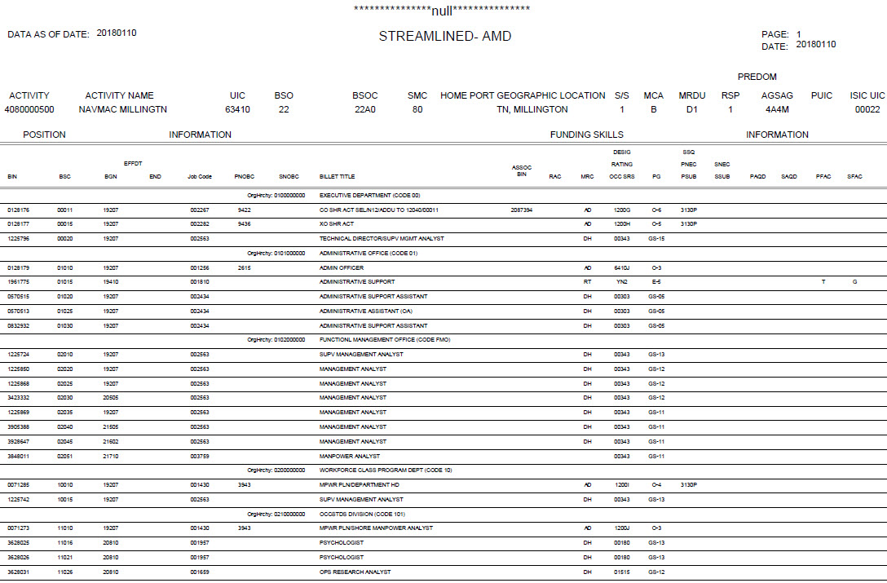
  S-AMD
UIC & Manpower BSO
Resource Sponsor and Activity Funding Information
(AKA Requirements Officer/RO)
A complete list of BSO and Resource Sponsor Codes and the definitions as applicable can be located in the Activity Manpower Management Guide (AMM-G).

Slide 6
  S-AMD
The S-AMD displays each position as a single line
$
Similar data is under
one elements group
Information is streamlined and easy to identify
Funding
Manpower Resource Code (MRC)
Position Information
Skill
Notes:
Similar data elements are under one group (i.e. Officer Desig/Paygrade, Enlisted Rate/Rating, Civilian Occupational Series).
Manpower Resource Code (MRC) indicates if and how funded/authorized.
In this instance, the MRC of RA indicates that the position is a FUNDED SELECTED RESERVE (SELRES)
If the MRC was “AD”, then that would indicate that the position was FUNDED as ACTIVE DUTY, etc.
If the funding was changed from SELRES to ACTIVE DUTY, then that would also be indicated by two lines of information as displayed on the next slide.

Slide 7
  S-AMD
References and Tools for defining the fields and their values are located in:
http://www.public.navy.mil/bupers-npc/organization/navmac/Pages/NAVMACInformation.aspx
OPNAVINST 1000.16 series
Activity Manpower Management Guide (AMM-G)
NAVPERS 18068 Vol I & II Manual of Navy Enlisted Manpower and Personnel Classifications and Occupational Standards
NAVPERS 15839 Vol I Manual of Navy Officer Manpower and Personnel Classifications

Slide 8
  S-AMD
The S-AMD is an additional Manpower report option and is available through:
  Total Force Manpower Management System 2.0 (TFMMS 2.0)
Notes:
The AMD report will remain basically unchanged
Anticipated improvements and refinements
The AMD report will remain the source document for the data fields not identified on the S-AMD report (i.e. Commercial Activity fields, Budgeting information, Unique Program Identifiers, etc.)

Slide 9
  Activity Manpower Management Guide (AMM-G)
The AMM-G is the primary reference document for data reflected on the S-AMD
The AMM-G:
  Identifies manpower coding assigned to requirements and authorizations
  Clarifies definitions and applicability of the code
  Identifies responsible Program Manager/Office /Supporting Policy
  Provides links to reference sites
Link to AMM-G:
http://www.public.navy.mil/bupers-npc/organization/navmac/Pages/NAVMACInformation.aspx
Notes:
The Activity Manpower Management Guide - The information contained in the sections will provide insight and guidance that has been incorporated from various sources to begin forming a single source manpower program guide.
Each section provides a brief definition, applicable web link, and the Command and Office Code responsible for maintenance and/or update of the identified area.
Requested changes and modifications to the information contained within should be addressed directly to the NAVMAC Commanding Officer for formal review and consideration by the Position Management Functional Review Board (PM-FRB)

Slide 10
Detailed
Walk-thru

Slide 11
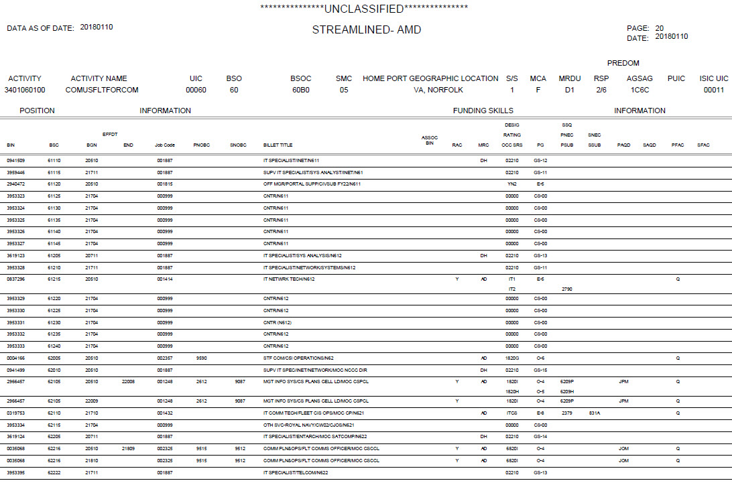
  S-AMD
A second line of data will be displayed if any of the authorization or requirement data elements are different. Example below:
BIN number 2966457
BSC 62105
Position will be Downgraded from an 0-5 Commander (H) to an 0-4 Lieutenant Commander (I)
Notes:
In this example BIN number 2966457, BSC 62105 is currently an approved, funded 1820 Commander (H/O-5), however
Effective Date 22009 ( 2= Millennium, 20= Fiscal Year of Change, 09= Calendar month of change) Sept 2020, the position will be Downgraded from an 0-5 Commander, down one level to an 0-4 Lieutenant Commander (I)

Slide 12
  S-AMD
BILLET IDENTIFICATION NUMBER (BIN)
A unique seven digit system generated number assigned to each manpower position.
END DT
The end date is only populated if there is a change to the BIN or if the BIN goes away.
21809
Notes:
(the preceding 2=Millennium) i.e. 2 18 09

Slide 13
  S-AMD
BILLET SEQUENCE CODE (BSC)
A sequential number used to organizationally structure manpower positions.

Slide 14
  S-AMD
JOB CODE
A unique numeric identifier assigned to each Job providing a general description of duties performed in the position.
A complete list of Job Codes and definitions is located on the NAVMAC Web Page Workforce Classification, References.
http://www.public.navy.mil/bupers-npc/organization/navmac/Pages/NAVMACInformation.aspx
Notes:
JOBCODES are unique identifiers which are assigned to all Navy jobs (O/E/C), just like BIN is a unique identifier assigned to all Navy positions (O/E/C). It allows the different O/E/C jobs to be managed in a single total force structure. JOBCODE represents the “job” which provides a general description of duties performed in a specific job. Currently the JOBCODES are assigned to the Manpower Types as follows:
Enlisted – Every NEBC is assigned a unique total force jobcode
Officer – Every NOBC is assigned a unique total force jobcode
Civilian – Every Civilian Occupational Series (includes Contractor) is assigned a unique total force jobcode.
NOBCs consist of a unique identifier (Jobcode), a short title (displayed on the billet title), a long description and a “NOBC Code”. The NOBC Code (e.g.. “9087” in the above AMD) is the how the work/job is “Classified” with in the Navy Officer Occupational Classification System (NOOCS). NOBC Code “9087” falls within the 9000-9999 classification group which is the Naval Operations Field Group and 9000-9099 which is the Staff and Fleet Command sub-Group. So the NOBC Code provides a three level hierarchy of work, while the JOBCODE just provides a total force unique identifier.

Slide 15
  S-AMD
PNOBC/SNOBC
The primary/secondary Navy Officer Billet Classification Code provides a general description of duties performed in the position.
Values for Officer NOBCs are located in the NAVPERS 15839 Vol I Manual of Navy Officer Manpower and Personnel Classifications.
Notes:
Q - Will NEBCs be displayed, and if so, when and where? (under the NOBC columns?)
A – 1) Just like NOBCs, NEBCs consist of a unique identifier (Jobcode), a short title and a long description. The NEBCs do not have a “NEBC Code” similar to the “NOBC Code “ to group/classify enlisted work. Enlisted work is classified using Dept of Labor’s Standard Occupational Classification (SOC) Codes and not a Navy only classification of the work. SOC are not currently loaded into TFMMS so they are not able to be displayed. If they are added to TFMMS they would be added to the same location as NOBCs on the AMD. There are no current plans to add SOC to TFMMS to provide the total force classification of work that SOC provides

Slide 16
  S-AMD
BILLET TITLE
Provides a description of the position.
Per OPNAVINST 1000.16L, the Officer billet title will mirror the assigned NOBC Short Title as provided in the NAVPERS 15839 Vol I Manual of Navy Officer Manpower and Personnel Classifications
Notes:
Any modification or additional information required to the Officer Billet Title can be made by adding a “ / ” (slash) after the NOBC Short Title and add additional Title information. The above examples displays the option

Slide 17
  S-AMD
ASSOCIATED BIN
A cross reference BIN identifying relationship for positions that are:
Additional Duty (ADDU to/from)
Mobilization (MOB to/from)
Personnel Exchange Program (PEP)
Notes:
The Associated BIN provides ready reference information for the other Navy Manpower position involved in the relationship.
Additional Duty (ADDU) manpower authorizations are assigned to satisfy the need for expertise not available from within activities’ assets, when valid workload does not support a full-time manpower requirement, or to accommodate limited staff functions. There will always be an ADDU TO (where is the support going to) and an ADDU FROM (where did the support come from) relationship. By using the Associated BIN, a Manpower Manager can cross reference the billet information more readily.
PEP - The Personnel Exchange Program (PEP) provides for a one-for-one exchange between USN military personnel and personnel from other military services, including foreign services. Billet Compensation. Each PEP billet will be represented by two authorizations. The compensation billet is the US Navy manpower authorization that would otherwise be occupied by the Navy officer or enlisted member on exchange with the other US service or foreign service. The compensation authorization sends all of the normal demand signals that other authorizations send, except to the distribution system. The compensation billet is denoted in the Manpower System (TFMMS) by a FAC of “X” per the OPNAVINST 1000.16. The second authorization is the destination authorization. It provides a demand signal for distribution purposes only and carries required information about the destination billet for detailing. The destination authorization is denoted by an MRC of “PP” in TFMMS.
MOBILIZATION (MOB TO / MOB FROM). This combination is used primarily by BUMED to specifically identify where the PEACETIME position/billet from the Hospital will report to during a full MOBILIZATION as well as identifying which position/billet normally filled by Active Duty during Peacetime will be “back filled” by SELRES resources. Although BUMED is the primary user of this relational data, the data elements are available to all Manpower Managers.

Slide 18
  S-AMD
MANPOWER RESOURCE CODE (MRC)
Reflects if the position is funded/resourced and the type of resourcing applied to the position
AD = Active Duty
RA = Reserve Augment /SELRES
RT = Full Time Support
DH = Direct Hire (Civilian)
If the MRC is blank, the position is unfunded
A complete list of all Functional Area Codes and the definitions can be located in the Activity Manpower Management Guide (AMM-G).
Notes:
Contractors are displayed and are assigned an MRC of “CN”.

Slide 19
  S-AMD
DESIGNATOR (Desig)
Officer Designator is the primary specialty qualification category of an officer
RATING
Enlisted rating is a broad enlisted career field identifying an occupational specialty.
Occupational Series (OCC SRS)
Civilian Occupational Series is a number assigned by the Office of Personnel Management identifying a specialized line of work and qualifications
.
Enlisted Ratings can be found in the NAVPERS 18068 Vol I & II Manual of Navy Enlisted Manpower and Personnel Classifications and Occupational Standards.
Officer Designators can be found in the NAVPERS 15839 Vol I Manual of Navy Officer Manpower and Personnel Classifications.

Slide 20
  S-AMD
PAY GRADE (PG)
The required position pay grade level for Officer, Enlisted and Civilian positions
Enlisted Paygrades are located in the NAVPERS 18068 Vol I & II Manual of Navy Enlisted Manpower and Personnel Classifications and Occupational Standards
Officer Paygrades are located in the NAVPERS 15839 Vol I Manual of Navy Officer Manpower and Personnel Classifications and Occupational Standards
Notes:
On the current AMD report, the Paygrade field (O-5) is not displayed and only has the Designator and Paygrade merged into one field (i.e. 1200H)
(In building the S-AMD report reviewers had asked to have both because it was to time consuming to translate a “H” to an O-5)

Slide 21
  S-AMD
PNEC/SNEC The Primary and Secondary Navy Enlisted Classification Code identifies the specialized knowledge or skill required beyond those of the Enlisted rating structure.
PSUB/SSUB The Officer Primary and Secondary Sub-Specialty Code identifies and classifies positions for which significant experience, functional training, or advanced education or equivalent experience required for a position.
The Civilian Specific Skills and Qualifications SSQ identifies a specific qualifications required by the position
(similar to the Officer AQD)
Enlisted PNEC/SNEC’s are located in the NAVPERS 18068 Vol I & II Manual of Navy Enlisted Manpower and Personnel Classifications and Occupational Standards. Officer SubSpec’s are located in the NAVPERS 15839 Vol I Manual of Navy Officer Manpower and Personnel Classifications and Occupational Standards

Slide 22
  S-AMD
PAQD/SAQD Officer Primary/Secondary Additional Qualification Designator Code identifies additional qualifications, skills and knowledge required.
Complete list of the Officer PAQD/SAQD are located in the NAVPERS 15839 Vol I Manual of Navy Officer Manpower and Personnel Classifications.

Slide 23
  S-AMD
PFAC/SFAC The primary/secondary Functionality Area Code identifies the need for Manpower, Personnel, Detailing and Placement special consideration . Applies to all Manpower Types.
EXAMPLES:
R= Meets SELRES Requirement
Q=Top Secret SSBI Required
Complete list of all Functional Area Codes and the definitions can be located in the Activity Manpower Management Guide (AMM-G).

Slide 24
  S-AMD
ORGHRCHY Organizational Hierarchy Code is located at the beginning of each Dept, Branch, Section, etc. reflecting the Activity’s organizational breakdown.
The title of the organizational component is reflected in the “Title” column.
The full definition and additional guidance for OrgHrchy is located in the Activity Manpower Management Guide (AMM-G)
Notes:
Q - Why does ORGHRCHY have a BIN and BSC?
A – Every line item/record in the system has a BIN/BSC identifier. BIN is a total force unique identifier, unique across all records; BSC groups/classifies the line within the UIC/organization, only unique within the UIC. The ORGHRCHY is displayed as a Header Record only and contains no Manpower/Billet information.
(There are three types of records in the system – Billet Record / Header Record / Note Record)
Billet Record – Displays the Billet information
Header Record – Used to identify the Departmental break within an activity as applicable (not always used)
Note Record – Used to make notes or comments as applicable
DETAILED HISTORY BEHIND THE ORG_HRCHY:
The Navy Organizational Hierarchy Code was developed to support the DoD Global Force Management Data Initiative (GFM DI) initiave. Every position in the Navy is assigned a Code based on where the position falls within the activity and per the Chain of Command. The ORGHRCHY will be used to “link” each Component’s authorized structure in a top-to-bottom hierarchical format by collecting, organizing and formatting force structure data in order to expose it in the Organizational and Force Structure Construct (OFSC). In this way, force structure data is aligned with GFM constructs and suitable for storage in each DoD Component Organization Server (Org Server).
The mission of Global Force Management Data Initiative (GFM DI) starts with providing authorized force structure data that can be used uniformly across the Department of Defense (DoD). Force structure data comprises of the decomposition of command structure combined with the chain of command.
The purpose of the Global Force Management Data Initiative (GFM DI) is to establish a Joint data standard enabling Department of Defense (DOD) systems to exchange authorized force structure data in a common format integrating force structure data into all other applications that use force structure data and exploiting the potential of a net-centric data environment. The goal of this initiative is to improve the quality of information available to perform Joint Force Management (JFM) at every level throughout the Department.
JFM is the ability to integrate existing and future human and technical assets from across the Joint Force to make the right capabilities available at the right time and place in support of the National Defense Strategy. Global Force Management (GFM), a subset of JFM, is the ability to align force apportionment, allocation, and assignment methodologies to assist in the decision making process involved with global force availability and readiness.
The GFM DI is a transformational effort guided by an Office of the Secretary of Defense (OSD), Joint Staff, multi-Service, and interagency Community of Interest (COI) to enhance the GFM process by improving the quality of essential force structure authorization data. The results of this effort will provide the capability to link authorized force structure, resources, and capabilities data to support risk analysis and decision-making.

Slide 25
  S-AMD
References and Tools for defining the fields and their values are located in:
http://www.public.navy.mil/BUPERS-NPC/ORGANIZATION/NAVMAC/Pages/NAVMACInformation.aspx
OPNAVINST 1000.16 series
Activity Manpower Management Guide (AMM-G)
NAVPERS 18068 Vol I & II Manual of Navy Enlisted Manpower and Personnel Classifications and Occupational Standards
NAVPERS 15839 Vol I Manual of Navy Officer Manpower and Personnel Classifications

Slide 26
Questions?

