Slide 1

Activity Manpower Document
(AMD)
February 2018
CAPT Steve Milinkovich
Commanding Officer
CDR Shaletha Moran
Executive Officer
Mr. George Vogel
Technical Director

Slide 2
Purpose of the AMD
The AMD is a single source document that provides the quantitative and qualitative manpower requirements and manpower authorizations allocated to a naval activity to perform assigned Missions, Functions, and Tasks (MFTs) as defined in the Required Operational Capability/Project Operational Environment (ROC/POE).
The AMD contains current and future manpower requirements and authorizations. It is used for personnel strength planning, recruiting, training, and personnel distribution.

Slide 3
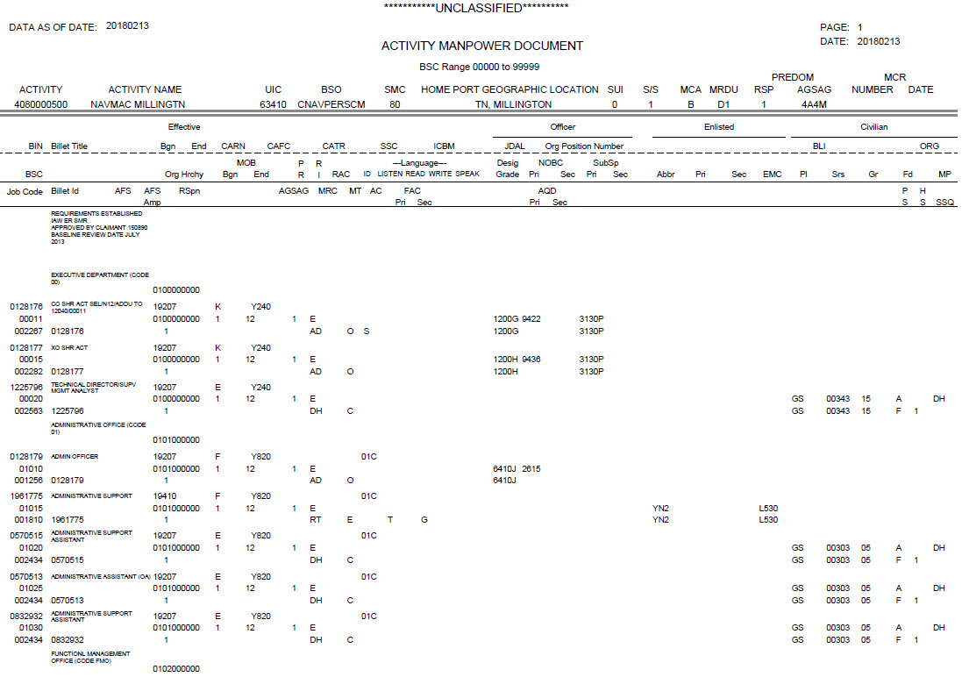
Default
Billet Sequence Code
(BSC)

Slide 4
TFMMS Data Date
Date Printed

Slide 5
ACTIVITY CODE
Assigned by OPNAV
10-digit code unique to each command.
Last two numbers of “00” indicate a parent
command. Subordinate commands will
have same first eight numbers, last two
will be unique to that command
Notes:
A 10-digit code identifying each activity. The first four numbers represent the type of activity (i.e., 1500: NS), the next four numbers are unique to a specific activity, and the lat two number indicated a parent-component activity relationship (00: parent activity, 01-99: component activity of the parent).

Slide 6
ACTIVITY NAME:

Slide 7
UIC:
UNIT IDENTIFICATION CODE
Assigned by DFAS

Slide 8
BSO/SMC
BSO: Budget Submitting Office (used to be referred to as “Claimant”)
SMC: Sub-Manpower Claimant (Claimant is now referred to
as Budget Submitting Office, however the acronym SMC is still valid in TFMMS)

Slide 9
HOME PORT GEO LOCATION:
Physical location of activity
Notes:
GEOLOC is an 8-digit code that can be used to identify CONUS as the USA (first two positions of GEOLOC equal to “02”) less Alaska (0202) and Hawaii (0215). OUTUS is all that is not CONUS.

Slide 10
S/S:
Sea/Shore duty code

Slide 11
MCA:
Manning Control Authority:
B= MCA Bureau (BUPERS)
F= MCA Fleet (CFFC)

Slide 12
PREDOM (Predominate)
RS/AGSAG:
RS: Resource Sponsor
AGSAG: Activity Group/Sub-Activity Group:
Data to identify Financial Resources
Notes:
An alpha-numeric code along with PE (Program Element) which facilitates BSO alignment of similar types of activities/functions for budget justification and accounting purposes. A product of PPBES (Planning, Programming, Budgeting and Execution System)----their definitions and effective dates can change with each FYDP (Future Years Defense Program) cycle.

Slide 13
Manpower Change Request (MCR)
number and date

Slide 14
BIN
Billet identification number
A 7 digit number unique to each
billet. The BIN will stay with
the billet for the life of the billet.

Slide 15
BSC
Billet Sequence Code:
Sequential 5 digit number to
indicate location in AMD

Slide 16
Billet Title:
Description of billet.

Slide 17
Job Code:
6 digit code assigned by “field”
of duties (e.g. admin, supply, etc)

Slide 18
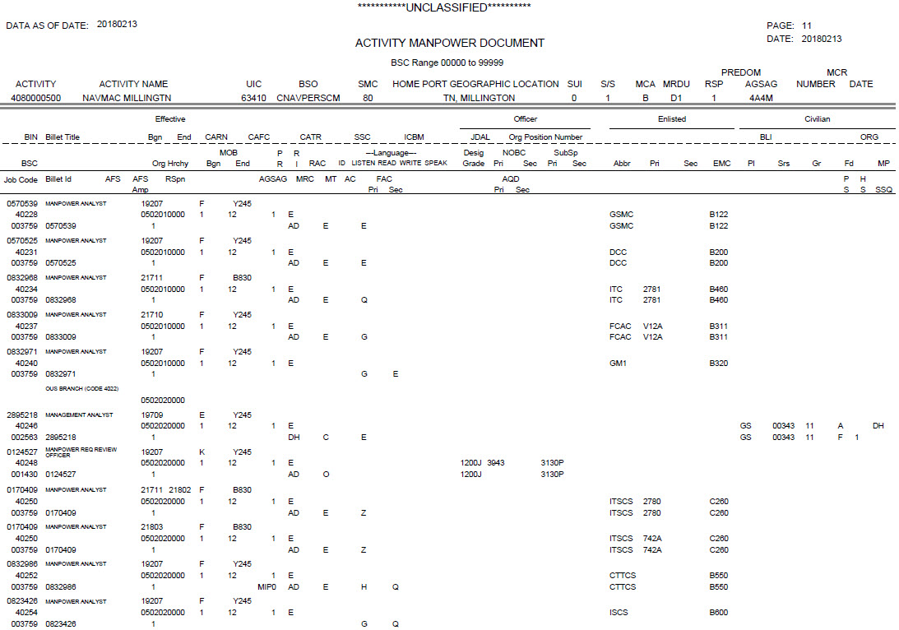
Effective Bgn/End:
Date of Beginning or End of billet
Begin Date: 21711: (Nov 2017)
End Date: 21802: (Feb 2018)
If no date, no change

Slide 19
CARN/CAFC/CATR/SSC
(Commercial Activities Reason Code, Commercial Activity Function Code,
and Commercial Activities Tracking Code)
CARN: Identifies the reason a positions is Inherently Governmental
or subject to completion of a study.
CAFC: Identifies the functional area of responsibility, mission area
And/or task of the civilian billet.
CATR: Identifies legal information associated with the Function and
and Reason Code.
SSC: Identifies positions involved in the Navy’s cost-cutting plans.

Slide 20
MRC: Manpower Resource Code:
Identifies the resource funding type for the
Future Year Defense Program (FYDP). The
MRC is a mandatory code on all budgeted
positions.
Examples:
AD= Active Duty
DH= Direct Hire (civ)
RT= Full Time Support

Slide 21
FAC: Functional Area Code
Identifies the need for special
consideration in manpower
programs, personnel detailing
and placement.
Examples:
T= Full Time Support
I= Instructor

Slide 22
Officer Section:
Designator: 1200
Paygrade: G
NOBC: 9422
SubSp: 3130P

Slide 23
Enlisted Section:
Rate: YN2
NEC: if needed
Note: EMC is auto-fill field

Slide 24
Civilian Section:
Payplan: GS
Series: 00303
Paygrade: 05

Slide 25
REVIEW BILLET STATUS:
9 Enlisted
1 Civilians
1 Officers
AUTHORIZATION
- Is Funded
- Creates 2nd Line
- Has Manpower Resource Code (MRC)
REQUIREMENT
- Is Unfunded
- Shows 1 Line Only
- No MRC

Slide 26
Is the billet funded?
Indicators to look for:
- Does the BIN have a requirement line and an authorization line?
- Is a Manpower Resource Code (MRC) present?
- Is there an ending date that affects funding?

Slide 27

Cancellation of BIN (Billet)
Cancellation of a billet due to either deletion or conversion will be “phased” on the AMD using effective end date (EFF END DT).
Breakdown of EFF END DT “21910”
December 2017: Billet still fully funded, has “BA”.
January 2017: Billet loses “BA”/NMP and will no longer drive a detailing requisition (9 month detailing window).
October 2019: Billet loses active duty funding, becomes an unfunded requirement; “21910” (FY19)

Slide 28
AMD
References and Tools for defining the fields and their values are located in:
http://www.public.navy.mil/BUPERS-NPC/ORGANIZATION/NAVMAC/Pages/NAVMACInformation.aspx
OPNAVINST 1000.16 series
Activity Manpower Management Guide (AMM-G)
NAVPERS 18068 Vol I & II Manual of Navy Enlisted Manpower and Personnel Classifications and Occupational Standards
NAVPERS 15839 Vol I Manual of Navy Officer Manpower and Personnel Classifications

