Slide 1

Department Guide
PERSTEMPO
(PERS-34)
Millington, TN

Slide 2

Table of Contents
What is PERSTEMPO?
Application Access Administration
Control-D Report Viewing Center
PERSTEMPO Online Transactions
Compliance and Negative Reporting
PERSTEMPO Query and Forecasting
Hardship Duty Pay TEMPO (HDP-T)
PERSTEMPO Points of Contact

Slide 3
What is PERSTEMPO?
PERSTEMPO is a program mandated by Congress to track and report military member time away from home. PERSTEMPO events are defined as any time a Sailor is engaged in their official duties at a location or under circumstances that make it infeasible for a member to spend off-duty time in the housing in which the member resides. In addition, the event must occur at least one night outside the member’s permanent duty station. PERSTEMPO event categories are:
Deployment
Operations
Exercise
Unit Training
Mission Support Temporary Duty
Home Station Training or
Local Operating Area of a Ship
Non-Deployment
Individual Training
Duty in Garrison
Hospitalization at Homeport
Disciplinary event
Inactive Duty Training
Muster Duty
Funeral Honors Duty

Slide 4
PERSTEMPO OV-1
220

Slide 5
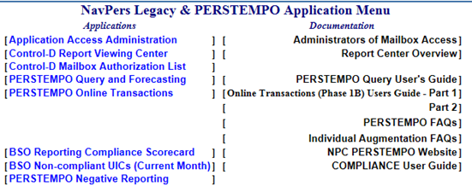
Application Access
Administration
This application is only accessed by and used for someone with Ownership Rights. To view who may have Ownership Rights and can grant access, you can select the “Control-D Mailbox Authorization List” on the main NavPers Legacy & PERSTEMPO Application Menu.
This application is used to provide another person with access to an UIC; with two options available – Administration or Viewing Rights. Administration Rights allows them to provide access to others as well as view reports; Viewing Rights only allows them to view reports.
The directions listed is the same for both Sailors and civilians/contractors who have a BOL account.
There is no wait time once the access has been given.
There are three ways covered in this slide show: Build and Release access, access for an on-Board UIC, access not for the on-board UIC. However, there is also access that can be granted to the additional section of PERSTEMPO Query and Forecasting; which is not covered in this slide show.

Slide 6
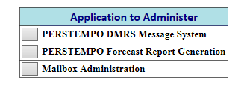
Application Access
Administration
Rights to Build and Release Messages:
1. On NavPers Legacy & PERSTEMPO page, click on “Application Access Administration”.
2. Click on "PERSTEMPO DMRS Message System".
3. Click on the individual's onboard UIC (the one who needs access).
4. Then select on "All Personnel Assigned”.
5. Go to bottom of the page and click on "Proceed".
6. Click on their name.
7. Click on the rights that you need them to have. It can be either: rights to Write and Release Messages or just rights to Write Messages.
8. Click on "Proceed". Once selected, they now have rights for messages.
Note: Once you have access to Build & Release Messages, you can Build for any UIC. No one can have access to Release Messages that is outside their on-board UIC. You will put in the UIC number of the Sailor(s) that the transaction will apply to; whether it's your UIC or not. However, your Reporting UIC DOES NOT change. If you change it, you will not be able to release the message. Once completed with building the message, you will release it. The transaction will automatically go into the Sailor's PERSTEMPO. We will discuss transactions shortly.

Slide 7
Application Access
Administration
Access given to a person FOR their onboard UIC:
1. On NavPers Legacy & PERSTEMPO page, click on “Application Access Administration”.
2. Click on "Mailbox Administration".
3. Click on the individual's onboard UIC (the one who needs access).
4. Select on "All Personnel Assigned”.
5. Go to bottom of the page and click on "Proceed".
6. Click on their name.
7. Click on the rights you need them to have; Administration or Viewing Rights.
8. Click on "Proceed". Once selected, they now have rights to the reports.
Access given to a person NOT in their onboard UIC:
1. On NavPers Legacy & PERSTEMPO page, click on “Application Access Administration”.
2. Click on "Mailbox Administration".
3. Click on UIC the person needs access into.
4. Select "Assign NON-UIC personnel administration rights" and enter their SSN in the space next to 'Enter SSN for Non-UIC personnel'.
5. Go to bottom of the page and click on "Proceed".
6. Click on their name.
7. Click on the rights you need them to have; Administration or Viewing Rights.
8. Click on "Proceed". Once selected, they now have rights to the reports.

Slide 8
Control-D Report
Viewing Center
On the NavPers Legacy and PERSTEMPO page, click on the “Control-D Report Viewing Center”. This should bring you to your list of UICs that you have access into. Click on the UIC that you need to view. Once the mailbox comes up, you will see a list of reports. In order to get into the report you need, you click on the report’s name. Here are the descriptions of some of the reports that you may find in your UIC’s mailbox for PERSTEMPO:
REPORT RUN GUIDE: This report gives the dates of when certain reports in that UIC's mailbox will generate.
P-ALPHA RPT: This report shows all of the Sailors in the UIC as well as their PERSTEMPO days for the last two years.
P-PROSPCTV GAINS: This report shows incoming Sailors into the command and their PERSTEMPO days for the last two years as well as any events that may still be open.
P-EXPIRED EVENTS: This report is a list of those in the command with events that have gone past the 30 days since the Projected End Date or if there is no Projected End Date, the event would show up after 190 days past the start date.
P-ACKNWL/ERR RPT: This report will show up when a transaction has been entered in the past 24 to 48 hours. When you open the report, you will get one of two messages: If the transaction is accepted, there will be a receipt. If not, then it will show the message that is rejected and explains why.
P-TRANS BY OTHER: This report gives the transactions that were submitted by another command. It provides the Sailor’s information, the transaction type with the dates used, and the reporting UIC.
P-UNREL TRANSACT: This report will generate 7 days after a transaction was created but not released into the system. It will continue to generate every day until either it is released or 21 days after the transaction was created. After the 21st day, the system will delete the event and you will have to recreate the transaction.
ODCRS: This report is an ADOBE/ACROBAT file that is the Officer Distribution Control Report.
AMDS: This report is the Activity Manpower Document.

Slide 9
PERSTEMPO
Online Transactions
The transaction types to choose from when building messages:
PUDB/PMDB - Enter the start date to start the event. (It will also ask you to input a projected end date, which is the date the Unit/Sailor is EXPECTED to be back.)
PUDE/PMDE - Enter the actual ending date to close the event. (If you submit a PMDB, you MUST submit a PMDE after they return. Same process if you enter in a PUDB, you MUST submit a PUDE.)
PUXB/PMXB - Cancels the event all together if the Unit/Sailor never went on the deployment or if you need to change the start date of the deployment. If changing the start date: Enter the incorrect start date that is indicated in the report. (The date that needs to be changed, not the new start date.) Once accepted in the system, you will submit a PUDB/PMDB with the new start date.
PUXE/PMXE - Use this to change the ending date of the Unit/Sailor's last entered in event. (Note: Must submit a PUDE/PMDE to re-input the correct ending date)
PUDO/PMDO - Use this to input a past event (no future dates). This allows you to input the start and stop date at the same time. This one can only be used when there is both the start and stop date. As long as the dates do not overlap, you can submit multiple PUDO/PMDOs at one time.
The difference between Unit Transactions (PU) and Individual Transactions (PM) are the Sailors that are selected. When you submit Unit Transactions, you select the people who DID NOT go. When you submit Individual Transactions, you select those who DID go. In addition, the system updates weekly on Saturdays. Any updates or changes will post in the Control-D Reports on Monday after the system updates.

Slide 10
PERSTEMPO Online
Transactions
Example on how to submit PMDOs (which puts in the start and stop date at the same time), which is a two-part process:
To build the message:
1. Have the Sailor's deployment beginning and ending date on hand.
2. Click on “PERSTEMPO Online Transactions” from the NavPers Legacy & PERSTEMPO page.
3. Click on “Build PERSTEMPO DMRS Messages”.
4. In the drop box where you choose the transaction type, you will select "Individual - Omitted PERSTEMPO event (PMDO)".
5. Enter in the sailor's UIC number and make sure the PERSTEMPO Reporting UIC box has your UIC number in it at all times. Hit "Click HERE to continue“; which is located on the left side of the screen.
6. On the next page, enter in the PERSTEMPO Start Date and the PERSTEMPO Stop Date.
7. You will need to select the Deployment Type of “Deployed” or “Non-Deployed”. Select the PERSTEMPO Category and PERSTEMPO Category Purpose. Then hit "Click HERE to continue".
8. On this page, you will select the Sailors who the event applies to. Hit "Click HERE to continue".
9. On this page, you will need to enter/select the duty UIC.
10. Then hit "Click HERE to save" to see the confirmation.
To release the message (This is the same for any message that is created):
1. Once you see the confirmation, hit the "Home" button; which is located on the right side of the screen.
2. Click on "Administer Pending PERSTEMPO DMRS Messages".
3. Click on your UIC and you will see your built transaction(s). Select the transaction you wish to release.
4. Once the message you built comes up, you can "Delete", "Modify", or "Release" the message.
5. If everything is correct, click on "Release" and you will see a confirmation that the message has been released into the system, which is the last step. It is highly suggested that you print the confirmation page out for your records to show that the action has been completed.

Slide 11
Compliance and
Negative Reporting
Every month you must comply your PERSTEMPO by either entering in transactions or certifying your UIC. This application is used for reviewing your BSO’s compliancy, reviewing UICs that are non-compliant, and to certify your system.
On the NavPers Legacy and PERSTEMPO choose from any of the following options at the bottom of the main PERSTEMPO screen:
Option 1: BSO Reporting Compliance Scorecard (Provides access to specific BSO Reporting Compliance Scorecard)
Option 2: BSO Non-Compliant UICs (Provides access to those UICs within the BSO that are non-compliant for the current month)
Option 3: PERSTEMPO Negative Reporting (Provides capability to report individuals in a UIC that did not have PERSTEMPO event for the current month)
Note: If you need to view a secondary BSO or UIC, you will need to contact the PERSTEMPO helpdesk at perstempohd@navy.mil with the following information:
Your name, phone number and e-mail address
Your current BSO and/or UIC
The BSO or UIC for which you are requesting access (secondary BSO)
Justification for access
The Help Desk will contact the secondary BSO and request access on your behalf. The Help Desk will contact you on the status of your request once the primary BSO has made a determination on your request.

Slide 12
Sample Compliance
Scorecard

Slide 13
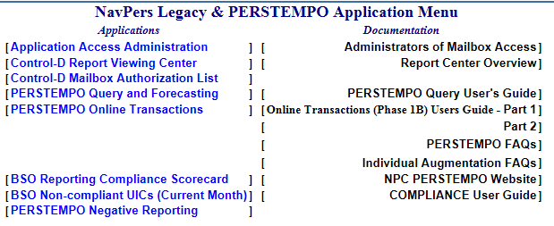
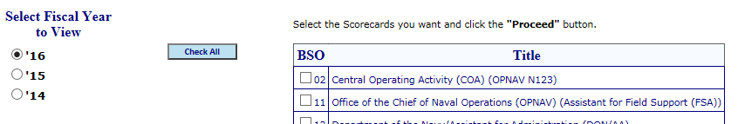
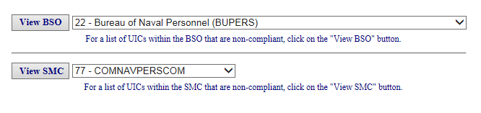
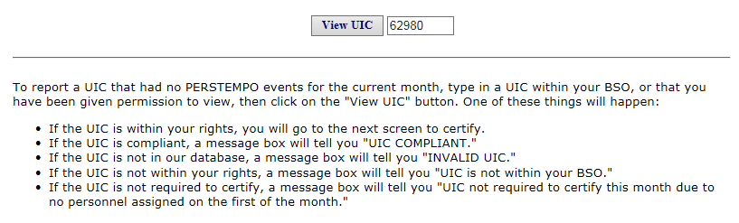
Compliance and
Negative Reporting
OPTION 1 - BSO Reporting Compliance Scorecard
Select “BSO Reporting Compliance Scorecard”.
Check the box beside the BSO you are authorized to access.
Press “Proceed” to review the selected scorecard.
OPTION 2 - BSO Non-Compliant UICs
Select “BSO Non-Compliant UICs (Current Month)”.
Select a BSO that you are authorized to access.
Click on ‘View BSO’ for a list of UICs within the BSO that are non-compliant.
OR
Select an SMC within a BSO.
Click on ‘View SMC’ for a list of UICs within the SMC that are non-compliant.
OPTION 3 - PERSTEMPO Negative Reporting
Select: “PERSTEMPO Negative Reporting”.
To report a UIC that has had no PERSTEMPO events for the current month, type in a UIC within your BSO, or that you have been given permission to view.
Click on the "View UIC" button.
1
2
3

Slide 14
PERSTEMPO
Query and Forecasting
The PERSTEMPO Query and Forecasting is a application within PERSTEMPO that assists with tracking a Sailor’s deployment and/or forecasts possible additional deployment counts. There are five sections within PERSTEMPO Query and Forecasting:
Individual SSN Query: This application allows the User to type in or query a single Sailor’s SSN to review all deployments that has been entered in for the Sailor since 2001. If it has been longer than two years since the Sailor has been on a deployment, or had anything entered in for them, it will have zero PERSTEMPO days. This does not mean the Sailor has lost all of their deployments; it is not visible due to the Sailor having not been anywhere within the last two years. Once a deployment has been entered in, the information will appear.
Unit/Flag Management Query: This application allows the User to create a report that will be generated within 2 to 3 hours. The report will give a listing of the information that will be within the parameters selected. This query is used to track current Sailor’s deployments and any days that may have been entered in this week prior to the new ALPHA Report; which generates on the following Saturday.
HDP-T Query: This application is used to compensate Sailors for lengthening operational deployments and time spent away from home. The next slide gives further details into this application.
Deployment Forecast: This application allows the User to create a report that will be generated within 2 to 3 hours. The report will give a listing of the information that will be within the parameters selected. This query is used to forecast a Sailor (or Sailors) PERSTEMPO days if additional deployments were added.
Review Pending Queries: This application allows the User to review the pending query reports that have yet to be sent to the UIC’s mailbox at the “Control-D Report Viewing Center”.

Slide 15
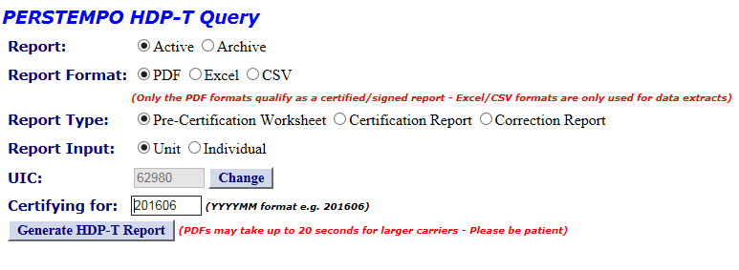
Hardship Duty Pay – TEMPO
(HDP-T)
In accordance with Navy policy, payment of Hardship Duty Pay – Tempo (HDP-T) is used to compensate enlisted Sailors and officers, both active and reserve components, for extended operational deployments overseas.
US Code 37, Section 305: HDP-T will be paid at a monthly rate of $495, prorated daily at $16.50 (max is 30 days within a month). Eligible members will begin earning HDP-T on the day immediately following the 220th consecutive day of an operational deployment overseas.
For greater details and/or a complete list of HDP-T policy, business rules, and explanation about leave, please see the MILPERSMAN 7220-075; which can be accessed at the NPC PERSTEMPO website.
In addition, the User Guide and FAQs is also located at the NPC PERSTEMPO Website (http://www.npc.navy.mil/bupers-npc/support/itempo/).

Slide 16
PERSTEMPO POC
PERSTEMPO System Help Desk (Pers-34)
DSN 882-4717, opt. 1; Comm. (901) 874-4717, opt. 1;
Toll-Free 1-800-951-NAVY, opt. 1
Email: perstempohd@navy.mil

